Slide 1
Biodiversity pilots
15st March online in Teams
obsgession.eu

Slide 2
Seminar Programme
9.00 – 9.05: Introduction to the seminar
9.05 – 9.25: Pilot 1: Multiscale
9.25 – 9.45: Pilot 2: Policy obligations
9.45 – 10.05: Pilot 3: Forest health
10.05 – 10.25: Questions
10.25 – 10.35: BREAK
10.35 – 10.55: Pilot 4: Ecosystem conditions
10.55 – 11.15: Pilot 5: Fresh water
10.15 – 11.35: Pilot 6: Water quality
11.35 – 12.00: Questions

Slide 3
Introduction to the seminar

Slide 4




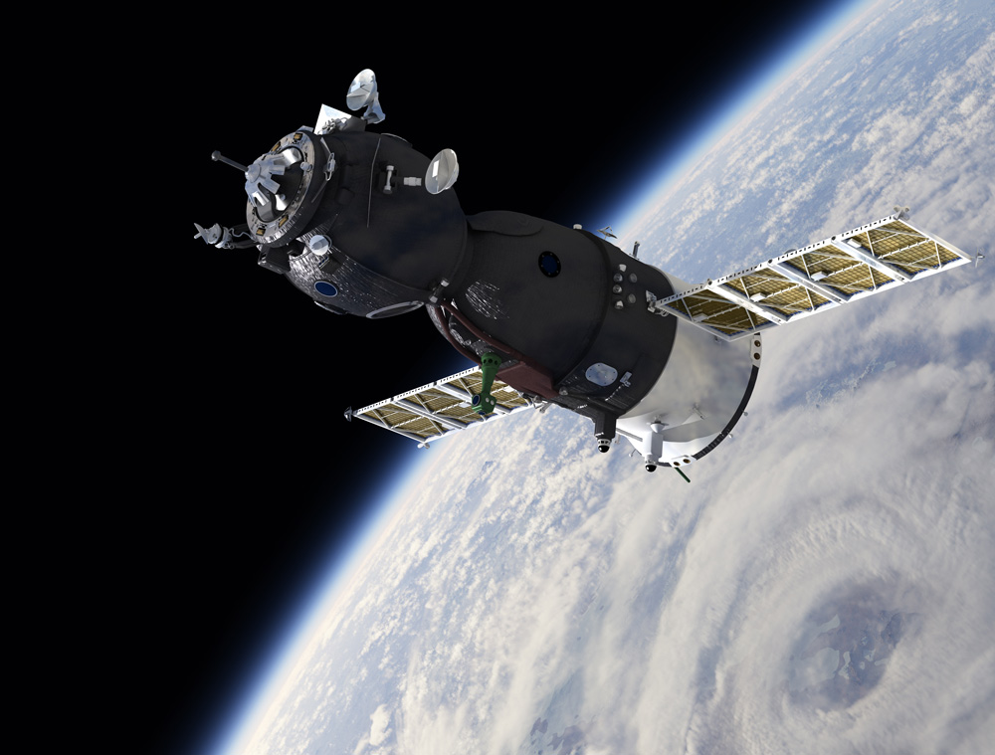
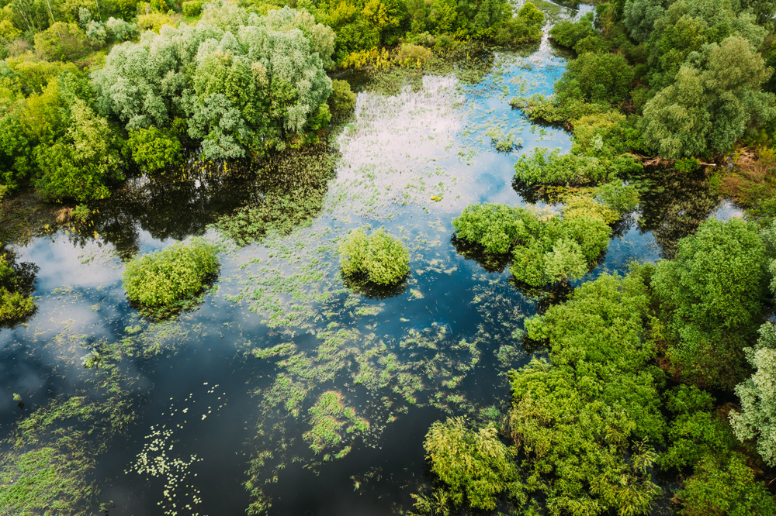
Specific Needs
Knowledge
on Drivers of Ecosystem Change
Harmonised Biodiversity Monitoring
Improved
use of Earth Observation
(EO) data
Knowledge
on Drivers of Ecosystem Change

Slide 5
Mission of OBSGESSION
Monitor and predict biodiversity change and its direct and indirect drivers in terrestrial and freshwater ecosystems through integration of
state-of-the-art multi-sensor Earth Observation (EO) data, innovative in-situ
(including citizen science) data, together with next-generation ecological models that account for uncertainty.

Slide 6
Purpose of Work Package 5
To develop specific case studies based on applied science R&D aspects to demonstrate the implementation of techniques in WP2, WP3 and WP4 and to respond to the European (EU) Biodiversity Strategy for 2030 and the joint Flagship Action on Biodiversity and Vulnerable Ecosystems initiated by European Space Agency (ESA) and European Commission (EC).
Demonstrate and improve techniques

Slide 7

Work package 5: Biodiversity pilots
5.1: Multiscale
5.2: Policy obligations
5.3: Forest health
5.4: Ecosystem conditions
5.5: Fresh water
5.6: Water Quality

Slide 8

Pilot 5.1 Multiscale, multimodal and multi-temporal understanding and predicting of biodiversity response to global change in the European Alps
CNRS, UZH, VITO
obsgession.eu

Slide 9
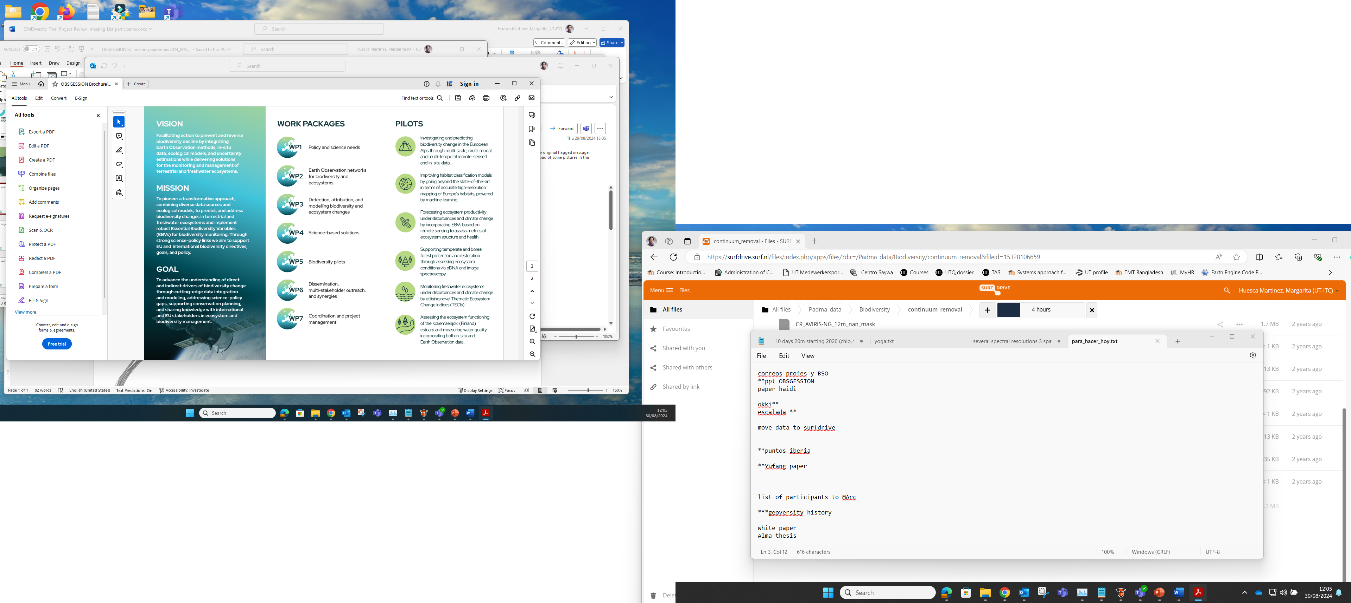
WP5 Biodiversity Pilots (Lead: UTwente)
Objective: To develop specific case studies based on applied science R&D aspects to demonstrate the implementation of techniques in WP2, WP3 and WP4 and to respond to the European (EU) Biodiversity Strategy for 2030 and the joint Flagship Action on Biodiversity and Vulnerable Ecosystems initiated by European Space Agency (ESA) and European Commission (EC).

Slide 10
Mission Pilot 5.1.
Build AI-based models to predict in space and time the response of functional and trophic groups across a gradient of alpine environments.

Slide 11
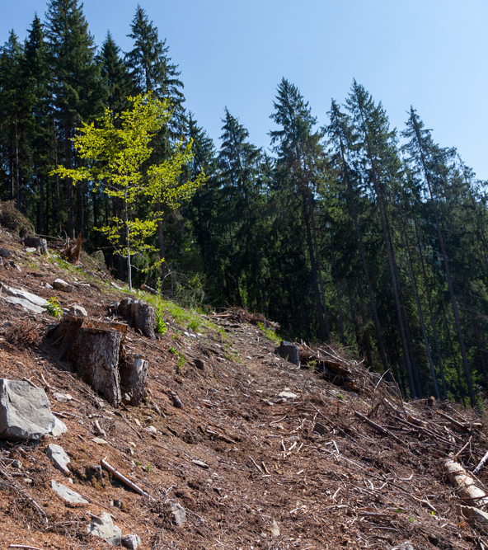

Locations and ecosystems
Swiss National Park
French Alps
Laegern Forest
Greifensee
Forests, grasslands and wetlands in Alpine ecosystems

Slide 12
Remote sensing biodiversity products to EBVs
Community Composition
EQR of phytoplankton & macrophytes
Invasive species, Species / Functional / Trophic diversity,
Ecosystem Structure
Ecosystem distribution of EUNIS habitats
Structural complexity of riparian habitats
River connectivity / free river flows
Vertical structure (vegetation height)
Ecosystem distribution of EUNIS habitats
Ecosystem fragmentation and heterogeneity (variance)
Primary Productivity
Harmful freshwater algal blooms
Freshwater phenology
Ecosystem phenology
Primary productivity
Fire disturbance / Irregular inundation
Ecosystem Function
Freshwater
Terrestrial
Community
Composition
Invasive species, Species
Functional
Trophic diversity
EQR of phytoplankton & macrophytes
Ecosystem distribution of EUNIS habitats
Structural complexity of riparian habitats
River connectivity / free river flows
Ecosystem
Structure
Vertical structure (vegetation height)
Ecosystem distribution of EUNIS habitats
Ecosystem fragmentation and heterogeneity (variance)
Primary Productivity
Harmful freshwater algal blooms
Freshwater phenology
Ecosystem phenology
Primary productivity
Fire disturbance / Irregular inundation
Ecosystem
Function

Slide 13
Goals
Link between hyperspectral and LIDAR products & all in-end biodiversity data
How do change in spectral structure explain multi-trophic compositions?
Do HS information help to predict multi-trophic species distributions?

Slide 14
Existing data
France:
plant relevés, soil environmental DNA metabarcoding, passive acoustic recorders, camera-traps
Switzerland:
in situ biodiversity assessments, genetic diversity of Fagus sylvestris, imaging spectroscopy, EC tower data

Slide 15
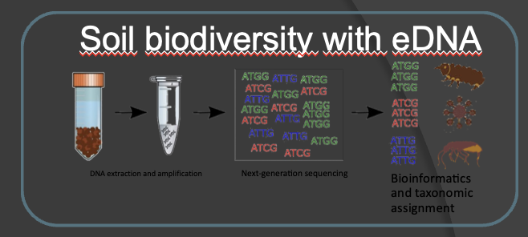
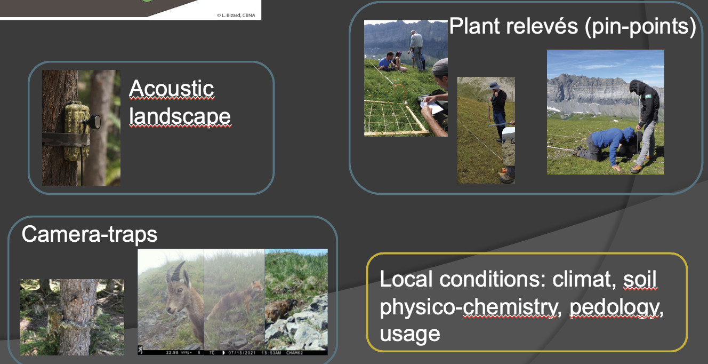
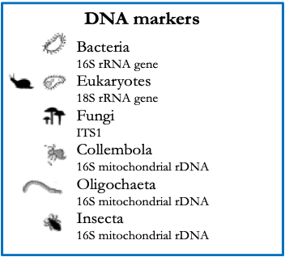
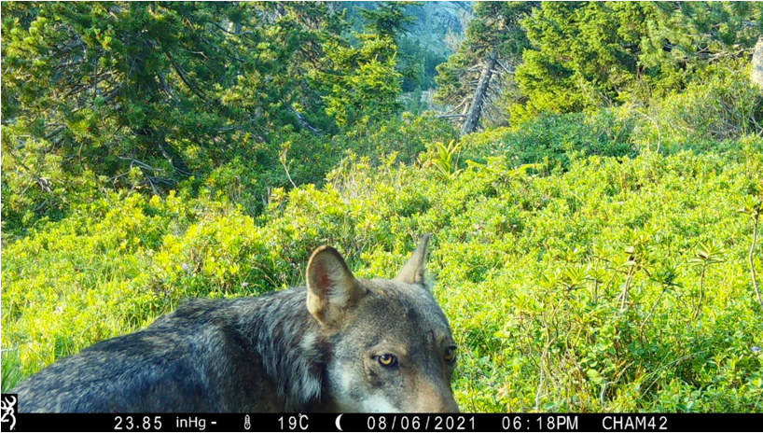
Existing data

Slide 16
Data collected 2024

Slide 17
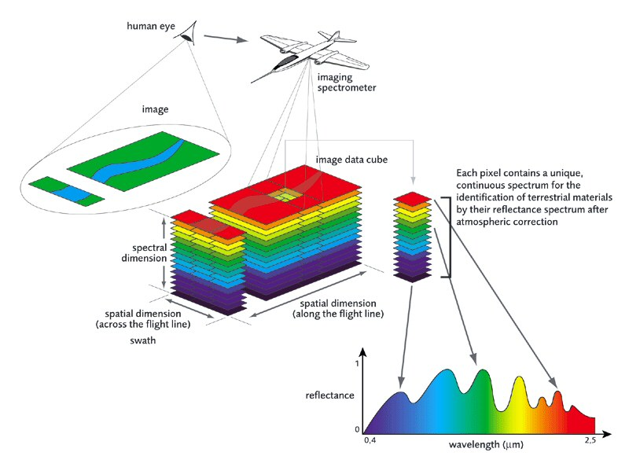
Overflights - European Alps

Slide 18
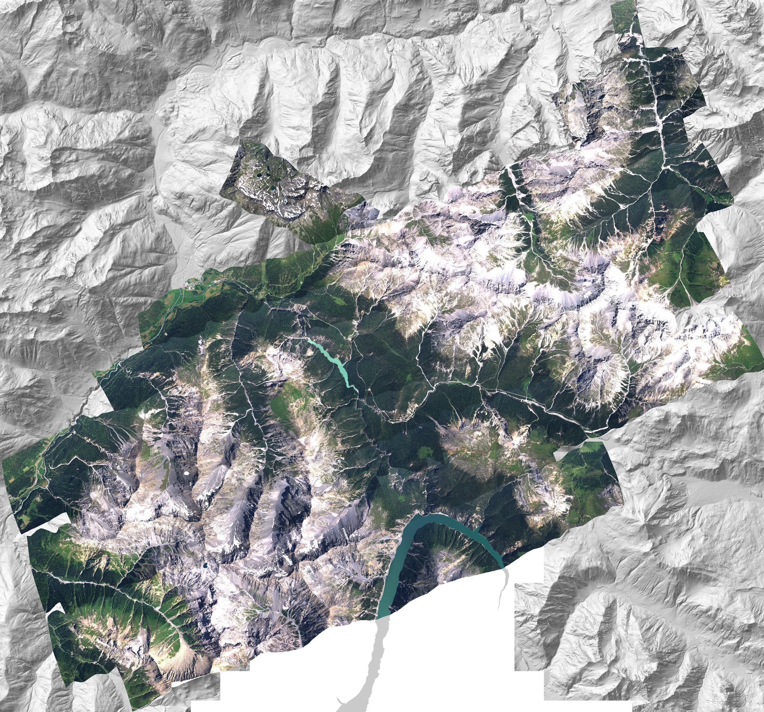
A peak into the data…
DRAFT

Slide 19
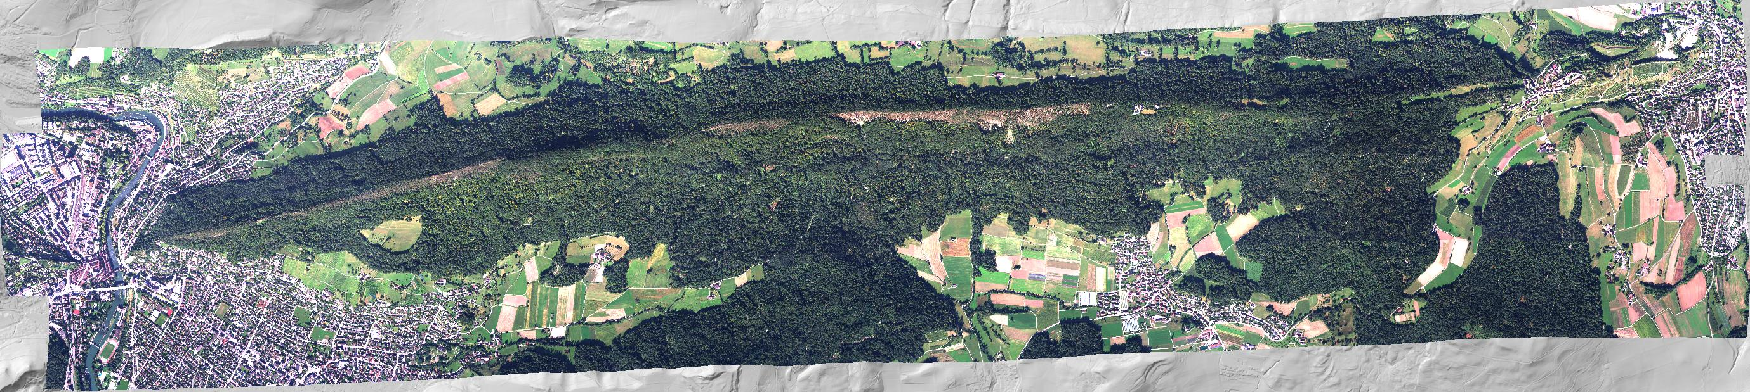
A peak into the data…
DRAFT

Slide 20
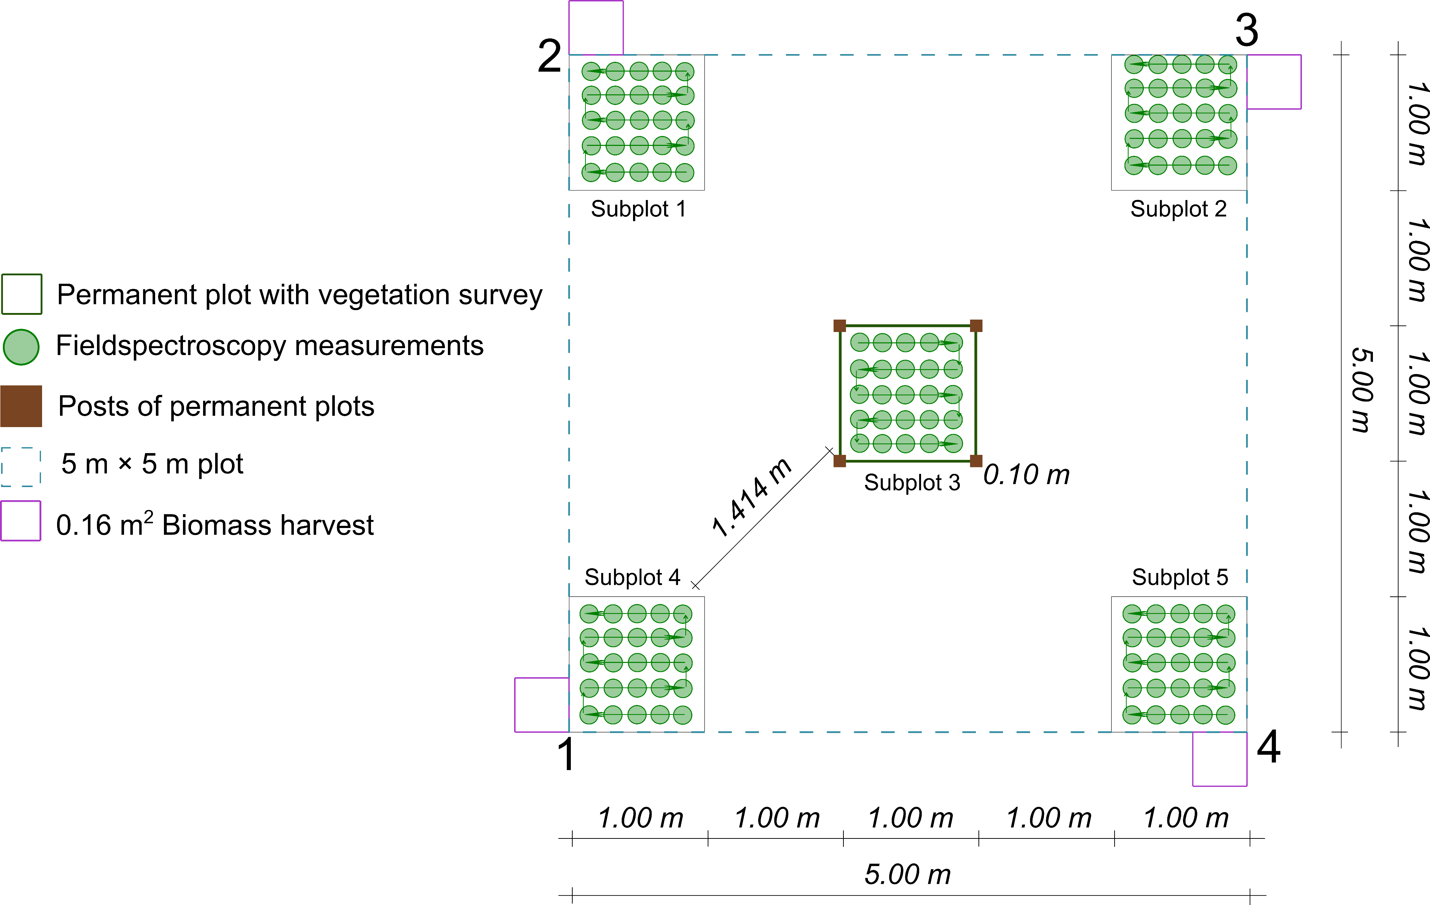
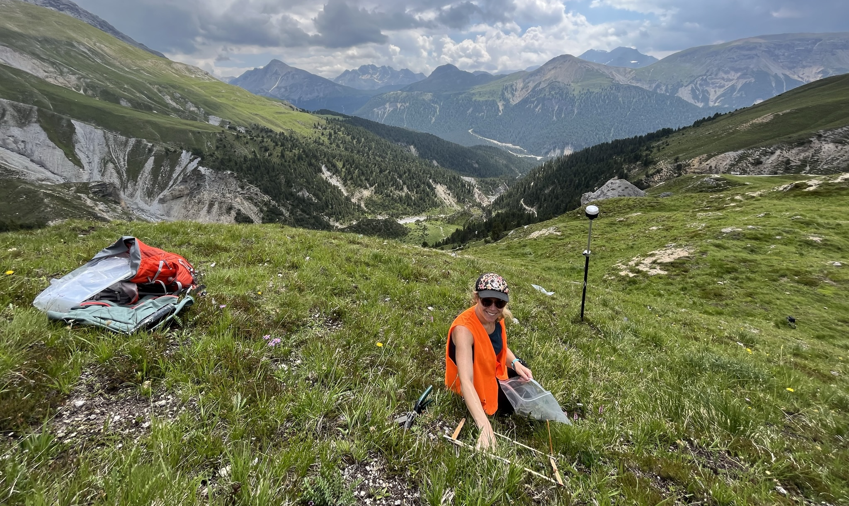
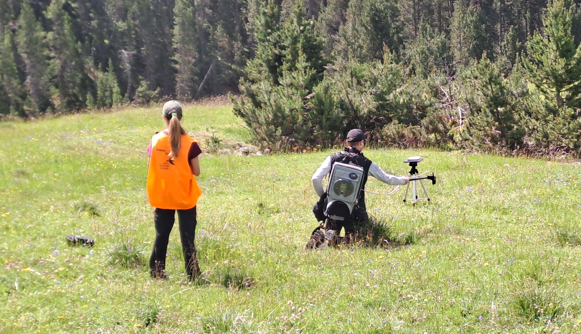
Conformity testing
  Airborne AVIRIS 4 data
  Collection of in-situ spectral and trait data
[Koch et al. in prep]
Notes:
absence of detailed quality requirements

Slide 21
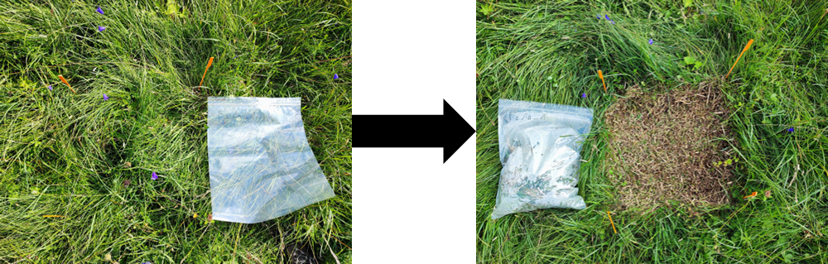

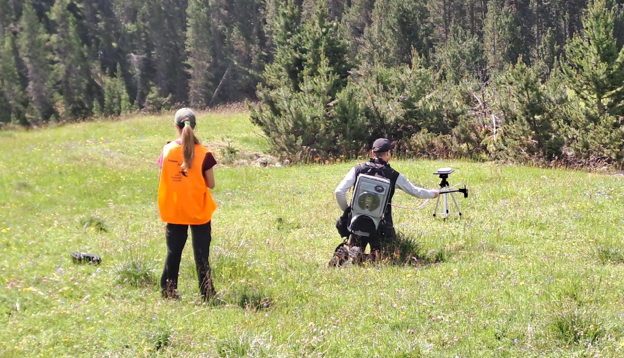
Available data – CH fieldwork summer 2024
  Collection of in-situ spectral and trait data to calibrate and validate biodiversity products
  Forest:
    Leaf optical properties of 180 leaves from 18 beech trees across structurally diverse forests stands
    Trait retrieval (leaf area & mass, lab analyses...)
  Grassland:
    Species-specific leaf spectra of most abundant species (97 species, 486 samples)
    Biomass collection (24 plots with 4 each)
    In-situ spectra of plots (19 plots with 5 each)

Slide 22
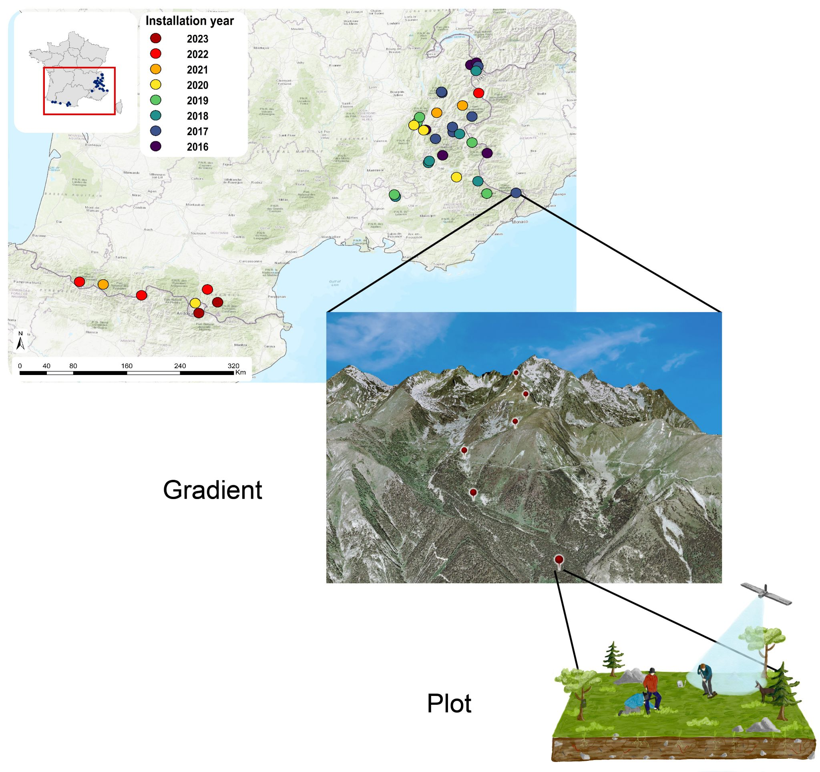
Orchamp:
Spatial Representation
# permanent gradients: 37 [2023]
4 to 9 permanent plots per gradient
30 x 30 m permanent plots
~ 200 m of altitude apart of each other

Slide 23
Plan 2025

Slide 24
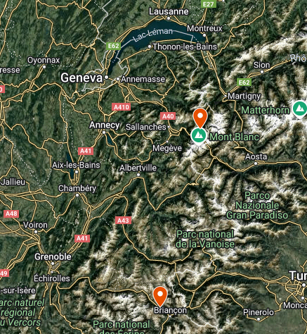
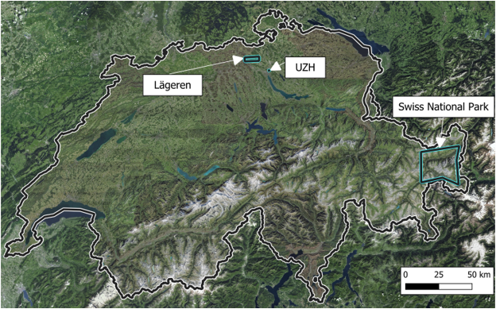
Locations | French & Swiss sites

Slide 25
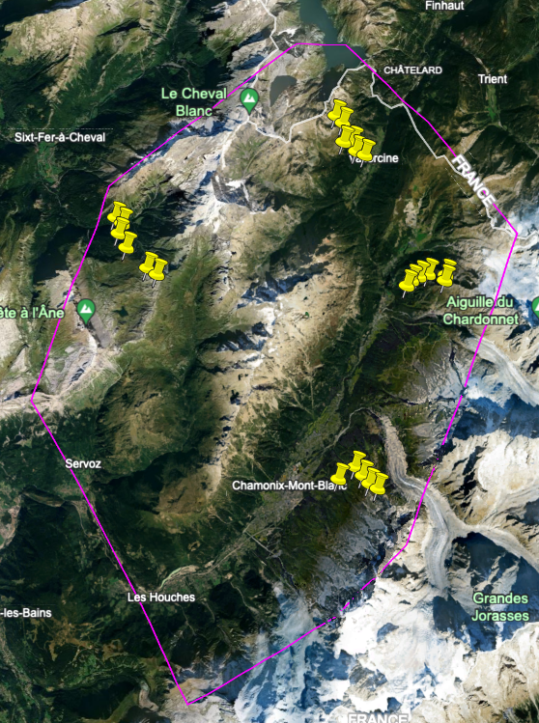
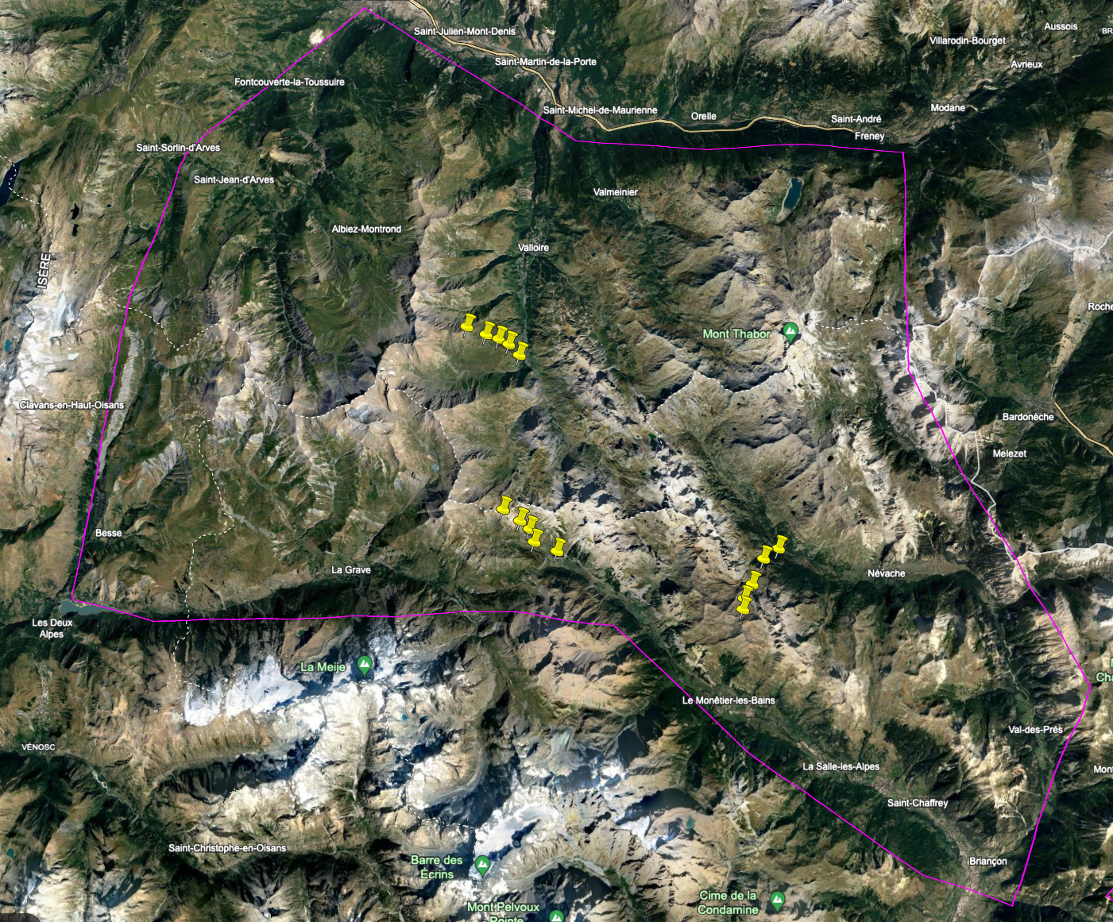
Target gradients | Plan summer 2025
Chamonix: Abbrev. #plots
Anterne ANT 6
Argentière ARG 6
Pas de l’Aiguille PAI 5
Loriaz LORI 6
tot. 23
Guisane: Abbrev. #plots
Lautaret LAU 5
Clarée NEV 5
Valloire VAL 5
tot. 15

Slide 26
Target gradients | Plan summer 2025
  Collection of in-situ spectral and trait data to calibrate and validate biodiversity products
  Forest:
    Leaf optical properties of 180 leaves from 18 beech trees across structurally diverse forests stands
    Trait retrieval (leaf area & mass, lab analyses...)
  Grassland:
    Species-specific leaf spectra of most abundant species (~ 100 species, 500 samples)
    Biomass collection
    In-situ spectra of plots
Collection of in-situ biodiversity data
Soil eDNA (bacteria, fungi, eukaryotes, insects, collembola, earthworms)
Sounds
Camera-traps
Plants

Slide 27
Link to OBSGESSION goals
Knowledge
on Drivers of Ecosystem Change
Harmonised Biodiversity Monitoring
Improved
use of Earth Observation
(EO) data
Knowledge
on Drivers of Ecosystem Change

Slide 28

Thank you for your attention!
obsgession.eu
obsgession_
OBSGESSION_HorizonEurope
OBSGESSION receives funding from the European Union's Horizon Europe research and innovation programme under grant agreement No. 101134954. Views and opinions expressed are those of the author(s) only and do not necessarily reflect those of the European Union or the European Research Executive Agency (REA). Neither the EU nor the European Research Executive Agency (REA) can be held responsible for them.

Slide 29




Pilot 5.2 Mapping & Monitoring of European habitats
WR, CNRS, VITO, SYKE
26.03.2025 / WP5 meeting OBSGESSION
obsgession.eu

Slide 30
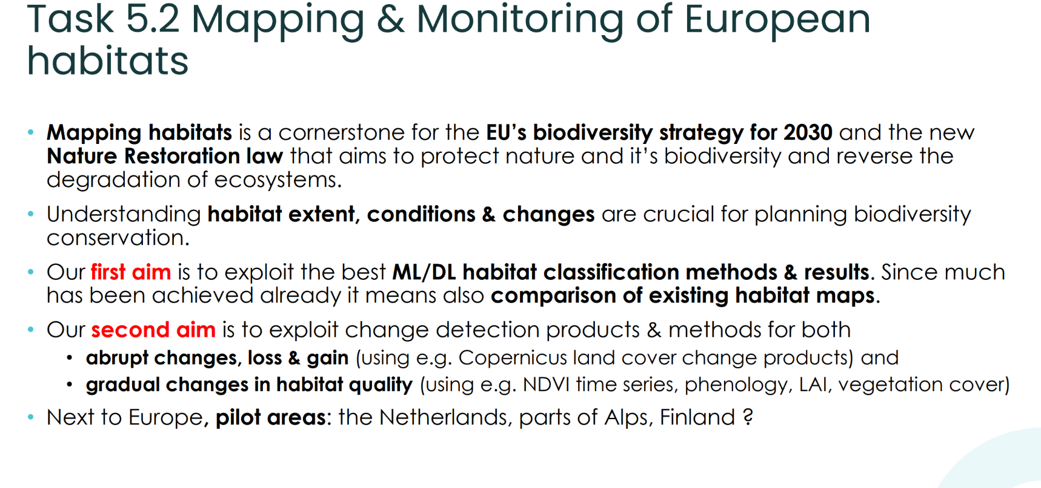

Slide 31
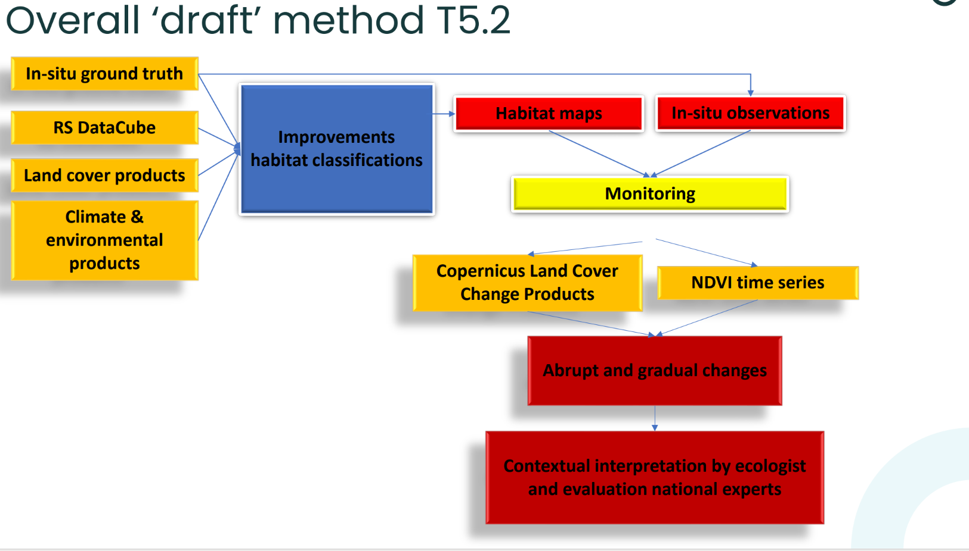

Slide 32
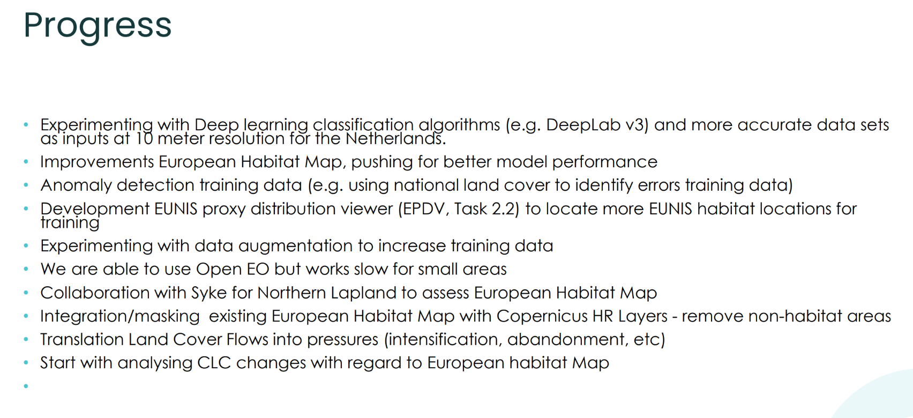

Slide 33
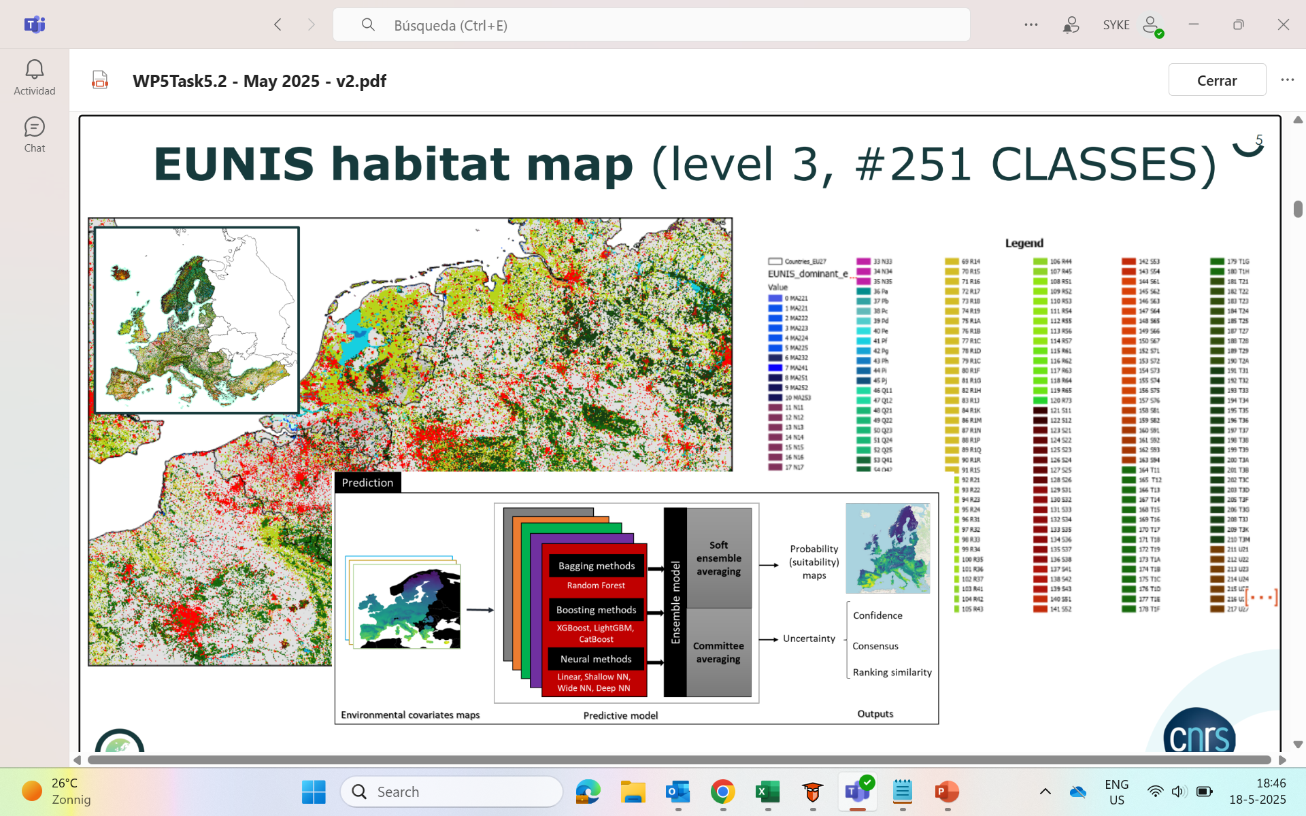

Slide 34
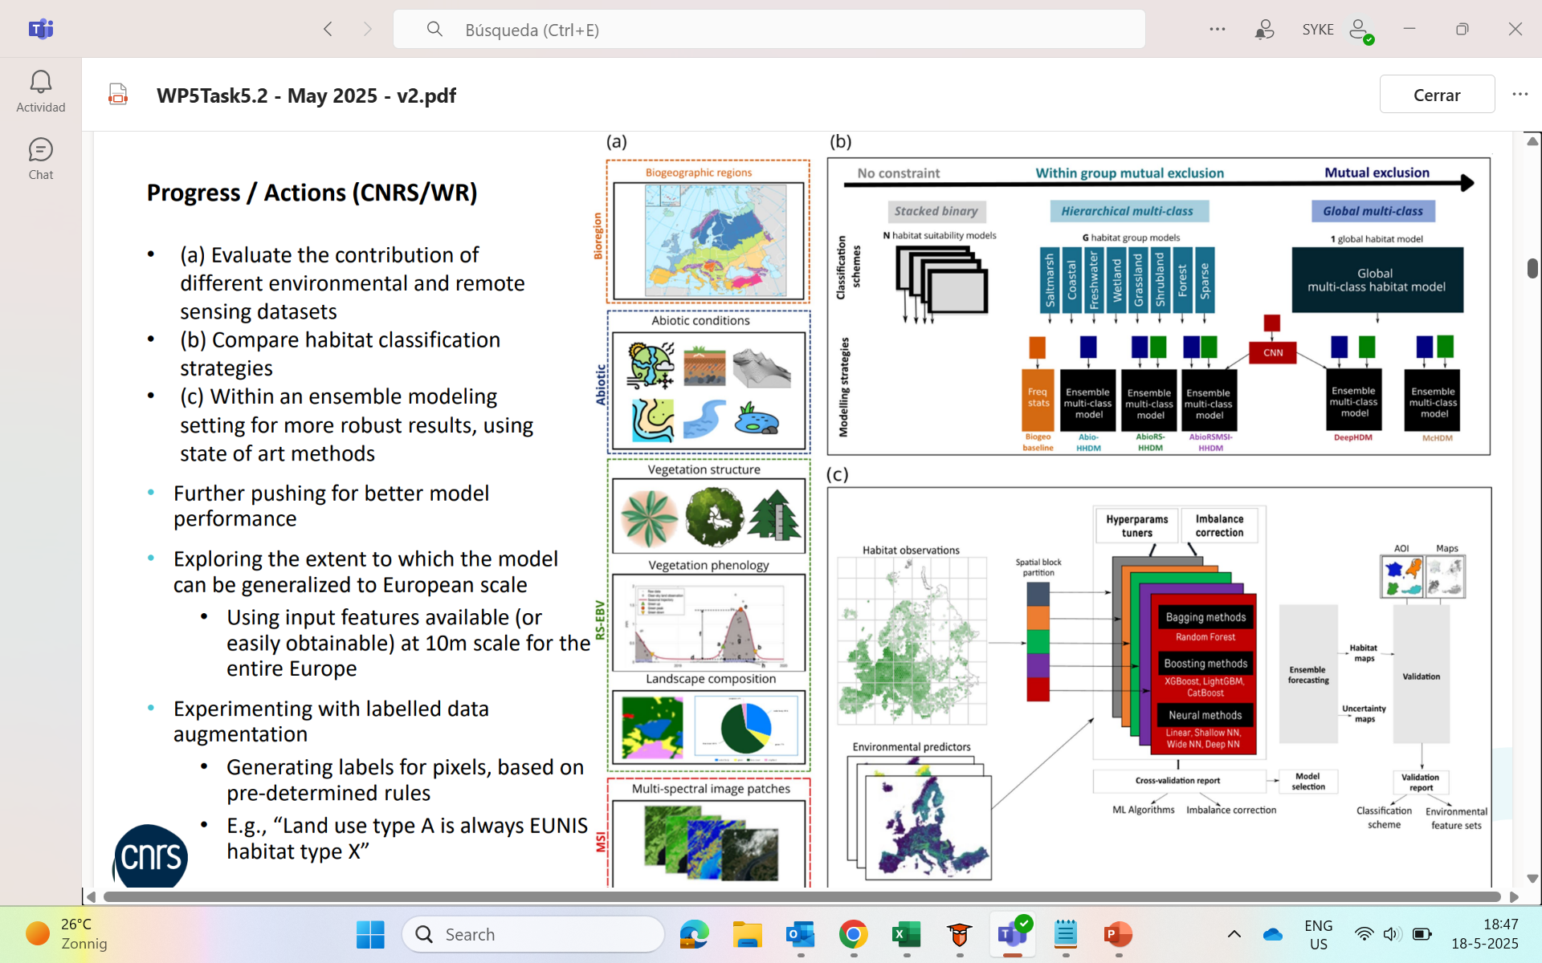

Slide 35
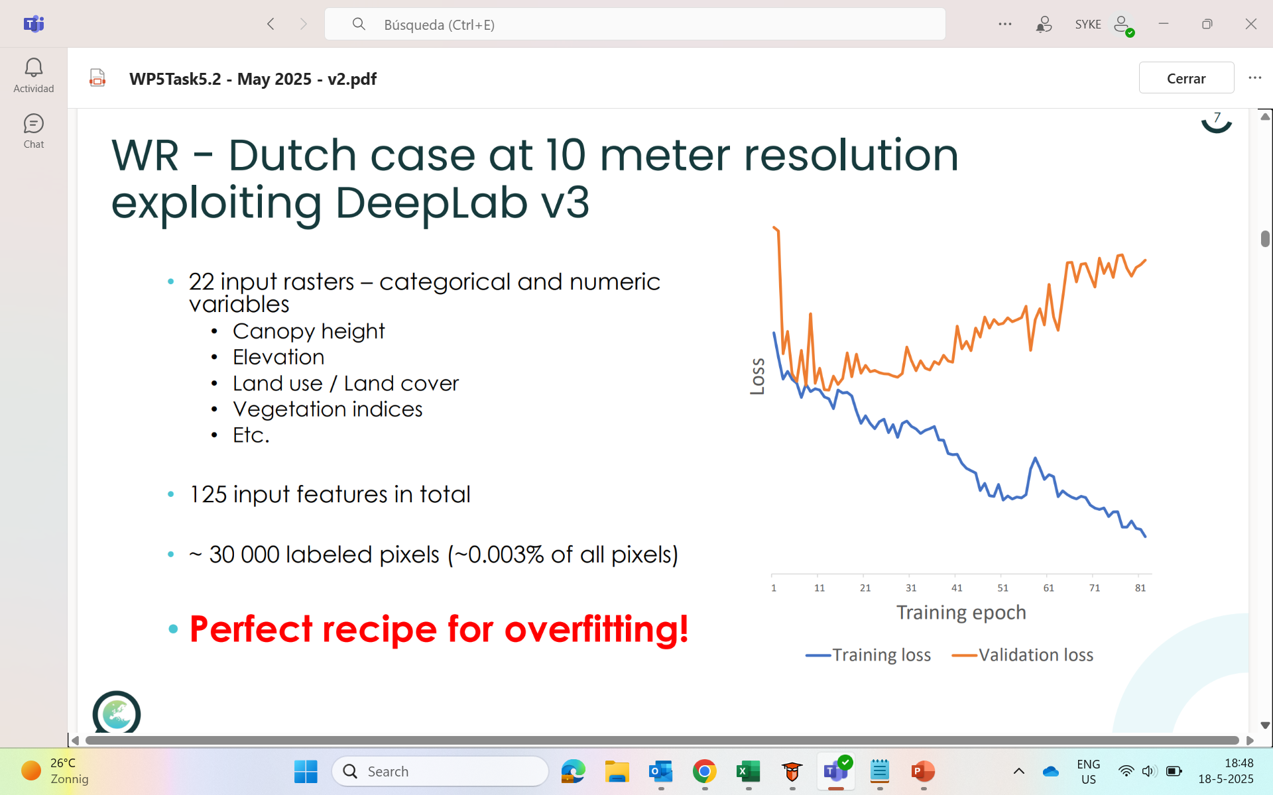

Slide 36
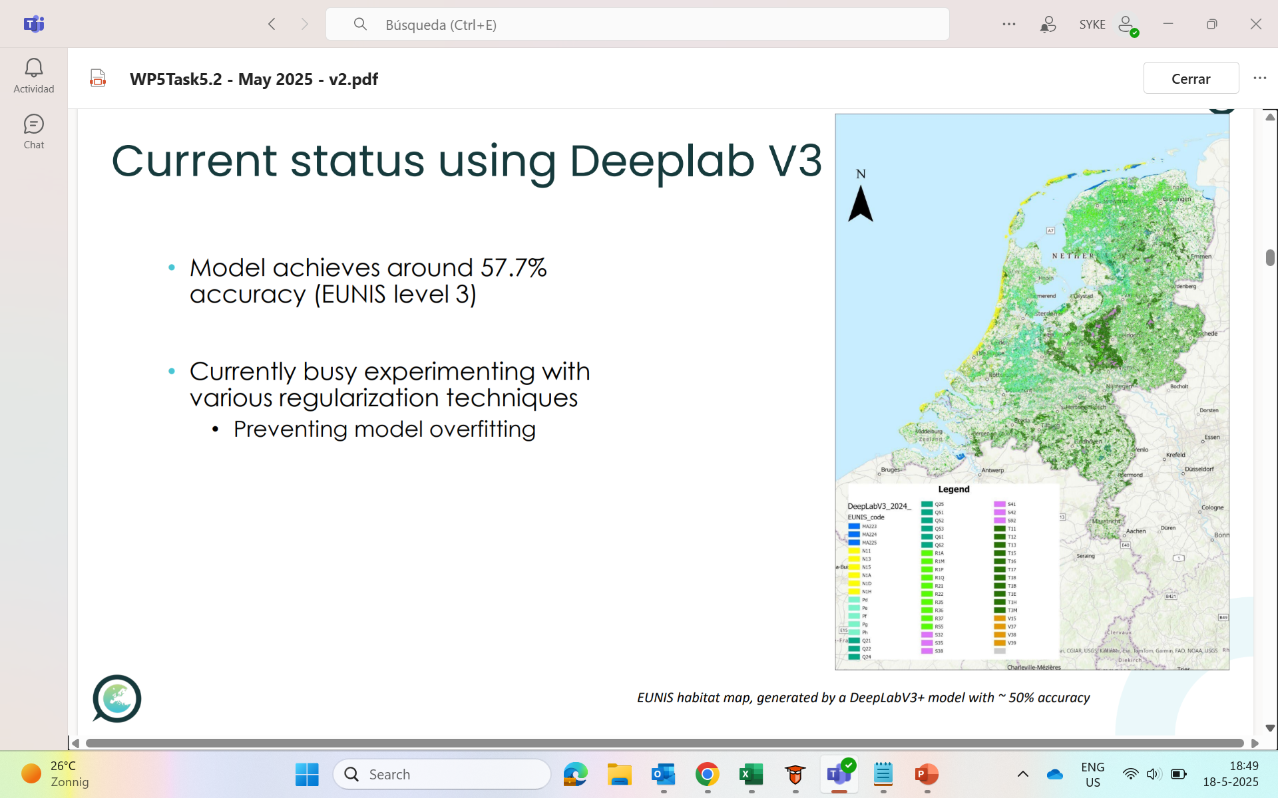

Slide 37
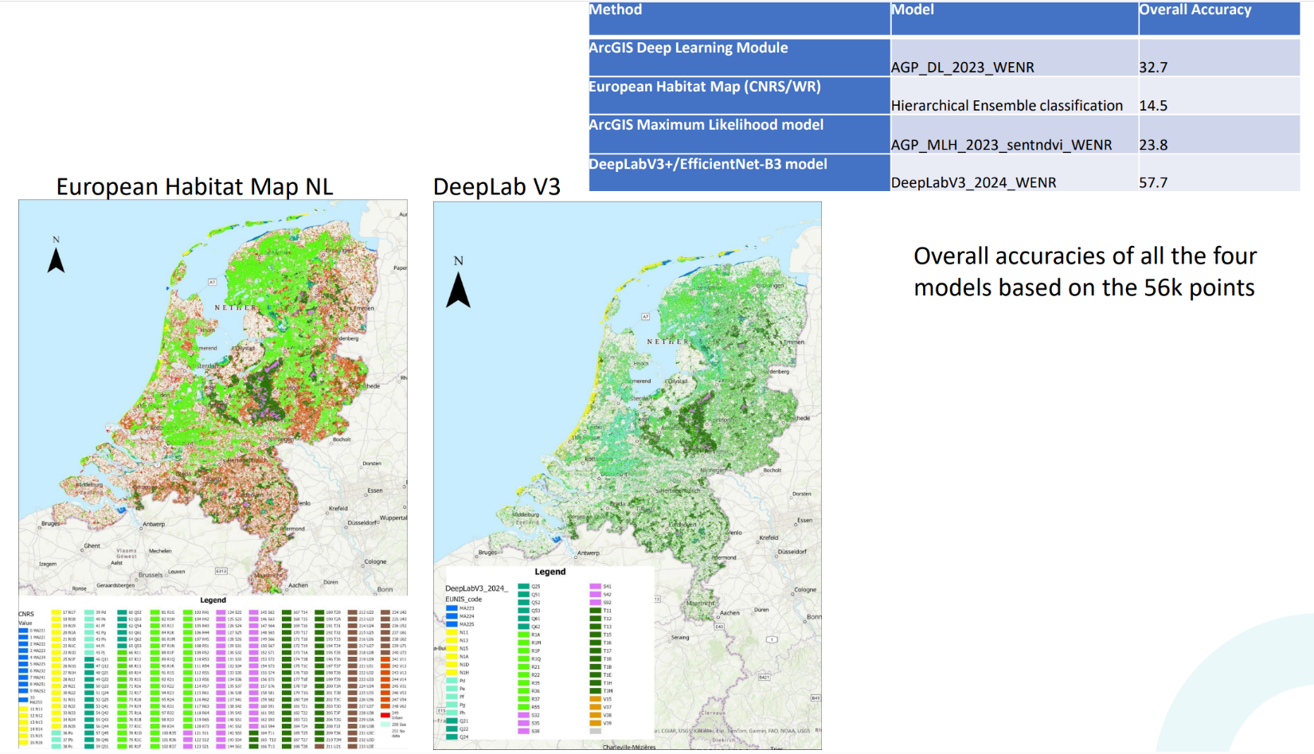

Slide 38
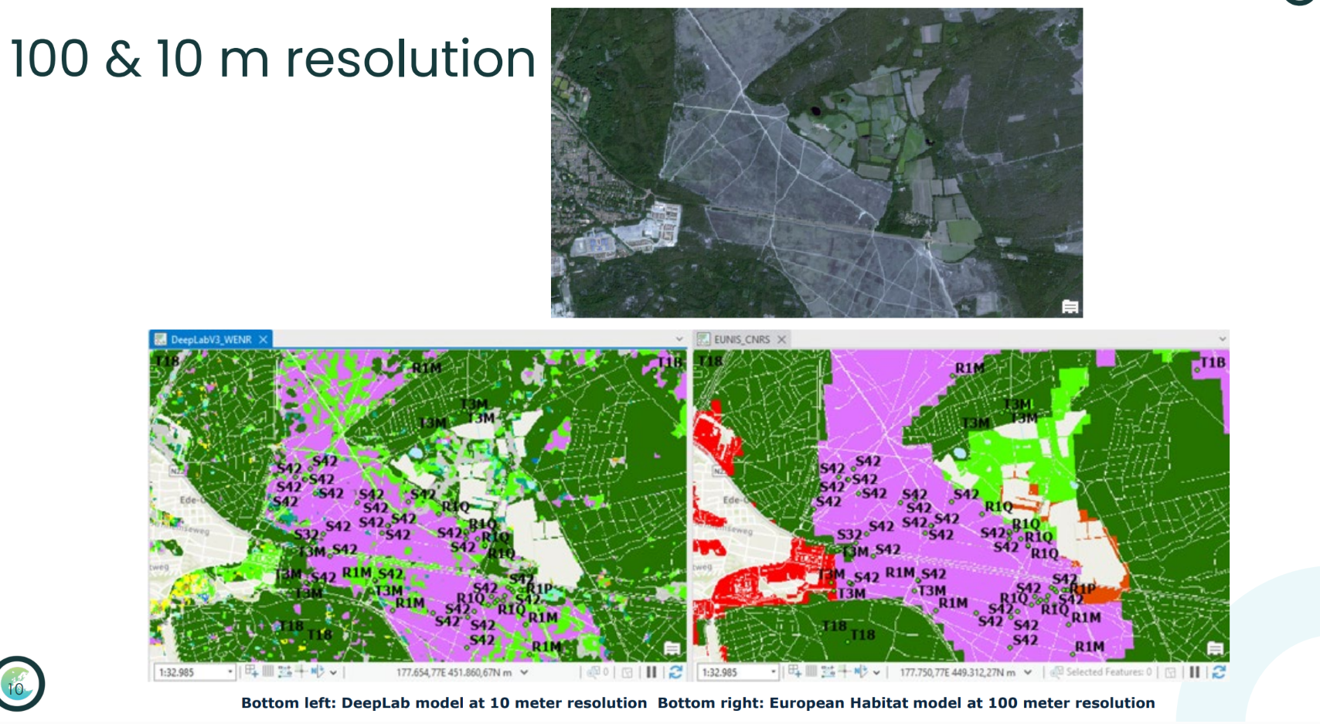

Slide 39
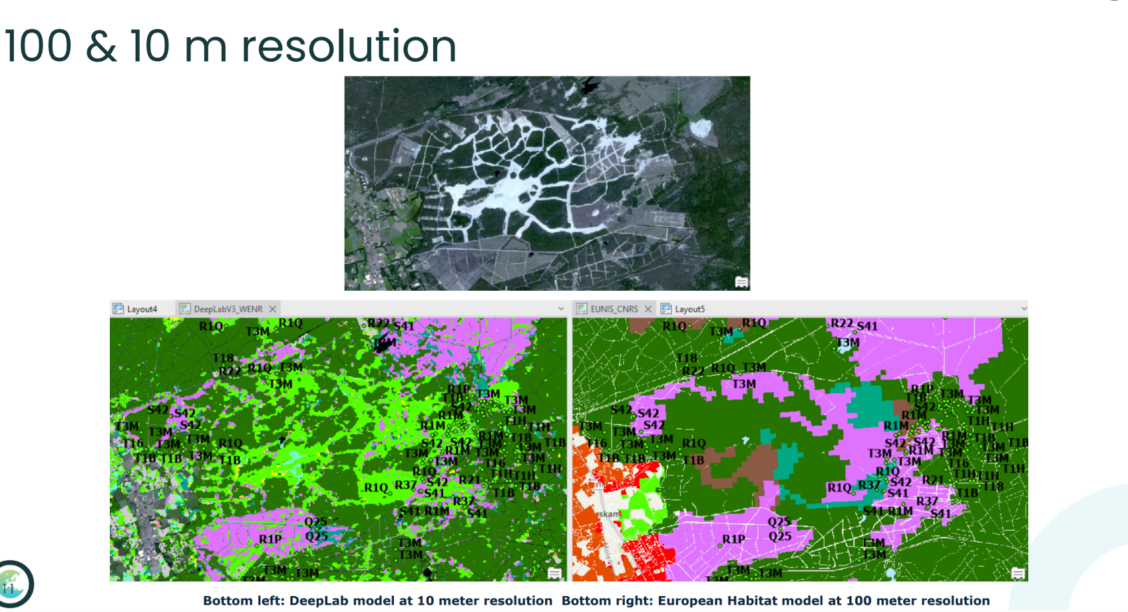

Slide 40
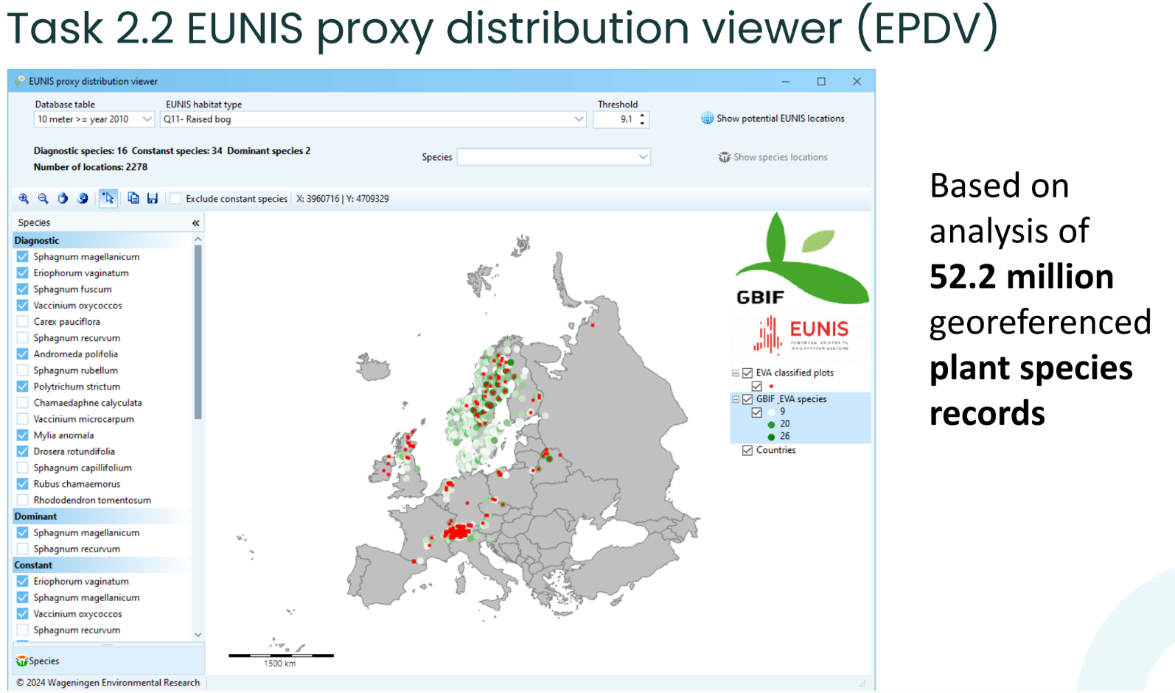

Slide 41
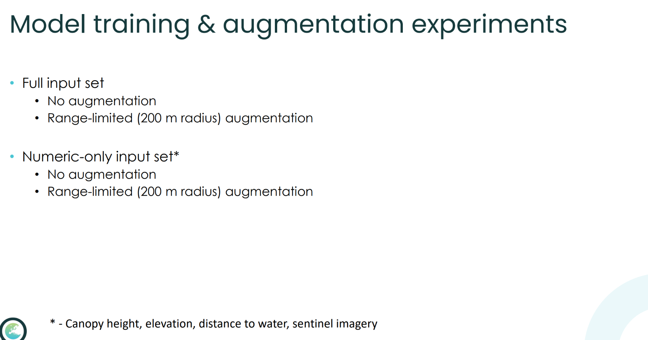

Slide 42
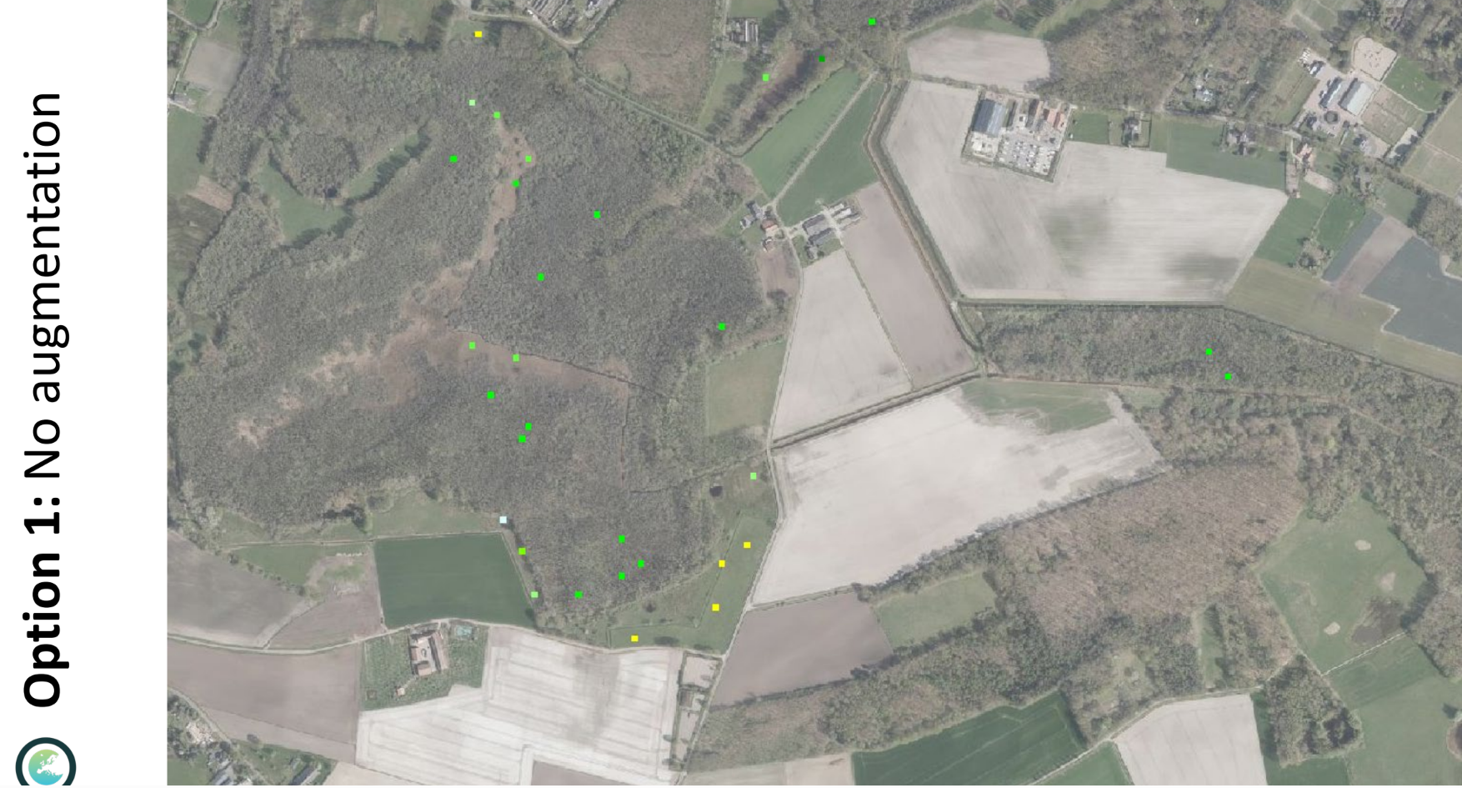

Slide 43
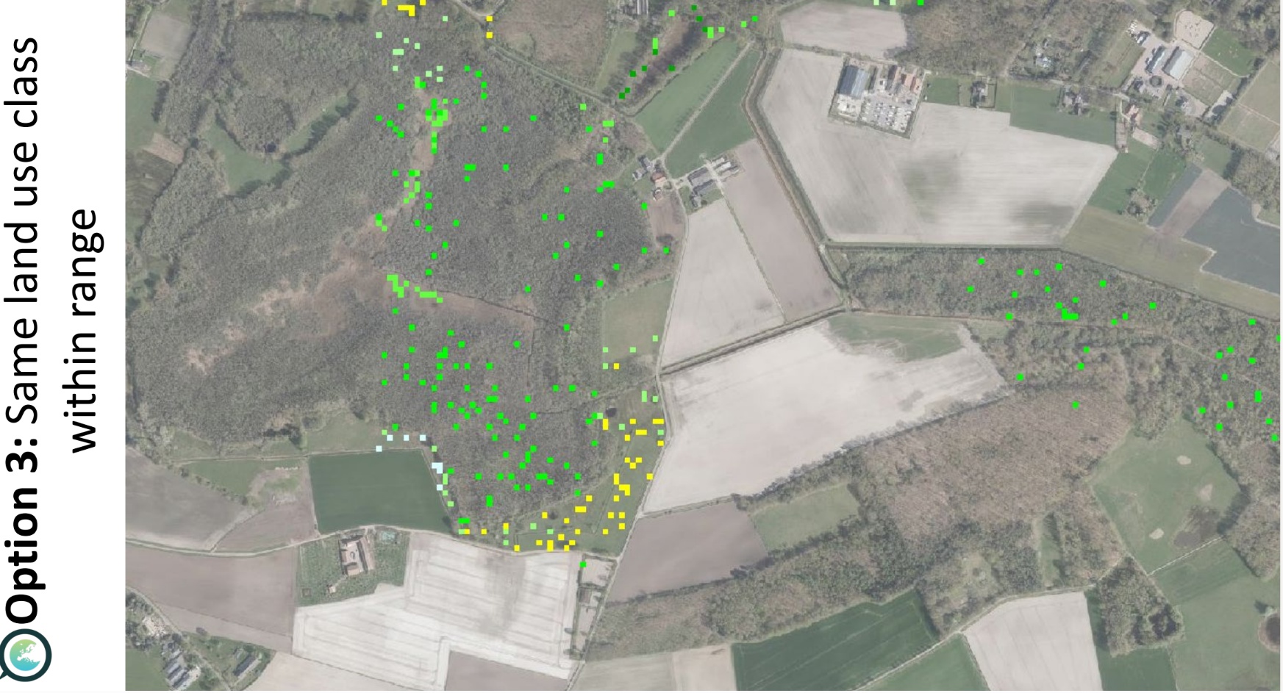

Slide 44
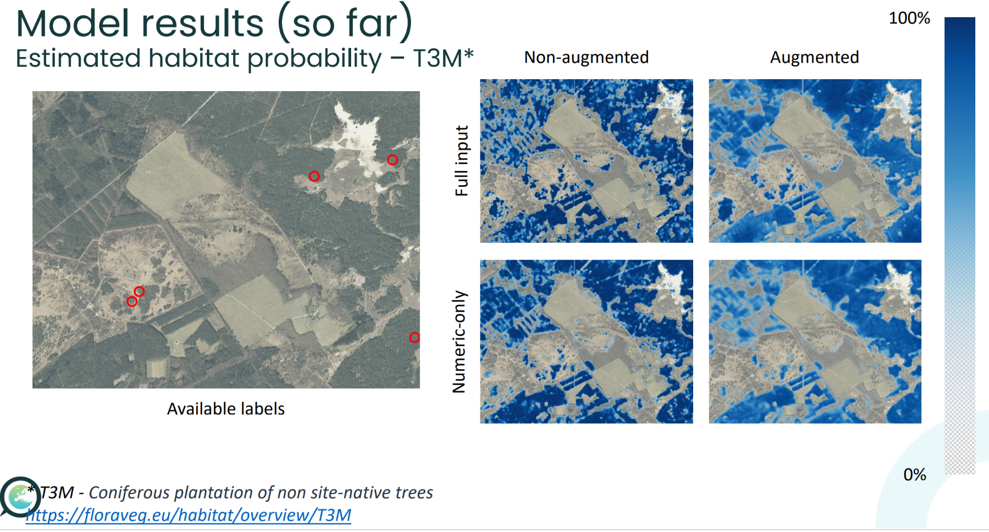

Slide 45
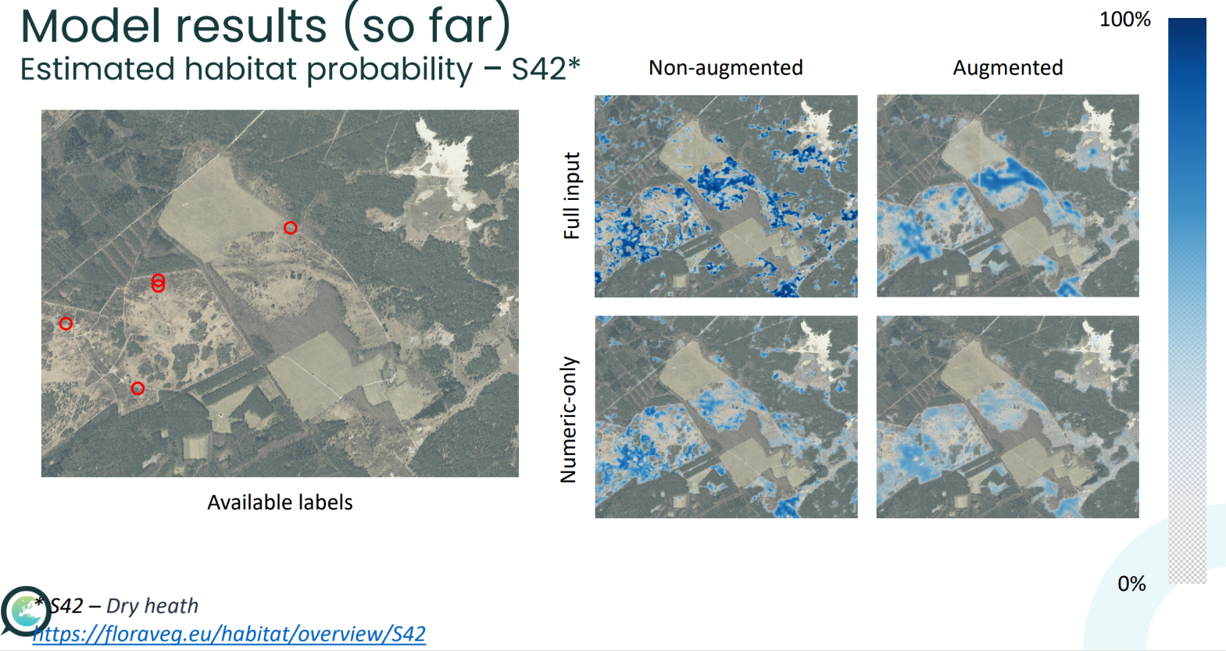

Slide 46
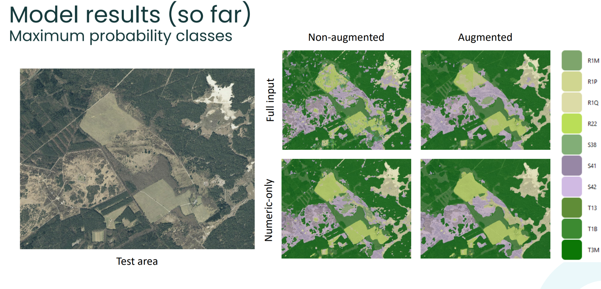

Slide 47
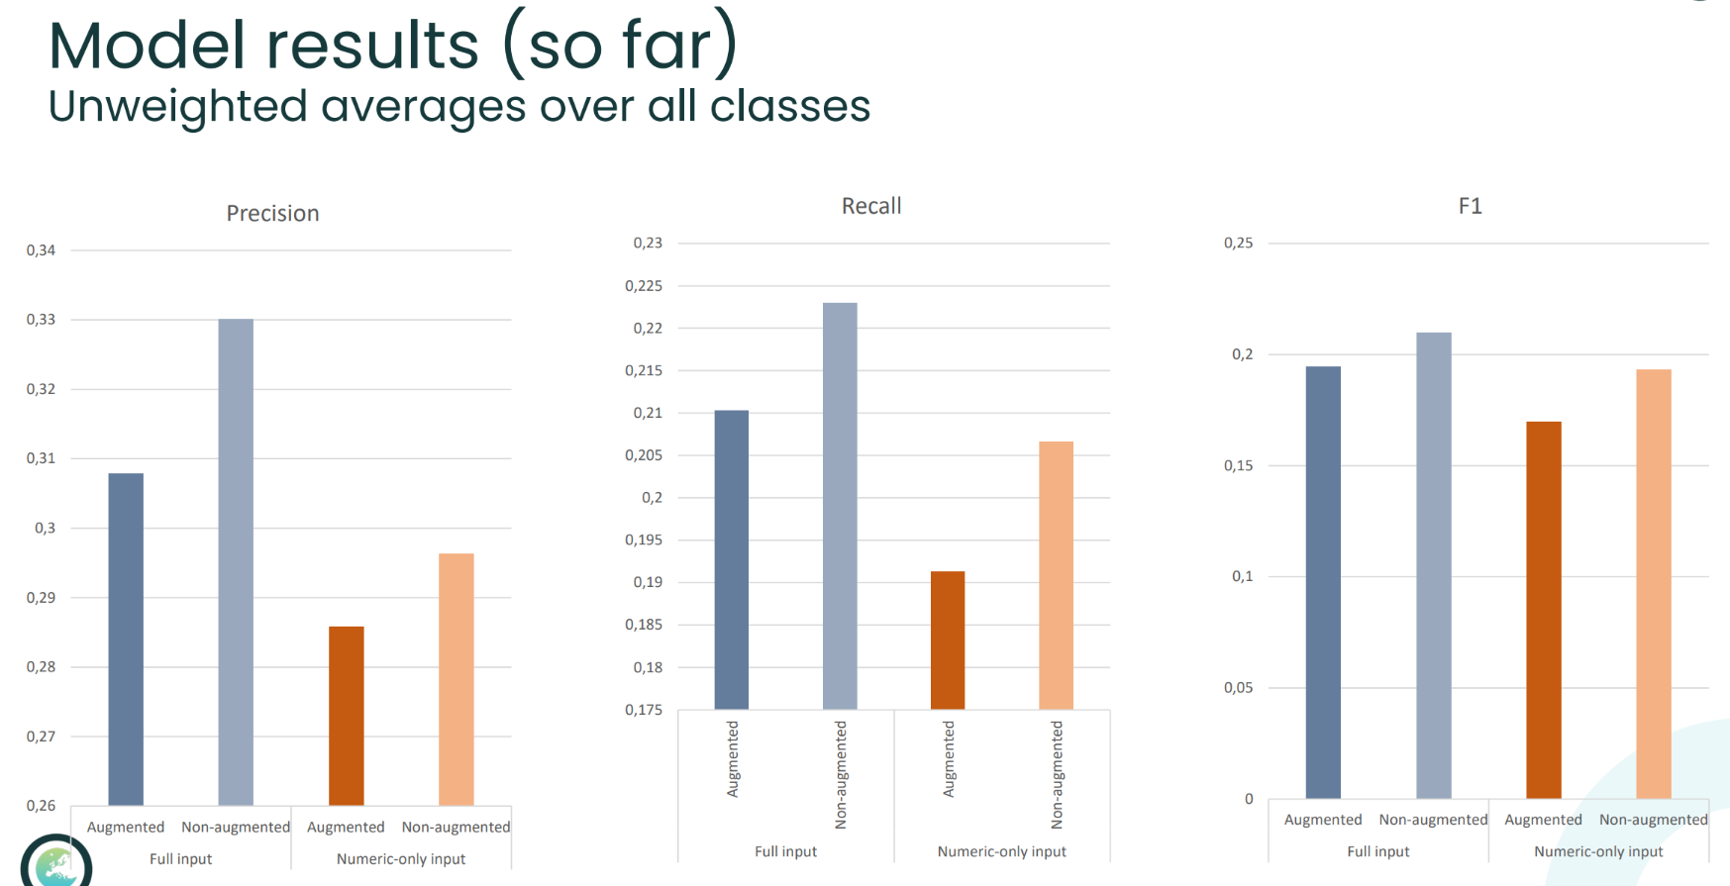

Slide 48
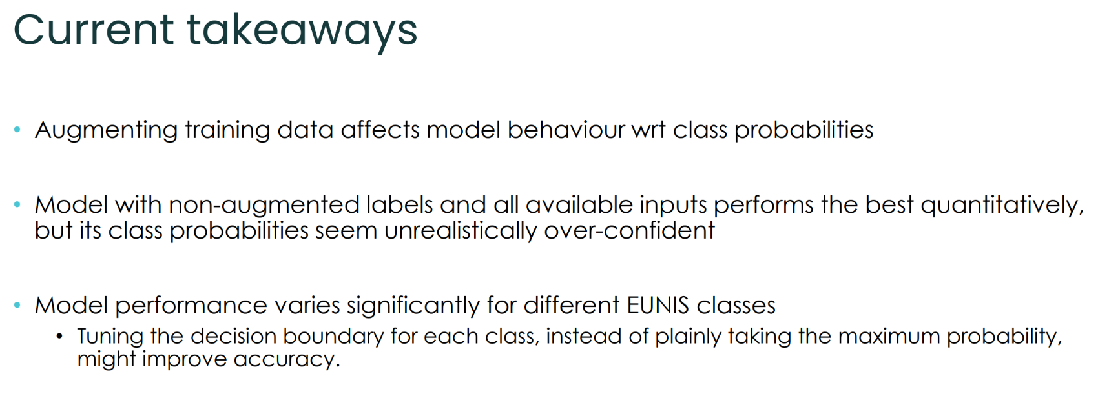

Slide 49
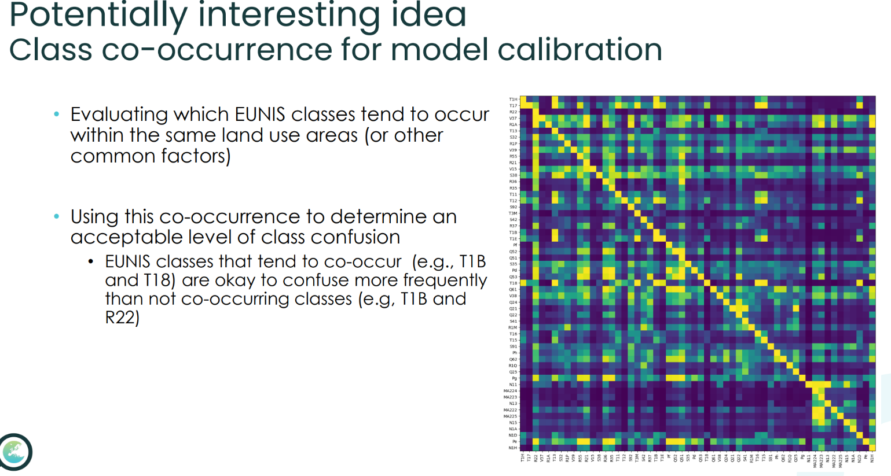

Slide 50
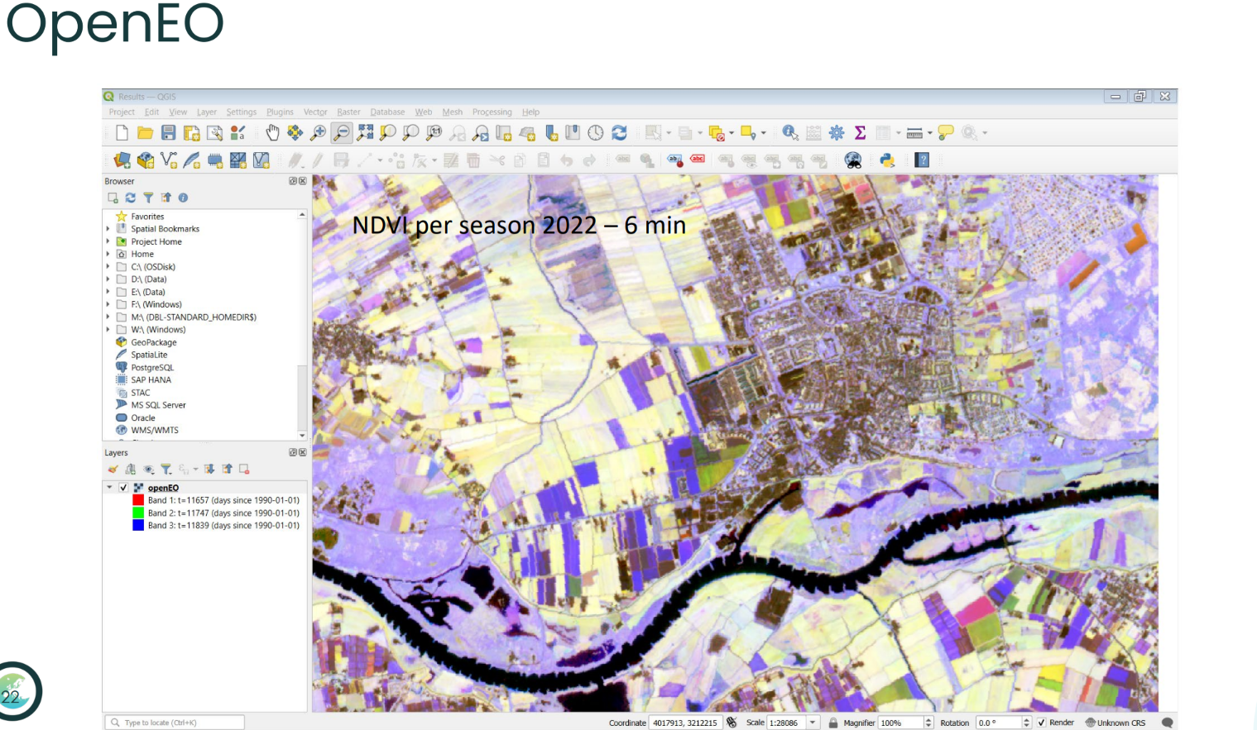

Slide 51
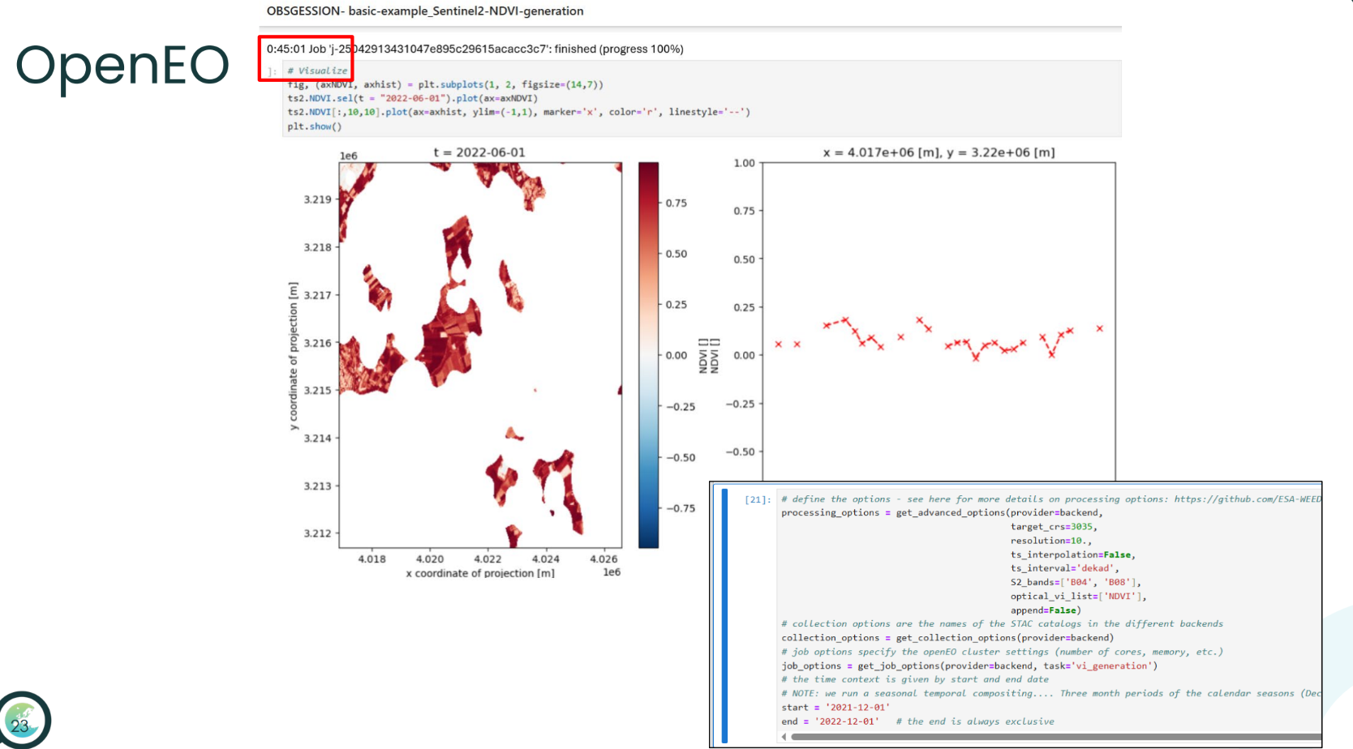

Slide 52
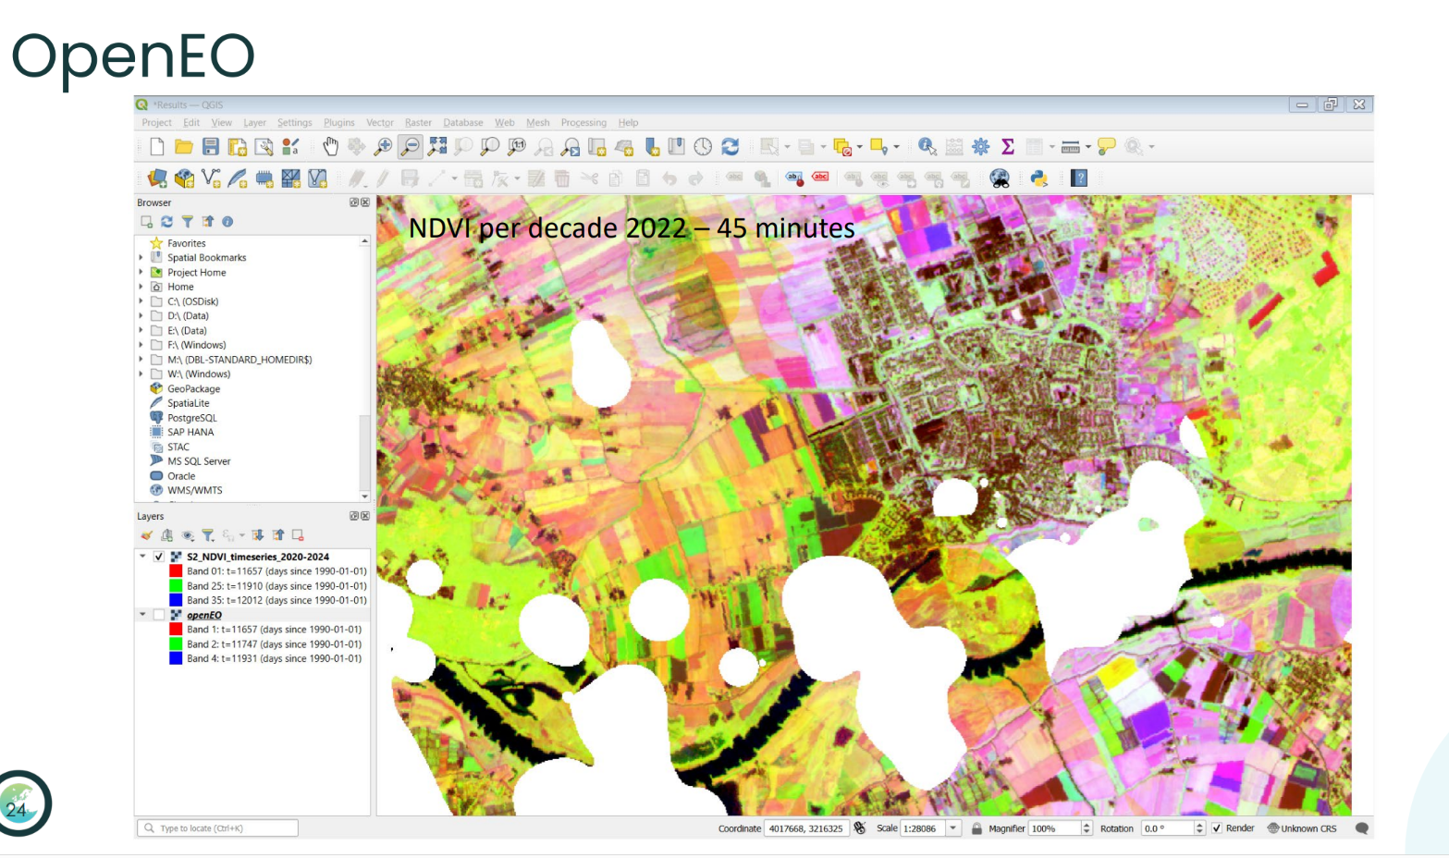

Slide 53
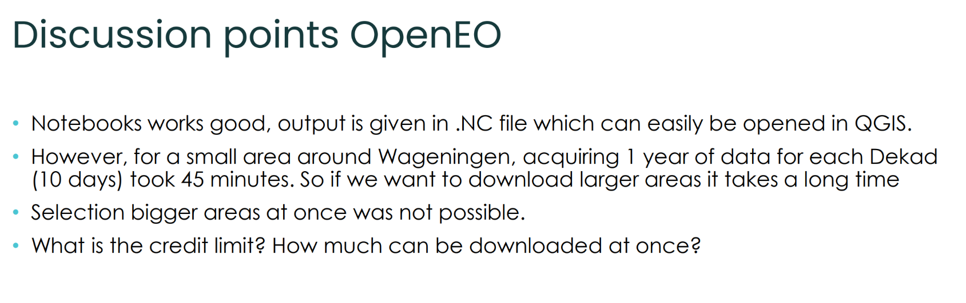

Slide 54
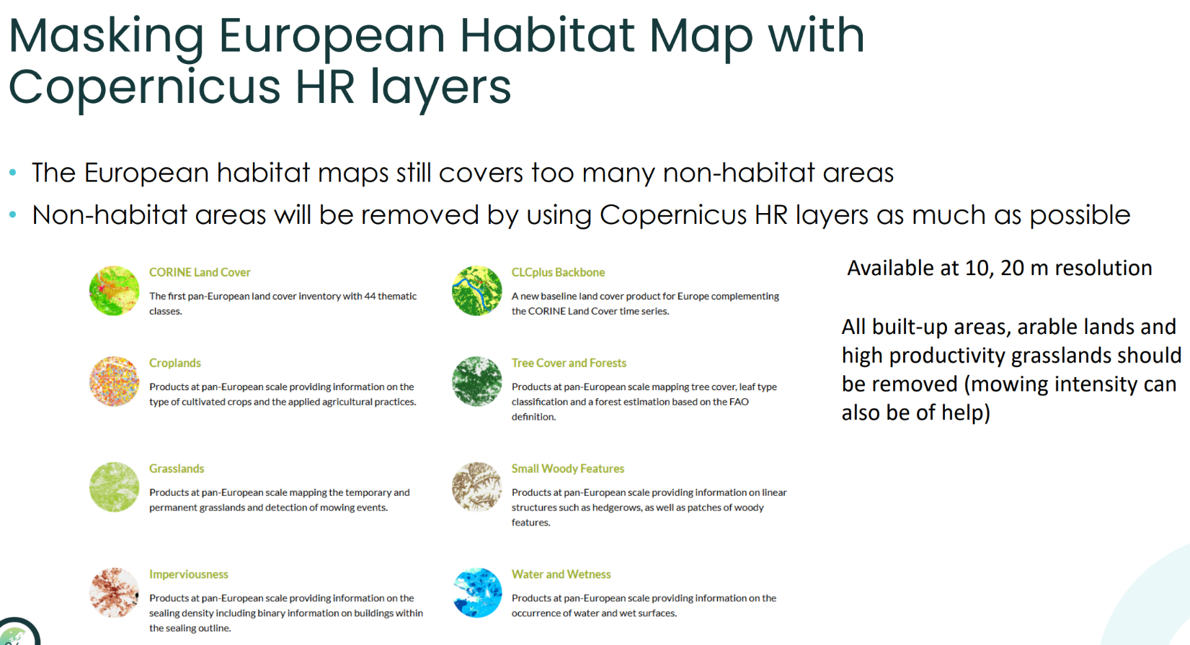

Slide 55
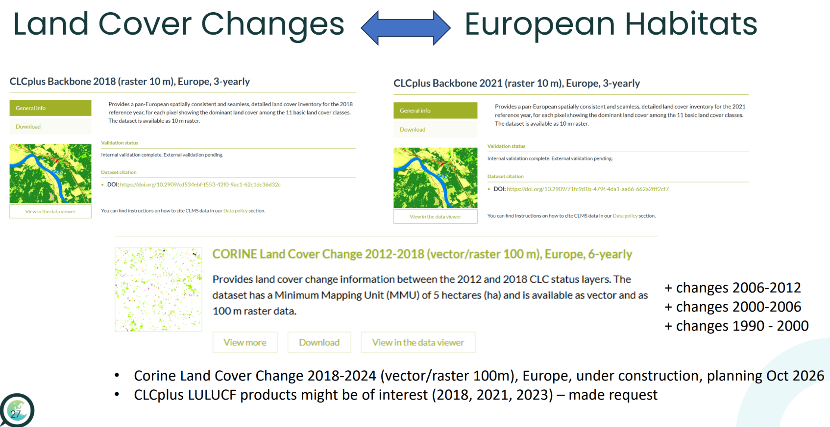

Slide 56
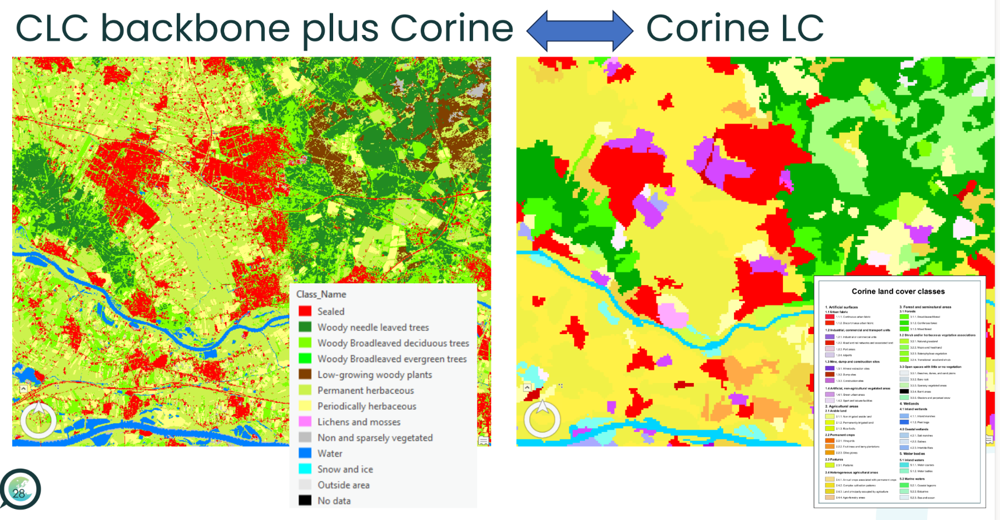

Slide 57
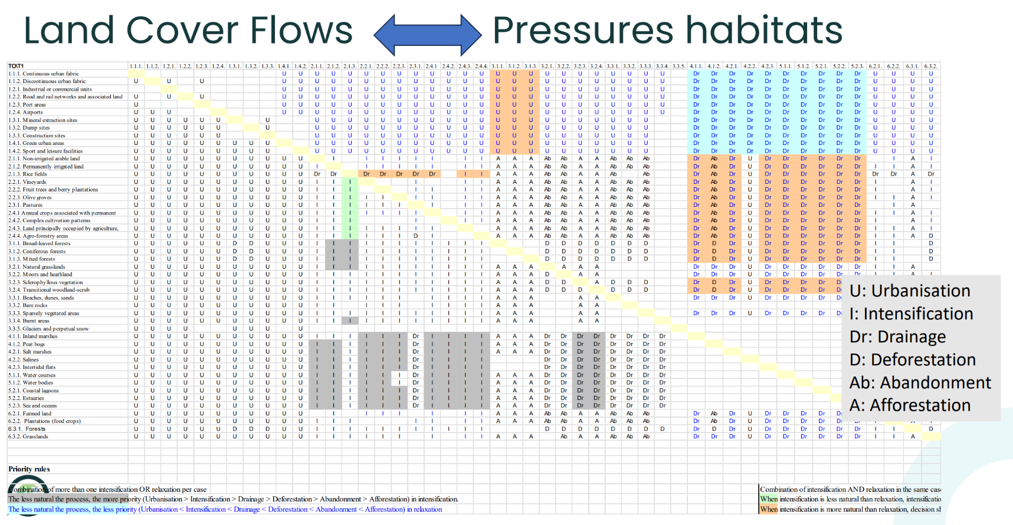

Slide 58


Slide 59
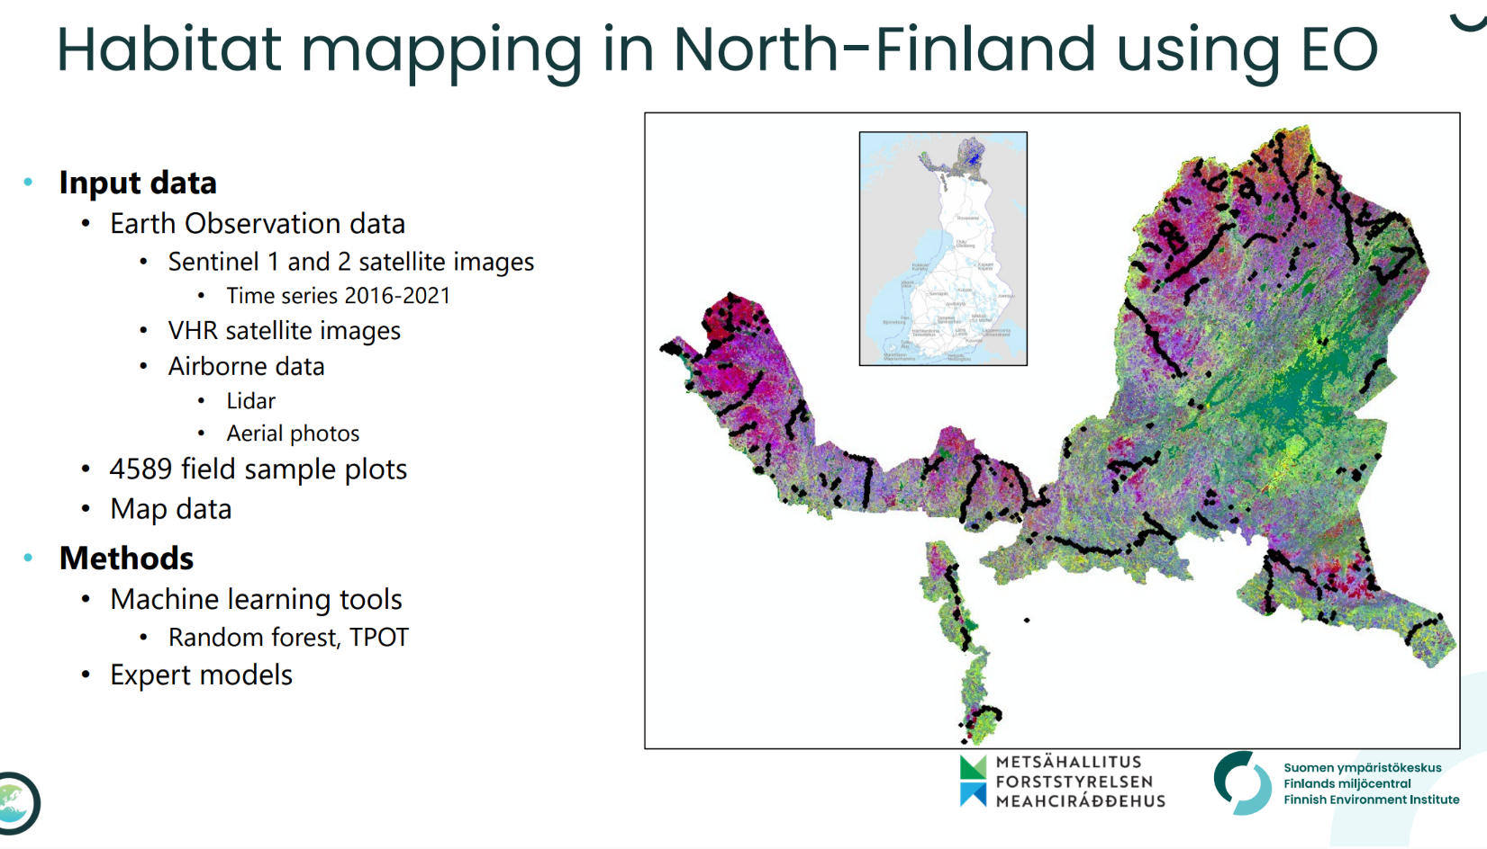

Slide 60


Slide 61


Slide 62


Slide 63
Pilot 5.3 Monitoring and forecasting forest ecosystem productivity and health under climate change and disturbances
ULUND, ITC
26.03.2025 / WP5 meeting OBSGESSION
obsgession.eu

Slide 64
Pilot 3 – Monitoring and forecasting forest ecosystem productivity and health under climate change and disturbances
End-to-end case study demonstrating the added value of RS enabled-EBVs to assess key metrics of ecosystem structure, function and health as the basis for understanding impacts, their causality, and identifying levers for mitigation actions (WP4-Task 4.4).
The case study will focus on contrasting regional settings of Sweden, Finland, or Germany, all of which host spruce-based forestry that has experienced economic and ecological impacts of bark beetles in recent decades.
Outputs for key proxies of ecosystem function (e.g. NPP, soil water and carbon) and structure (e.g. stand age/size structure, functional diversity) will be analysed to assess the causality of forest degradation accounting for interactions between biophysical drivers (drought, temperature, wind) and management, mediated by bark beetle populations and attacks on living Norway spruce
LPJ-GUESS ecosystem model enabled with bark beetle population dynamics and impact submodel.

Slide 65
Lund University team
Ben Smith, Tom Pugh – overall coordination, contributions to dissemination and policy translation, synergies with other model development activities and projects
Annemarie Eckes-Shephard – advice on ecosystem model simulations, set-up, analysis and preparation of outputs
Mats Lindeskog – main developer of forest management functionality in LPJ-GUESS, and designer of workflows for linking EO data to LPJ-GUESS output in precursor project EO4Diversity. Leads model set-up and integration with EO data.
Fredrik Lagergren and Anna Maria Jönsson – implementation and analysis of bark beetle disturbance effects on Norway spruce along climate gradients
Ali Mansourian, Rachid Oucheikh – AI methods for linking LPJ-GUESS to EO data

Slide 66

The Lund-Potsdam-Jena General Ecosystem Simulator (LPJ-GUESS)*
Second-generation Dynamic Global Vegetation Model (DGVM)
*Smith et al. 2001, 2011, 2014

Slide 67












Integration of bark beetle dynamics with Norway spruce
forest productivity and management*
1961-1990
2071-2100
Management:
latitude (°N)
continuous cover forestry
+5-10% broadleaved trees
successively shortened rotation length
Production (m³ ha⁻¹ yr⁻¹)
current forest management
Climate:
A1B scenario
1961-1990
2071-2100
latitude (°N)
*Jönsson et al. 2015
Mitigation & Adaptation Strategies for Global Change 20: 201-220
Damage risk (m³ ha⁻¹)

Slide 68

Earth observation (EO) data to constrain or downscale
climate-ecosystem model output*
Spruce bark beetle impacts on forest productivity – Bavarian Forest Park, Germany
April 2019*
5 km
kgC m⁻² month⁻¹
kgC m⁻² month⁻¹
kgC m⁻² month⁻¹
*Mats Lindeskog, unpublished
EO4Diversity project

Slide 69

Downscaling LPJ-GUESS outputs using EO data – proposed workflow
frequency in landscape
ecosystem variable
e.g. fPAR
LPJ-GUESS landscape – multiple patches
Map spectral variable distribution to ecosystem variable distribution
⟨
fPAR_{mod} = f ( NDVI )
frequency in landscape
spectral variable
e.g. NDVI
Predict fPAR distribution
across landscape
Spectral landscape – multiple pixels

Slide 70



Pilot 3 links to OBSGESSION Specific Needs
Harmonised Biodiversity Monitoring
Improved
use of Earth Observation
(EO) data
Knowledge
on Drivers of Ecosystem Change
Hybrid method links regional drivers (climate, soil, pollution, management regimes) to local plant and soil processes responsible for satellite-observed ecosystem state
Enriches EO data with process-based information on key drivers and responses, improving accuracy but also explanatory power for observed patterns and trends
Hybrid workflow systematically links EO data on ecosystem state and change to underlying processes and drivers
Workflows developed in pilot will be deployed in detection-attribution in WP3

Slide 71
Downscaling LPJ-Guess Outputs using Remote Sensing Data and Machine Learning

Slide 72
Concept Overview – Bridging LPJ-GUESS and Remote Sensing
Develop machine learning algorithms to downscale ecosystem model outputs for key ecosystem function proxies using remote sensing data.
The predictive model should bridge the scale and feature differences, thus generating fine-resolution maps consistent with LPJ-GUESS process-based dynamics and RS observations.
Scale mismatch: LPJ-GUESS outputs are coarse, while RS is fine (10–30 m pixels).
Feature representation: LPJ-GUESS predicts ecosystem processes, while RS captures spectral indices.

Slide 73
Machine learning workflow
Input Data Preparation
  LPJ-GUESS outputs: Coarse ecosystem variables (e.g., biomass, height).
  Remote sensing data: High-resolution spectral bands (Sentinel data)
Data Harmonization: Align data in temporal and spatial dimensions and create a unified dataset of predictors and responses.
Feature importance: Extract the most important features from RS data
  For example: for LAI, potentially use the following bands Bands 4 (Red), 8 (NIR), 5, and 6 (Red-edge).
Model building: custom deep learning models based on specific mechanisms, mainly:
  Autoencoders: learn the embeddings and shared representation domain.
  Transformers: learn the spatial context.
Prediction and Validation:
  Generate high-resolution rasters of ecosystem variables and use custom loss function for validation.

Slide 74
Data
Using initial data for test (Rumperod, Sweden and NSW North Coast Bioregion, Australia):
  Grid size:11km
  Number of patches: 50
  Patches are more than 17 years old.
LPJ-Guess outputs: fPAR, NPP, LAI , GPP and WC.
Remote sensing data: NBR, NDVI, and EVI.

Slide 75

Model Development

Slide 76
Model Losses
Regression loss: MSE
Conservation loss: The spatial mean of the downscaled output must equal the LPJ-GUESS input .
ensures physical plausibility for quantities like LAI or biomass (no negative values)
Smoothness Loss: Encourages spatial smoothness in the downscaled output to avoid unrealistic sharp transitions.
Pattern Loss: Ensures the downscaled output retains spatial patterns from remote sensing.
Notes:
Smoothness: implemented as a gradient penalty or by penalizing the Laplacian of the output, would reduce noise and improve visual coherence of outputs.
Ensures the downscaled output retains spatial patterns from remote sensing (RS) data (e.g., NDVI edges, texture). Often implemented using Structural Similarity Index (SSIM) or feature matching with a pre-trained CNN. But, If the output variable (e.g., LAI) is not directly comparable to RS data (e.g., NDVI), SSIM may enforce irrelevant patterns.
Scale Mismatch : RS data is high-resolution, but LPJ-GUESS inputs are coarse. Directly matching patterns could propagate RS biases (e.g., saturation in NDVI).
Losses do not account for uncertainty in LPJ-GUESS or RS data (e.g., weighting pixels by RS confidence).
Conservation is enforced only at the coarse scale. Multi-scale losses (e.g., enforcing conservation at intermediate resolutions) could improve robustness.

Slide 77
Training Results Analysis
Loss Convergence
  The training metrics show good convergence over the 10 epochs.
Total Loss: Decreased dramatically from 554.87 to 18.09 (97% reduction)
Conservation Loss: Started extremely low (~2.35e-07) and increased slightly to ~1.80e-05, still maintaining near-perfect conservation
Pattern Loss: Remained consistently around 1.0, indicating the model maintains spatial patterns from remote sensing data
Smoothness Loss: Reduced significantly from 1107.76 to 34.18 (97% reduction)
The most improvement occurred in the first 3 epochs, with more gradual refinement in later epochs.

Slide 78

Training Results Analysis
Total Loss: Decreased dramatically from 554.87 to 18.09 (97% reduction)

Slide 79

Training Results Analysis
Pattern Loss: Remained consistently around 1.0, indicating the model maintains spatial patterns from remote sensing data
Conservation Loss: Started extremely low (~2.35e-07) and increased slightly to ~1.80e-05, still maintaining near-perfect conservation
Smoothness Loss: Reduced significantly from 1107.76 to 34.18 (97% reduction)

Slide 80

Results Analysis
Per-Sample Performance: The model learned across all four seasonal NBR datasets:
  Each sample has its unique characteristics, demonstrating the model's ability to adapt to different seasonal patterns
  Consistent improvement across all samples indicates robust performance regardless of season

Slide 81
Training Results Analysis
The metrics reveal interesting insights about our loss components:
Smoothness Loss: Dominates the total loss, indicating that the model was initially producing outputs with high spatial gradients.
Pattern Loss: Stable throughout training, showing the model consistently respects the spatial patterns from remote sensing inputs
Conservation Loss: Small contribution, demonstrating that the physics-guided layer effectively enforces conservation principles.
Model Evolution
  The visualizations show clear progression from epoch 1 to epoch 10:
  Initial outputs (epoch 1) are noisy with high spatial gradients
  Final outputs (epoch 10) show smoother, more coherent spatial patterns that better match the remote sensing constraints
Per-Sample Performance
  The model learned across all four seasonal NBR datasets:
  Each sample has its unique characteristics, demonstrating the model's ability to adapt to different seasonal patterns
  Consistent improvement across all samples indicates robust performance regardless of season

Slide 82
Model Performance Investigation
Attention-based spatial learning: Incorporate self-attention mechanisms to better capture long-range spatial dependencies in the remote sensing data
Multi-Scale feature integration: Consider models with pyramid network (FPN) to process information at multiple spatial scales simultaneously
Loss weighting: Assign different weights to the losses.
Uncertainty quantification: Add probabilistic outputs to estimate prediction uncertainty alongside downscaled values
Temporal consistency: Enhance the model to ensure consistency across temporal sequences of data

Slide 83
Model Performance Investigation
Cross-Modality transformer U-Net (TransUNet++)
  Replace the attention fusion block with Cross-Modal Transformers for dynamic fusion of remote sensing and LPJ-GUESS embeddings.
Dual-Branch Encoder-Decoder with feature alignment loss
  Use two independent encoders (CNN for RS, MLP or transformer for LPJ) with feature alignment loss at multiple levels.
  Align and concatenate features at different resolutions.
Notes:
Models long-range dependencies and better alignment of spatial and tabular modalities.

Slide 84
Model Performance Investigation
Multi-Scale Swin U-Net with physics-informed attention:
  Encoder and decoder use Swin Transformer blocks for multi-scale context.
  Physics-guided attention mechanism enforces constraints at multiple levels, not just output.
GNN-based ecological-spatial model:
  Graph Neural Network (GNN) from patches or superpixels of RS data where each node enriched with LPJ-GUESS embeddings.
  Use Graph Attention Networks (GAT) or GraphSAGE layers for spatial and ecological learning.
Notes:
Better spatial generalization.
Local/global context with physics-aware attention at each scale.
GNN: Captures ecological interactions and spatial topology more explicitly.

Slide 85
Model Performance Investigation
Diffusion-based decoder:
  Replace standard decoder with a conditional diffusion decoder (like in denoising diffusion models).
  Incorporate physics rules into the denoising process via constraints.
Contrastive pretraining with fine-tuned fusion network:
  Pre-train both encoders (RS and LPJ-Guess) using contrastive learning to learn strong feature embeddings.
  Fine-tune fusion module with attention and residual dense blocks.
Notes:
Generates high-res outputs while ensuring stochastic fidelity.
Captures uncertainty and physical bounds.
More robust in low-data settings and better generalization.
Stronger features lead to better fusion and final prediction quality.

Slide 86
Model Comparison
Model | MAE | RMSE | R² | Conservation Ratio (CR) | TV (Smoothness) | SSIM (Pattern) | Mutual Info (Pattern)
Baseline Model | 0.187 | 0.302 | 0.62 | 1.05 | 0.498 | 0.83 | 0.61
TransUNet++ | 0.160 | 0.268 | 0.70 | 1.02 | 0.312 | 0.88 | 0.69
Dual-Branch Feature Aligned | 0.158 | 0.265 | 0.72 | 1.01 | 0.290 | 0.89 | 0.71
Swin U-Net and Physics attention | 0.145 | 0.250 | 0.74 | 1.02 | 0.272 | 0.91 | 0.75
GNN-Based Model | 0.165 | 0.278 | 0.68 | 1.01 | 0.333 | 0.86 | 0.68
Diffusion Decoder based Model | 0.148 | 0.255 | 0.74 | 1.02 | 0.275 | 0.93 | 0.74
Contrastive Pretraining + Fusion | 0.150 | 0.260 | 0.73 | 1.03 | 0.280 | 0.90 | 0.72

Slide 87
Results
Swin U-Net with physics attention and Diffusion decoder are top performers across most of the criteria, balancing numerical accuracy, physical conservation, and spatial realism.
TransUNet++ and Dual-Branch models show good regression and pattern preservation, but slightly higher total variation.
GNN-based model slightly underperforms in pixel accuracy but excels in global consistency (CR = 0.98).
Contrastive pretraining improves feature robustness and shows acceptable overall results.

Slide 88
General Insights on Learning Mechanisms
Transformer-based architectures (like Swin and TransUNet++) outperform CNNs in preserving spatial structure and long-range dependencies, making them ideal for capturing landscape-scale patterns in heterogeneous environments.
Contrastive approaches enhance generalization in data-limited contexts.
Graph-based models (GNNs) offer strong spatial smoothness and ecological consistency but may lag in pixel-wise accuracy

Slide 89
Next Steps
Consider improving the used custom conservation loss for a physics-informed neural network (PINN) residual. Off-the-shelf PINN libraries now support automatic Jacobians and mixed Dirichlet/Neumann boundaries.
A lightweight diffusion-based super-resolution head (conditioned on the deterministic features) can sharpen textures without violating energy/biomass sums [1]
[1] R. A. Watt, L. A. Mansfield. Generative Diffusion-based Downscaling for Climate. ArXiv. 2024

Slide 90
Next Steps
Downscale all LPJ-GUESS variables jointly with a shared encoder and task-specific decoders. Soft-parameter sharing proved more stable than hard constraints for sea-surface-wind downscaling [1]
Yue et al. (2025). Spatial Downscaling of Satellite Sea Surface Wind with Soft-Sharing Multi-Task Learning. Remote Sensing, 17(4), 587.

Slide 91
Links to other pilots
Pilot 5.4 Disturbances products with 20 m resolution can use the output of pilot 5.3.
WP5.4 will provide Pilot 5.3 with disturbance data which is available for the entire Europe and covers the specific sites of pilot 3 (Berchtesgaden and Carpathian) – a meeting will take place to initiate collaboration in the next two weeks.
WP1: Policy relevance EBVs—ecosystem function
WP2: Algorithm benchmarking
WP3: Compare the results of coarse resolution obtained from T3.3 with our fine-resolution outputs
WP4: Uncertainty modeling (and propagation) in LPJ-Guess

Slide 92


Some Downscaled examples

Slide 93
Ongoing and Next Steps
The model still have some limitations. We will try to improve it.
Merging all recent developments in LPJ-GUESS into branch used (fine-resolution elevation input, forest individual tree initialisation, storm and bark beetle models)
Obtaining all input data to run simulations at the Berchtesgaden and Carpathian forest sites: Satellite data.
Forest structure: 0.5º data sample (30 patches) from NFI plots (available), local data
Climate: 0.1º E-OBS (available), local climate data (?)
Run simulations for bark beetle modelling in part of Sweden, compare outbreak areas with less affected ones. Later apply to Central European region (Berchtesgaden, Carpathians).
Wind load input: for storm-bark beetle modelling

Slide 94
Site Selection
Criterion | Berchtesgaden | Carpathians
Natural disturbance record | Long-term, well-documented | Large-scale, diverse
Elevation gradient | Strong | Very strong
Forest type diversity | Moderate to high | Very high
Data availability | Very good (LiDAR, plot data, remote sensing) | Improving (satellite & field campaigns)
Management impact | strict protection | Mixed (protection & exploitation)
Remote sensing potential | Excellent for calibration | Excellent for scaling & testing

Slide 95
Site Selection
Berchtesgaden National Park in Germany is a strictly protected alpine forest landscape with no commercial logging since the 1970s, making it an ideal natural disturbance laboratory. It experiences regular windthrow, bark beetle outbreaks, and snow-related damage, and offers rich field data, high-resolution remote sensing, and strong elevation gradients for modeling climate-sensitive disturbances in LPJ-GUESS.
The Carpathian Mountains span several Central and Eastern European countries and host some of Europe’s largest remaining old-growth forests. With a wide range of forest types, mixed management regimes, and overlapping disturbances like logging and bark beetle outbreaks, the Carpathians provide a diverse and ecologically complex setting for testing LPJ-GUESS downscaling and future disturbance scenarios.

Slide 96
Pilot 5.4 Ecosystem condition of temperate and boreal forest protection and restoration from soil eDNA combined with image spectroscopy
26 March 2025
ITC-University of Twente & SYKE
online
obsgession.eu

Slide 97
General Objectives of the Pilot
Using remote sensing (image spectroscopy and multispectral data) combined with soil eDNA samples to:
“Evaluate the impact of forest disturbances and environmental stressors on biodiversity, using eDNA-derived indicators alongside remote sensing to detect changes in community composition and ecosystem function.”
Notes:
Assess ecosystem conditions in boreal and temperate forests by analyzing eDNA-based alpha and beta diversity metrics, particularly focusing on community composition.

Slide 98
Innovation
Integration of high-resolution remote sensing data with soil eDNA-derived biodiversity metrics to unlock new insights into forest ecosystem functioning.
Development of scalable framework to monitor ecosystem health and detect biodiversity shifts linked to forest disturbances and stressors.
Notes:
Assess ecosystem conditions in boreal and temperate forests by analyzing eDNA-based alpha and beta diversity metrics, particularly focusing on community composition.

Slide 99

Impact
- Fine grain monitoring of biodiversity from space
- Coupling next generation satellite remote sensing with environmental DNA (eDNA) profiling
- Pilot combines, for the first time, these two powerful, cutting-edge techniques for monitoring biodiversity at the continental level in a consistent manner
- Satellite remote sensing is able to survey the environment as a single, continuous, fine-resolution map
- eDNA profiling can rapidly quantify much greater taxonomical and functional breadth and depth than human field observation
- Deepening of our scientific understanding of how biodiversity is impacted by anthropogenic pressure as well as by natural environmental gradients

Slide 100


Links to Mission of OBSGESSION
Mission: "Monitor and predict biodiversity change and its direct and indirect drivers in terrestrial and freshwater ecosystems through integration of ​state-of-the-art multi-sensor Earth Observation (EO) data, innovative in-situ (​including citizen science) data, together with next-generation ecological models that account for uncertainty." ​
Links:
Monitor and predict biodiversity change and its direct and indirect drivers in terrestrial ecosystems
integration of ​state-of-the-art Earth Observation (EO) data and innovative in-situ ​data (eDNA)
Use next-generation statistical models
Account for uncertainty (collaboration with WP4?)

Slide 101

Specific Needs
Harmonised Biodiversity Monitoring​
  To comprehend and evaluate forest (microbial soil) biodiversity
  Using standardized methods, protocols, and data pipelines to produce consistent, comparable, and scalable biodiversity data products
Improved ​use of Earth Observation ​(EO) data​
  To demonstrate how combining EO image spectroscopy and multispectral data with soil eDNA enhances biodiversity monitoring. Hereby providing a powerful, scalable approach to detect changes in soil community composition caused by forest disturbances and/or environmental stressors.
Knowledge ​on Drivers of Ecosystem Change
  To provide scalable eDNA and EO based basemaps to study drivers of ecosystem change at continental and local scales

Slide 102



Methods

Slide 103




Data Requirements to Achieve Pilot Objectives
eDNA Data
Local scale: BIOSPACE test site data
EU scale: LUCAS soil biodiversity dataset
Remote Sensing Data
Local scale: Image spectroscopy (e.g. DESIS and PRISMA)
EU scale: Multispectral data from Sentinel-2
Additional Environmental Variables
- E.g. Soil physical properties (from LUCAS)
- E.g. Climate variables (e.g., temperature, precipitation)
- E.g. Forest disturbance / stress variables

Slide 104

Preliminary results:
To comprehend and evaluate forest biodiversity
Bacterial diversity as proxy for soil biodiversity (under review)
Correlations in forest soil community composition

Slide 105



Preliminary Results
Alpha diversity: Phylogenetic Shannon Entropy – EU Scale 1km
Alpha diversity: Phylogenetic Shannon Entropy – Test Site 20 meter
Veluwezoom
Bavarian Forest National Park
De Hoge Veluwe

Slide 106
Thank you!

Slide 107
eDNA methods
Downloaded open-access bacterial (16S) LUCAS from European Soil Data Centre (2018)
Processed raw sequencing reads using Qiime2, DADA2 and SILVA
Quality checked and cleaned Amplicon Sequence Variant data
Selected forest data
Calculated bacterial alpha- and beta-diversity indexes

Slide 108
Work Expected in The Next 6 Months
Verify model outcomes using existing eDNA data from various locations across Europe.
Compare model predictions with other available remote sensing data (e.g., DESIS) at a local scale (pilot site).
Assess the influence of ecosystem conditions in boreal and temperate forests using soil eDNA alpha and beta diversity metrics.
Evaluate the effects forest disturbances and/or forest stress on soil biodiversity using eDNA-based alpha and beta diversity metrics.

Slide 109


Slide 110
Pilot 5.5 Monitoring freshwater ecosystem functioning under climate change and disturbances at European scale
BC, BG, Syke
obsgession.eu

Slide 111
Pilot 5.5 Goals
Focus on freshwater ecosystem functioning; primary production, phenology and disturbances + HABs
Target change and attribution of change in selected lakes
Assess potential for upscaling to European scale
Collaboration with other pilots, especially Pilot 6, for cross-pilot analysis
Collaboration with other WP3 for detection/attribution of change model

Slide 112






Goal 1 – Freshwater Ecosystem Functioning
Focus on freshwater ecosystem functioning; primary production,
phenology and disturbances + HABs
Freshwater Phenology
Pilot Study Sites
Disturbances and HABs

Slide 113


Freshwater Phenology
Bloom detection and shifts in phenology
Algorithm development
  No operational services available
  Focus on S3 OLCI chlorophyll concentration
Analysis of trends over years
  Include chlorophyll concentrations from services, e.g. Lakes CCI, CLMS

Slide 114

Cyano Detection with EO
Various publications and algorithms address immersed and floating cyano detection
  Phycocyanin detection, cell counts, abundances
  Based on water colour sensors with respective bands at absorption features
    S3 OLCI, MERIS
  Spatial resolution of medium resolution water colour sensors not sufficient for small inland waters
S2 MSI proven to be a valuable sensor for monitoring smaller inland waters bodies
  Cyano absorption features not covered with channels
B2
B3
B4
B5

Slide 115



Cyano Detection with EO
Lake Mälaren
Sentinel 3 | MPH
True CB | Class | Cyano | No Cyano | Sum
 | Cyano | 12 | 0 | 12
 | No Cyano | 2 | 10 | 12
 | Sum | 14 | 10 | 24
 |  |  |  |  | OAA: | 0.91
11.08.2020

Slide 116

Benchmarking
Product benchmarking started
  WP2
Algorithm benchmarking started
  WP2
  Selections of algorithms for S2 MSI and S3 OLCI
    ongoing
  Phenology more difficult to benchmark
    Multiple approaches available
    Similar methodology
    Validation difficult due to temporal limitations in in situ data

Slide 117

Pilot Study Sites
Lake Mälaren, Sweden
Markermeer, the Netherlands
Kokemäenjoki estuary+, Finland
  → Common with Pilot 6

Slide 118

Pilot Study Sites
1. Lake Mälaren
In situ data collected
Lakes CCI available
S3 and S2 Chl a and HAB (cyano identification) data cubes produced
Phenology produced and analysed
HAB validation on-going
3. Kokemäenjoki estuary+
Pilot 6 study site
In situ data available (Syke)
Lakes CCI available (Vanajavesi)
S3 Chl a and HAB datacubes produced. S2 on-going
  Lake Vesijärvi (annual blooms)
  Lake Vanajavesi (annual blooms)
  Lake Kirkkojärvi (annual blooms)
2. Markermeer
In situ data partly collected
Lakes CCI available
S3 Chl a and HAB (cyano identification) data cubes produced

Slide 119

Goal 2 - Target change and attribution of change
Strengthening the understanding of freshwater ecosystems and their changes
Timeseries of EO based RS-enabled biodiversity variables
Auxiliary data available if needed (meteorological data, land cover data, etc.)
Guidance from WP3 expected and welcome → DAM
Method category from WP3 (Attribution methods)
Independent detection
  Change detection, identifying trends
Causal discovery/Causal ML
  Understanding causal structures in freshwater ecosystems

Slide 120

Target change
Lake Mälaren
Investigate changes in time and space
  How to best detect trend or shifts?
  Can we identify drivers of change?

Slide 121

Goal 3 - Upscaling to European scale
Benchmarked algorithms used to process RS-enabled biodiversity variables on a European scale
Option of using ESA CCI or Copernicus services
Potentially apply detection/attribution of change model to European scale
Pilot Study Sites
European Scale

Slide 122
Timeline Pilot 5.5
Freshwater RS-enabled products
Upscaling to European scale
Processing of data ongoing
Validation for all pilot sites ongoing
Benchmarking of algorithms ongoing
Starting after Goal 1 and Goal 2
Goal 1
Goal 3
Knowledge
on Drivers of Ecosystem Change
Improved
use of Earth Observation
(EO) data
Harmonised Biodiversity Monitoring
Goal 2
Target change
Support from WP3
Interaction starting after method assessment of WP3 (?)

Slide 123
Pilot 5.6: Ecosystem functioning and freshwater & transitional waters quality (catchment scale)
Syke, BG, BC
obsgession.eu

Slide 124



Ecosystem functioning, freshwater & terrestrial
Catchment scale pilot site Finland
river Kokemäenjoki estuary
Linkages between field datasets (eDNA, water quality, citizen observations) and EO datasets (EBV datasets, over terrestrial and freshwater
Ecosystem functioning, freshwater quality, terrestrial land use and phenology analyses.
Freshwater and terrestrial EBVs & DAM
Habitat mapping: combining EO data with detailed in-situ of structural habitat features (Sentinel-2, Landsat).
Machine learning methods for improved change monitoring.

Slide 125

Pilot area in T5.6
The study area includes The Kokemäenjoki watershed area with valuable old-growth forests (protected and non-protected).
Ecological connectivity needs attention as regards the EU Biodiversity strategy 2030, as well as flooded riverine forest-bush habitats and coastal meadows.
T5.6 has well-established links to the data requirements in Water Framework Directive, the European (EU) Biodiversity Strategy for 2030 and recent Restoration law.
Sykes open EO-service Tarkka (tarkka.syke.fi): tool for combining multiresolution satellite observations, crowdsourcing and other monitoring data.
In OBSGESSION, this tool is complemented by combining EO and citizen observations for the final themes of interest, EBVs from Pilot area can be showcased (biodiversity, primary production, phenology, species information).

Slide 126

Datasets
EO Freshwater
WP2 datasets & linked with T5.5
Freshwater phenology (Chl-a)
Algae species & biomass & blooms
National EO database on water quality (chl-a, turbidity, …)
Turbidity (rivers)
EO terrestrial
Field datasets
WP2 terrestrial datasets
National high-resolution (20m) Corine Land Cover, harmonized time-series(2000-2018)
Very high resolution (2m) land cover with vegetation height (2022)
Changes in vegetation structure from Airborne LiDAR, two national campaigns (2008 – 2019, 2020 – 2025)
Multi-Source Forest Inventory data, forest parameters from 2009 every 2 years
Harmonized Landsat timeseries, 1984 – 2024
eDNA sampling (2024, 2025, 2026)
lake monitoring stations: water quality parameters and algae species
automated river station measurements
citizen science networks (algae blooms)

Slide 127

Evaluation of pan-European habitat type maps (link to pilot 5.2)
Pan-European EUNIS habitat type suitability maps were produced by UWageningen & CNR
  From these, habitat probability and habitat type classification maps were derived
Evaluation of these maps by comparing to habitat type maps available from Northern Finland (Syke, Metsähallitus)
Translation cross-walks between habitat typologies have to be concluded first (Fin Inventory class → EUNIS, or Annex 1 → EUNIS) – requires working time from Finnish habitat type experts

Slide 128

eDNA sampling
Fieldworks autumn 2024
  eDNA field campaign:
    eDNA, water quality analysis results, stream organic matter decomposition experiments (Cotton strips)
    Three stream catchments with contrasting land use pressures and water quality
    Sampling from headwater tributaries and mainstems
    Examination of biodiversity patterns (eDNA) and ecosystem functioning (Cotton strip decomposition) within stream networks and across the catchments
Technology Readiness Level of biodiversity monitoring with molecular methods – where are we on the road to routine implementation? (Laamanen et al. 2025)
https://mbmg.pensoft.net/article/130834/

Slide 129


eDNA field work plan for summer 2025
    Lake eDNA sampling & water quality in August 2025
      Lake Vanajavesi
      Lake Vesijärvi
      Lake Kirkkojärvi
      Lakes in Evo area
    Links and synergies with pilot 5.5
    Work in progress: combining existing soil and leaf eDNA & remote sensing data from Evo area
      UTwente & Syke collaboration Tanhuanpää et al (in prep.)

Slide 130





Focus areas in Kokemäenjoki drainage basin
Lake Vanajavesi
Evo, Pääjärvi
Lake Vesijärvi
Lake Kirkkojärvi
Complementary dataset: 20 observations Hypespectral instrument Hyperfield-1 by Finnish Kuva Space (Copernicus collaboration

Slide 131


Freshwater: chl-a and phytoplankton biomass within the pilot area lakes
Linked to WP2 EO datasets & T5.5 with freshwater EBV definitions &
Satellite Data and Coverage
  WP2: Sentinel-3 OLCI data, focusing on larger lakes (all basins).
  Cyanobacteria Presence: several lake in the area, where pilot 5.5. and 5.6 can harmonise
    Lake Vanajavesi
    Lake Vesijärvi
    Lake Kirkkojärvi
  Syke: freshwater phenology: chl-a
  In situ/ Station sampling: Algae bloom species, biomass
  Automated stations (Lake Vesijärvi)
Notes:
For Sentinel-2, WP2 will be starting with the following tiles: 34VEP, 34VFP, and 35VLJ. These tiles cover large parts of the five selected basins (yellow on the image

Slide 132




Phytoplankton data (lakes in Kokemäenjoki drainage basin)

Slide 133


Lake Pääjärvi, Evo

Slide 134


Lake Vanajavesi
Lake Vesijärvi

Slide 135
Linkages from WP3 into the WP5 Pilot 5.6 - DAM modelling
Key theme: applying the DAM (Detection-Attribution-Modelling) framework and selected DAM models into the detection and validation of the key drivers of biodiversity trends
Study issues
  Evaluate the requirements for robust DAM biodiversity model development
  Assess the detection potential of tipping points in the biodiversity data
Building robust biodiversity models for smaller-sized pilot areas includes uncertainties. To assess this, one option is
  Build DAM models in wider areas than the pilot area -> to provide improved performance
  Developing a) terrestrial DAM models for drivers and changes of bird and butterfly communities and b) aquatic DAM models for the drivers and changes of lake phytoplankton communities
  –> fitting the models built over wider area in Finland into the pilot watershed area
Joint species distribution models provide one model approach for the community level changes and other DAM methods for single biodiversity features and indices.
The projected biodiversity trends in the Kokemäenjoen basin can be assessed against both the national EO data and the WP2 EO data and trends therein.
The ability of EO-based features for detecting key drivers in both aquatic (e.g. brownification) and terrestrial (e.g. harmful land use) can be examined both for the wider area and the pilot area.

Slide 136
Links to other WPs and WP5 pilots
Pilot 5.6
WP1
WP2
WP4
WP5
Specifications
EBVs
Policy relevance
Biodiversity strategy, restoration law & water framework directive,
CBD GBF
EO and insitu datacubes + metadata
EO harmonised datasets
EBV enabling datacubes
Algorithm benchmarking
Collaboration is anticipated to activate more, when Task related to restoration (T4.4) starts
T5.1 hyperspectral datasets
T 5.2 Evaluation of pan-European habitat type maps
T5.4 soil eDNA Lucas
T5.5 freshwater datasets & comparison
Notes:
WP3 Tunnistetaan alueita, joissa eliölajit muuttuneet riittävästi, esim avohakkuut alueella vs.

Slide 137
Links

Slide 138



Rivers
  For river systems, the wider rivers within the selected areas can provide valuable insights (some have a width of 100-200m).
  Resolution of 20 m for the initial analysis (rivers and lakes) of the selected tiles.
  Syke complementary:
  River turbidity (total phosphorus) and aCDOM
  Linkages with automated measurement station with flow through and water sampling
    Turbidity, total phosphorus, discharge
Total phosphorus
EO Turbidity

Slide 139
Pilot 5.6
EO Freshwater
EO terrestrial
Field datasets
National high-resolution (20m) Corine Land Cover, harmonized time-series(2000-2018)
Very high resolution (2m) land cover with vegetation height (2022)
VITO's land cover interpretations
Changes in vegetation structure from Airborne LiDAR, two national campaigns (2008 – 2019, 2020 – 2025)
Multi-Source Forest Inventory data, forest parameters from 2009 every 2 years
Harmonized Landsat timeseries, 1984 - 2024
eDNA sampling (2024, 2025, 2026)
lake monitoring stations: water quality parameters and algae species
automated river station measurements
citizen science networks (algae blooms)
Freshwater phenology (Chl-a)
Algae blooms
Turbidity (rivers)
WP2 datasets & linked with T5.5
Also national EO database chl-a and turbidity
  Complementary dataset Hyperspectral instrument Hyperfield-1 by Finnish KuvaSpace (EVO area + three lakes)

Slide 140
WP5 Pilots - task 5.6: eDNA sampling
Fieldworks: autumn 2024, spring 2025/2026 & autumn 2025
Data will be analysed during the winter 2025
During autumn 2024
  eDNA field campaigns :
    eDNA, water quality analysis results, stream organic matter decomposition experiments (Cotton strips)
    Three stream catchments with contrasting land use pressures and water quality
    Sampling from headwater tributaries and mainstems
    Examination of biodiversity patterns (eDNA) and ecosystem functioning (Cotton strip decomposition) within stream networks and across the catchments

Slide 141



Thank you
obsgession.eu
obsgession_
OBSGESSION_HorizonEurope
OBSGESSION receives funding from the European Union's Horizon Europe research and innovation programme under grant agreement No. 101134954. Views and opinions expressed are those of the author(s) only and do not necessarily reflect those of the European Union or the European Research Executive Agency (REA). Neither the EU nor the European Research Executive Agency (REA) can be held responsible for them.

