Slide 1
WP1: Deliverable D1.1 – Policy Landscape and Needs
Ayesha Wijesekera, Stella Piipponen-Doyle, Natasha Ali
UNEP-WCMC
7 October 2025/Internal Seminar
obsgession.eu
Notes:
Today, I’ll be presenting the Policy Landscape and Needs Report (deliverable 1.1), developed under WP1 of OBSGESSION.

Slide 2
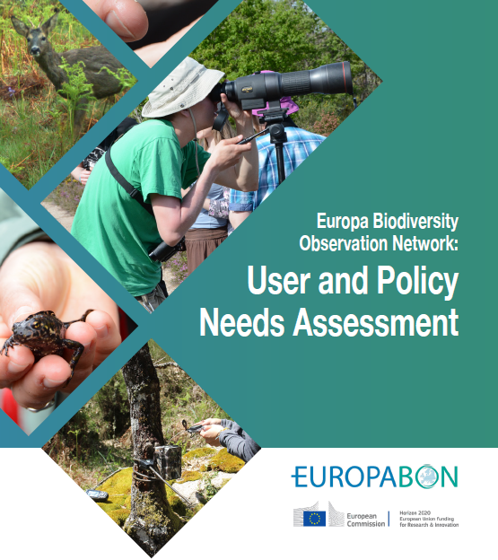
Context
Essential Biodiversity Variables
EBVs
Essential Ecosystem Service Variables
EESVs
EuropaBON (2022) ranked EBVs/EESVs for answering key policy questions for EU policy and legal frameworks
The top one-third included species abundance and distribution, community abundance and ecosystem distribution variables linked to specific taxa, ecosystems or other entities
Many EBVs mapped to existing indicators for reporting on the assessment of conservation status of habitat and species in the Habitats Directive (Article 17) and EBVs also have potential use for the assessment of "good" condition of habitats and species under several EU Directives
Current monitoring at the EU level is biased towards protected areas and species (birds and mammals), with gaps in habitats, ecosystems, and genetic diversity monitoring
OBSGESSION aims to address these gaps to help inform the development of RS biodiversity products and to better support EU policy needs
https://preprints.arphahub.com/article/84517/list/9/
Notes:
To first provide some context, in 2022, EuropaBON published a User and Policy Needs Assessment, where they identified and ranked by importance to national policy-making, Essential Biodiversity Variables (EBVs) and Essential Ecosystem Service Variables (EESVs) required to answer key policy questions for EU policy and legal frameworks (such as the Birds Directive, Habitats Directive and the EU Restoration Law).
They found that the top one-third of EBVs included species abundance, species distribution, community abundance and ecosystem distribution variables linked to specific taxa, ecosystems or other entities.
They also found that many EBVs map to existing indicators for reporting on the assessment of conservation status of habitat and species in the Habitats Directive under Article 17.
And EBVs have the potential for use in the assessment of "good" condition of habitats and species under several EU Directives such as the Marine Strategy Framework Directive and the Water Framework Directive.
However, the assessment also highlighted several biases in current monitoring schemes under EU Directives.
For example, they found a strong bias towards the monitoring of protected areas and species, particularly birds and mammals, as well as significant gaps in the monitoring of habitats, ecosystems and genetic diversity at the EU level, suggesting that existing EU monitoring schemes may not support the full range of biodiversity policy needs.
OBSGESSION aims to address some of these biases and gaps to help inform the development of RS biodiversity products to better support EU policy needs.

Slide 3
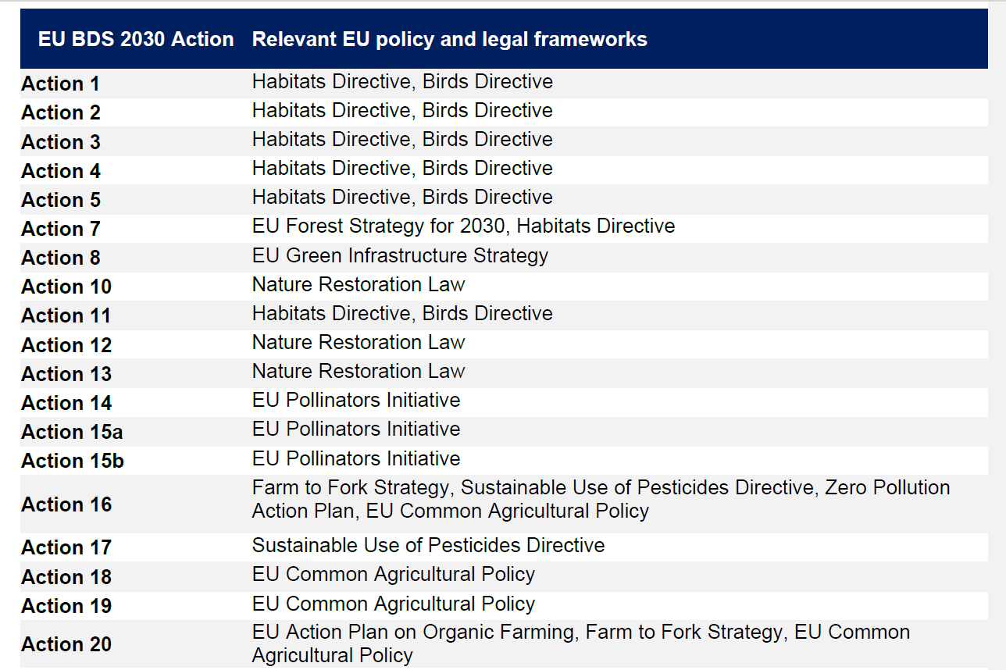
Policy Landscape
Overview of links between the actions of the EU BDS 2030 and relevant EU policy and legal frameworks, where applicable, based on mapping carried out under this task
Notes:
Recognizing existing mapping efforts like EuropaBON’s, we focused our review on the EU Biodiversity Strategy for 2030 (EU BDS 2030), which serves as the overarching framework for the EU’s biodiversity-related policies and legislation. Its overarching objective is to put Europe’s biodiversity on the path to recovery by 2030 for the benefit of people, climate and the planet. Each EU biodiversity Strategy action represents a concrete policy need and, therefore, provides an entry point where EBVs could be used to support the implementation of the strategy.
Based on mapping carried out under this task, we provided an overview of the links between the actions of the EU BDS 2030 (an example is provided in this table) and relevant EU policy and legal frameworks, where applicable. This included, but was not limited to, the Habitats Directive, Birds Directive, Water Framework Directive, Nitrates Directive and EU Nature Restoration Law.
Therefore, under Task 1.1, the needs of biodiversity policy at the EU level were identified through the framework provided by the EU BDS 2030.

Slide 4
OBSGESSION Policy Landscape and Needs Assessment
Aim: to identify a set of priority EBV candidates based on policy needs, as articulated in the EU Biodiversity Strategy for 2030.
Notes:
As such, our OBSGESSION Policy Landscape and Needs Assessment aimed to identify priority EBV candidates based on policy needs, as articulated in the EU Biodiversity Strategy.

Slide 5
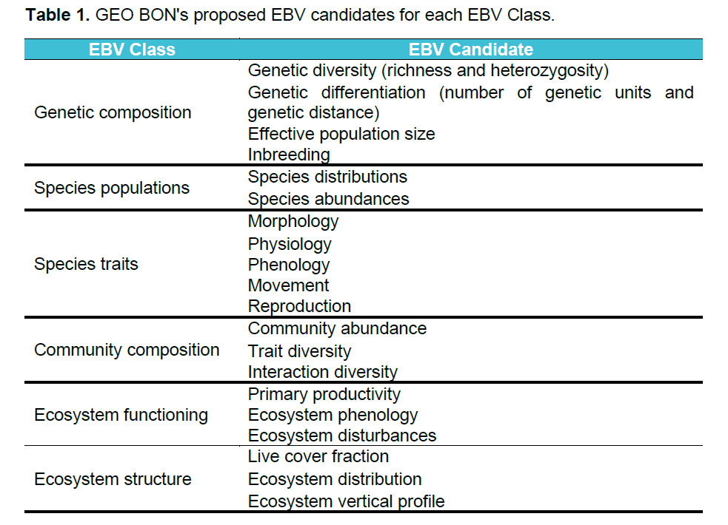
Methods
EU Biodiversity Strategy for 2030
102 actions and sub-actions
16 Indicators
Notes:
So how did we do this.
We started by reviewing the 102 actions and sub-actions outlined in the EU Biodiversity Strategy, along with the 16 indicators that were available on the EU BDS 2030 Dashboard at the time of writing.
Then, we mapped these actions and indicators to the 21 EBV candidates, grouped into six classes, as proposed by GEO BON. The GEO BON EBV framework, endorsed by the Convention on Biological Diversity (CBD), was used to ensure consistency with established EBV frameworks and to facilitate integration with global biodiversity monitoring efforts.

Slide 6
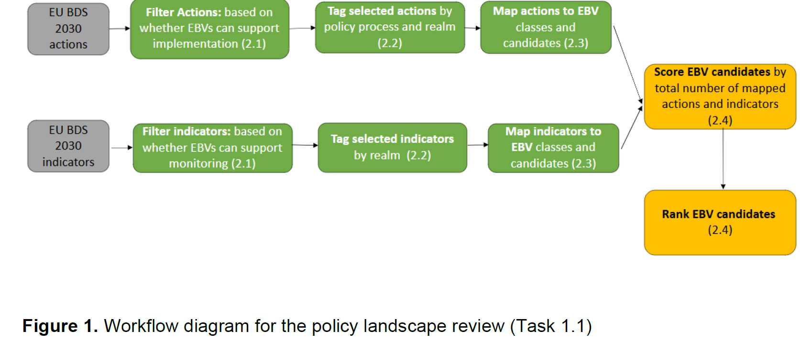
Methods
Notes:
Now, looking at the workflow.
To identify where EBVs could support policy needs, actions were filtered based on whether EBVs could broadly support their implementation, and indicators were filtered based on whether EBVs could be used to meet their data requirements.
This resulted in a dataset of EBV-applicable EU BDS 2030 actions and indicators.
These actions and indicators were subsequently tagged according to their relevance to different stages of the policy process, as well as tagged by ecosystem realm.
We then mapped the actions and indicators to specific EBV classes and candidates – and ranked these from high to low policy priority based on the number of actions and indicators that they were mapped to, both overall and within specific policy processes and ecosystem realms.
Candidates linked to the greatest number of actions and indicators were considered the highest policy priority.

Slide 7
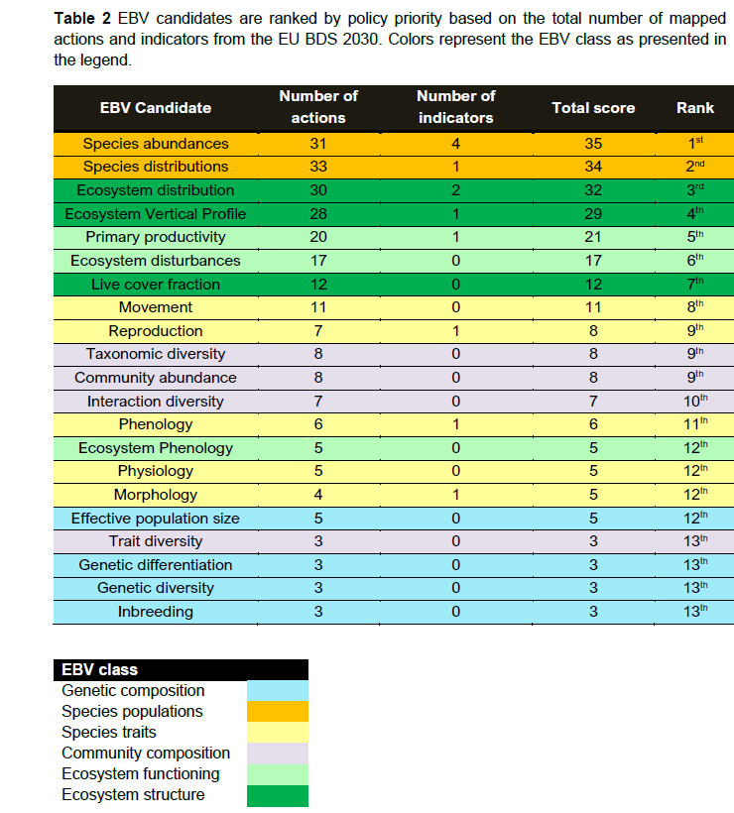
Results: EBV Candidates Overall Ranking
The review found that EBVs could broadly be used to support the implementation of 37 (out of 102) actions and the monitoring of five (out of 16) indicators.
Overall, the species abundance candidate ranked 1st in terms of policy priority, followed by species distributions (2nd), ecosystem distribution (3rd) and ecosystem vertical profile (4th), with markedly higher total scores than other candidates.
Notes:
Our review found that EBVs could broadly be used to support the implementation of 37 (out of 102) actions from the EU BDS and the monitoring of five (out of 16) indicators from the Strategy’s dashboard.
Overall, the species abundance candidate ranked 1st in terms of policy priority, followed by species distributions (2nd), ecosystem distribution (3rd) and ecosystem vertical profile (4th).

Slide 8
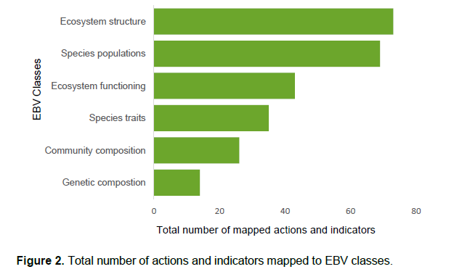
Results: EBV Classes Overall Ranking
At the broader class level, the ecosystem structure and species population class were mapped to the highest number of actions and indicators. The genetic composition class had the lowest overall ranking.
These rankings may reflect biases in current EU biodiversity policies towards the ecosystem and species level, and less policies addressing genetic diversity.
They could also reflect differences in technical feasibility for monitoring different EBV candidates and classes.
Notes:
At the broader class level, the ecosystem structure class was mapped to the highest number of actions and indicators, with all three of its candidates ranking in the top one-third of the candidate ranking list.
The species population class followed, driven by the high rankings of species abundances (1st) and species distributions (2nd). However, it received a lower overall score compared to the ecosystem structure class, because it only includes two candidates.
The genetic composition class had the lowest overall ranking, being mapped to only 14 actions/indicators in total.
These rankings may reflect biases in current EU biodiversity policies towards the ecosystem and species level, with less policies addressing genetic diversity.
Or the outcomes could reflect differences in technical feasibility for monitoring different EBV candidates and classes.

Slide 9
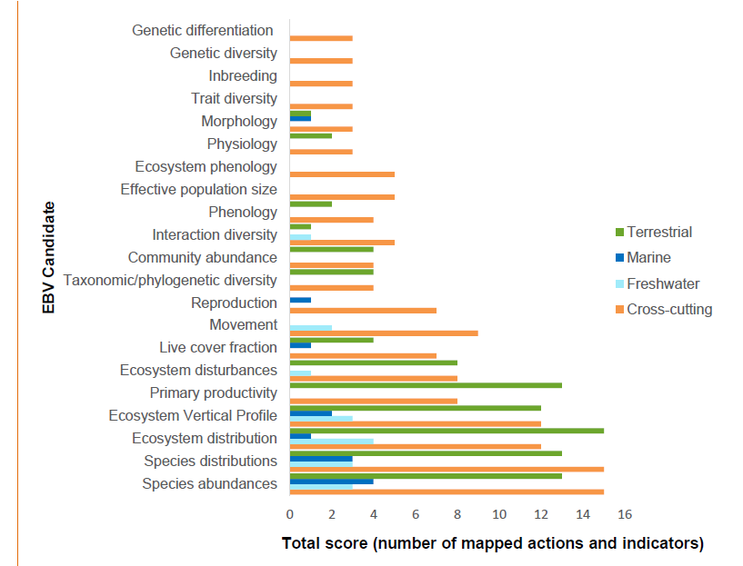
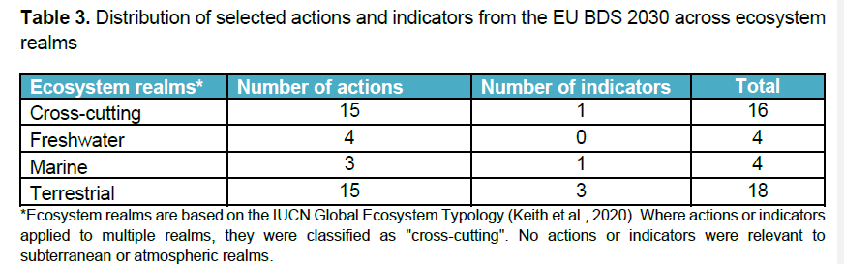
Results: EBV Candidates Ranking across ecosystem realms
Notes:
Looking at ecosystem realms, here we aimed to identify whether certain EBV candidates are more relevant to policy needs within specific realms.
Selected actions and indicators were assigned to the freshwater, marine or terrestrial realms or as cross-cutting.
As shown in the table, the majority of selected actions were categorized as either cross-cutting or terrestrial, with 15 actions each, while only four actions were assigned to the freshwater realm and three to the marine realm.
Similarly, most of the selected indicators (3 indicators) were assigned to the terrestrial realm.
As we can see from the figure on the right, the rankings by ecosystem realm largely support the overall EBV ranking, with species abundances, species distributions, ecosystem distribution, and ecosystem vertical profile consistently being mapped to the highest number of actions and indicators across all realms.

Slide 10
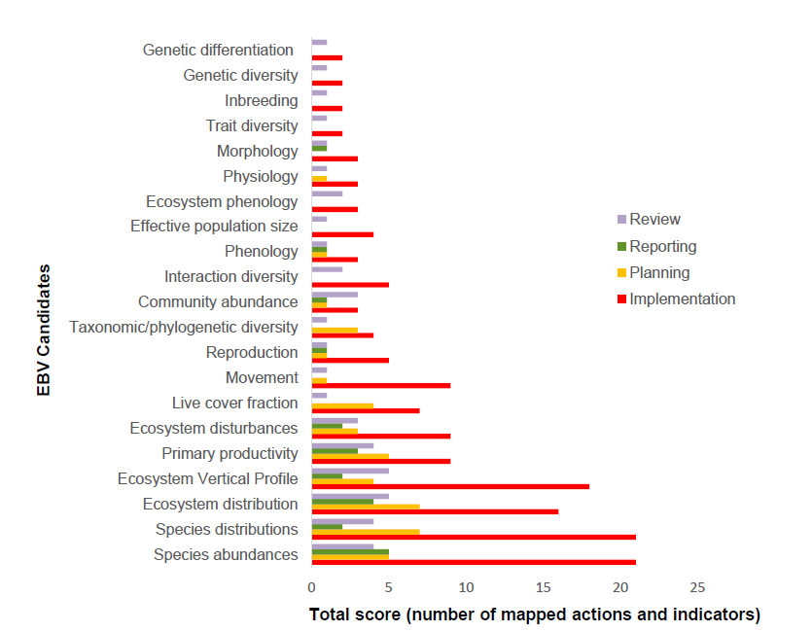
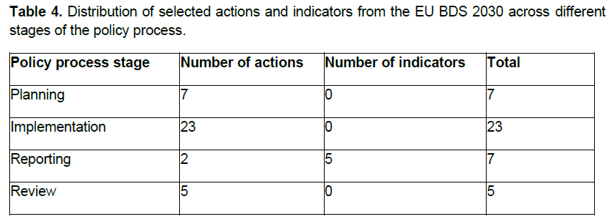
Results: EBV Candidates Ranking across stages of the policy process
Notes:
Looking across policy processes, here we aimed to assess the importance of different EBV candidates at various stages of the policy cycle—planning, implementation, review, and reporting.
Actions were tagged based on which stage they were most relevant to, whereas all five indicators were categorized under "reporting”.
The distribution of selected actions showed that most actions (23 out of 37 Actions) were relevant to the implementation stage, followed by policy planning, review, and reporting.
Again, these results support the overall ranking of EBV candidates, with the top four candidates being consistently ranked as the highest priority EBV candidates across all policy stages.
Similarly, genetic composition candidates rank low across all stages.
Notably, ecosystem-level EBVs ranked higher in the review stage with ecosystem distribution and ecosystem vertical profile ranking first, compared to second and third overall potentially reflecting the need for more ecosystem-scale data for policy review processes.
Similarly, species distribution and ecosystem distribution were ranked as joint-top priorities for the planning stage, potentially highlighting the importance of distribution data for policy planning.
However, these results are constrained by the relatively small number of actions linked to the planning, reporting, and review stages. As a result, even minor differences in candidate scores within realms can lead to shifts in ranking.

Slide 11

Conclusions
Top four EBV Candidates: Species abundance, species distribution, ecosystem distribution and ecosystem vertical profile
Markedly higher scores compared to other candidates
Consistently ranked among the top four candidates across ecosystem realms and policy stages
Rankings broadly consistent with EuropaBON Assessment, except ecosystem vertical profile (low priority in EuropaBON)
Recommendation to prioritize species abundance, species distribution and ecosystem distribution for meeting EU policy needs and RS-biodiversity product development under OBSGESSION
Ecosystem vertical profile requires further consideration of policy relevance
Notes:
Overall, the top four ranked EBV candidates in terms of policy priority are species abundance, closely followed by species distributions, ecosystem distribution and ecosystem vertical profile, which fall under the species population and ecosystem structure classes.
These candidates had markedly higher scores compared to other candidates, highlighting their strong relevance for monitoring, and implementing a wide range of actions and indicators from the EU BDS 2030.
They were also consistently ranked among the top four candidates across different ecosystem realms and stages of the policy process, indicating their importance to multiple dimensions of biodiversity policy.
These rankings are to some extent consistent with the EBV rankings from the EuropaBON Assessment, except for ecosystem vertical profile which was ranked as a low policy priority.
As such, based on the results of our review and the EuropaBON assessment, species abundance, species distribution, and ecosystem distribution candidates are recommended to be prioritized to meet policy needs at the EU level, and also for the development of RS-biodiversity products under OBSGESSION to best address EU policy needs.
Concerning the ecosystem vertical profile candidate, further consideration may be required to determine the policy priority, which could be verified through interviews with policy makers.

Slide 12
Limitations
Broad nature of many of the actions from the EU BDS 2030 - allowed for a range of interpretations of potential implementation approaches and data needs and consequently led to a range of potentially relevant EBVs.
E.g., the broad applicability of ecosystem structure and function EBV candidates could have led to an overestimation of their policy priority compared to how actions are implemented in practice.
The lack of a relevance scoring system - prioritization of EBVs was solely based on the number of actions and indicators they supported rather than the importance of each EBV for specific actions or indicators.
The lack of contextualization - the approach did not fully consider technical feasibility, knowledge/ data gaps, or capacity to monitor EBVs.
Notes:
However, the approach used in this policy landscape review has several limitations that may have affected the prioritization of EBV candidates.
One key limitation was the broad nature of many of the actions from the EU BDS 2030, which allowed for a range of interpretations of potential implementation approaches and data needs and consequently led to a range of potentially relevant EBVs being mapped.
This was particularly evident when mapping actions compared to indicators, as indicators had clearer data needs and were typically associated with only one or two EBVs.
The broad applicability of EBV candidates from the ecosystem structure and function classes, which can support multiple aspects of biodiversity monitoring, may have resulted in their frequent mapping. This could have led to an overestimation of their policy priority compared to how actions are implemented in practice.
Another limitation was that the prioritization of EBVs was solely based on the number of actions and indicators they supported rather than the importance of each EBV for specific actions or indicators.
The lack of a relevance scoring system meant that all mappings carried equal weight, which could have led to the over or under-ranking of certain candidates.
The lack of contextualization may have also limited the accuracy of the prioritization exercise, as the approach did not fully consider technical feasibility, knowledge/data gaps, or capacity to monitor EBVs. Some of these factors may be considered as part of further work under this Work package as part of the Science Policy Traceability Matrix (SPTM), under Task 1.2.

Slide 13

Next Steps:
D1.5 Policy landscape and needs(update)
Refine mapping through interviews with policy makers and practitioners
Introduce a relevance scoring system
Look at global commitments (e.g., Kunming Montreal Global Biodiversity Framework)
Take into consideration new information needs with respect to new strategies, policies and monitoring requirements
Look at Directives and policies with less well-established monitoring schemes
Notes:
Finally, onto the next steps.
This policy landscape review presents an initial approach that will be expanded throughout the project life cycle, with a report update due in June 2026.
Here, I have highlighted some of the next steps that we could take to update this review.
Firstly, to address the limitations mentioned, a refinement of our mapping could be achieved through interviews with policy makers and practitioners with experience in knowledge needs at regional, national, and sub-national levels. Engaging policy makers with an understanding of how actions are implemented in practice would help improve the accuracy of the EBV mapping process.
Additionally, introducing a relevance scoring system could address the potential overemphasis on ecosystem structure and function variables and provide a more precise prioritization of EBVs.
Furthermore, OBSGESSION could now look at mapping EBV needs to global commitments such as the Kunming-Montreal Global Biodiversity Framework. A set of EBVs that are aligned with the monitoring framework of the KMGBF could be used to support planning, monitoring, reporting and review activities in line with the KMGBF's goals and targets.
We could also take into consideration new information needs with respect to new EU strategies, policies and monitoring requirements.
And finally, we may look at Directives and policies with less well-established monitoring schemes.

Slide 14

Thank you
Natasha Ali, UNEP-WCMC
natasha.ali@unep-wcmc.org
obsgession.eu
obsgession_
OBSGESSION_HorizonEurope
OBSGESSION receives funding from the European Union's Horizon Europe research and innovation programme under grant agreement No. 101134954. Views and opinions expressed are those of the author(s) only and do not necessarily reflect those of the European Union or the European Research Executive Agency (REA). Neither the EU nor the European Research Executive Agency (REA) can be held responsible for them.

