Slide 1

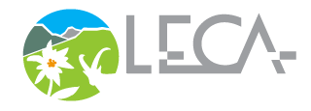




Internal Seminar
Detection & Attribution Modelling Framework
Joaquim Estopinan
Anne Thomas
Pierre Gaüzère / CNRS
Miriam Beck
Wilfried Thuiller
Lori Giagnacovo / VITO
Jussi A. Mäkinen / SYKE
October 29th 2025 / Online
obsgession.eu

Slide 2
Introduction
Joaquim Estopinan, Anne Thomas & Wilfried Thuiller

Slide 3
Agenda
Time (CET) | Session | Presenters
2.00 - 2.25 | Introduction Context, definitions & contribution map Thomas et al. (2025) presentation + Q&A | Joaquim Estopinan, CNRS Wilfried Thuiller, CNRS Anne Thomas, CNRS
2.25 - 3.00 | DAM conceptual basis & macroecological approach Schrodt et al. (2025) presentation + Q&A Gaüzère et al. (2025) presentation + Q&A | Miriam Beck, CNRS/FRB Pierre Gaüzère, CNRS
3.00 - 3.10 | ~~ Coffee break ~~
3.10 - 3.30 | NaviDAM decision tool Overview How to contribute + Q&A | Joaquim Estopinan, CNRS
3.30 - 3.55 | Applying the DAM framework Schrodt et al. (2025) application NaviDAM application Your application / Q&A | Jussi Mäkinen, SYKE Lori Giagnacovo, VITO Joaquim Estopinan, CNRS
3.55 - 4.00 | Conclusion Summary + last Q&A | Wilfried Thuiller, CNRS Joaquim Estopinan, CNRS

Slide 4
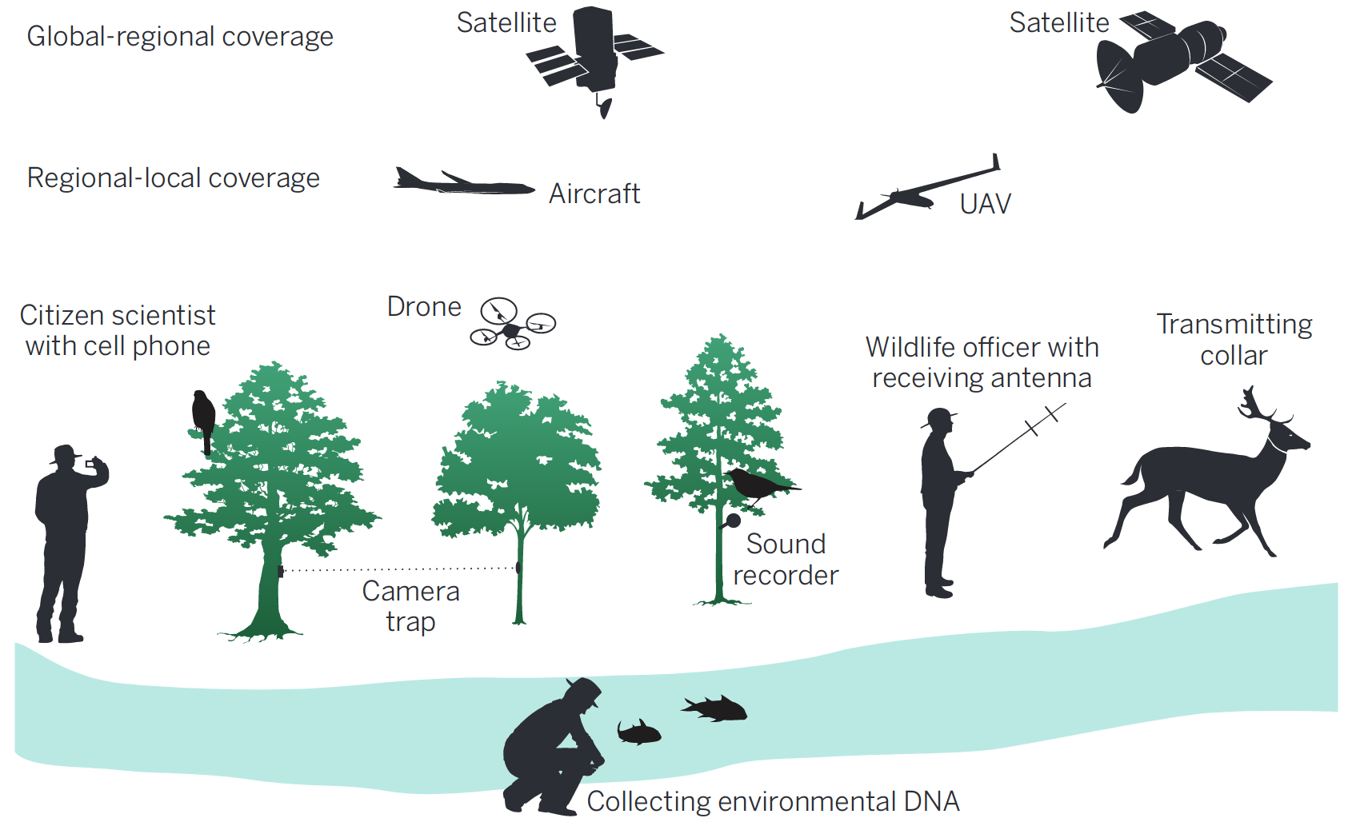
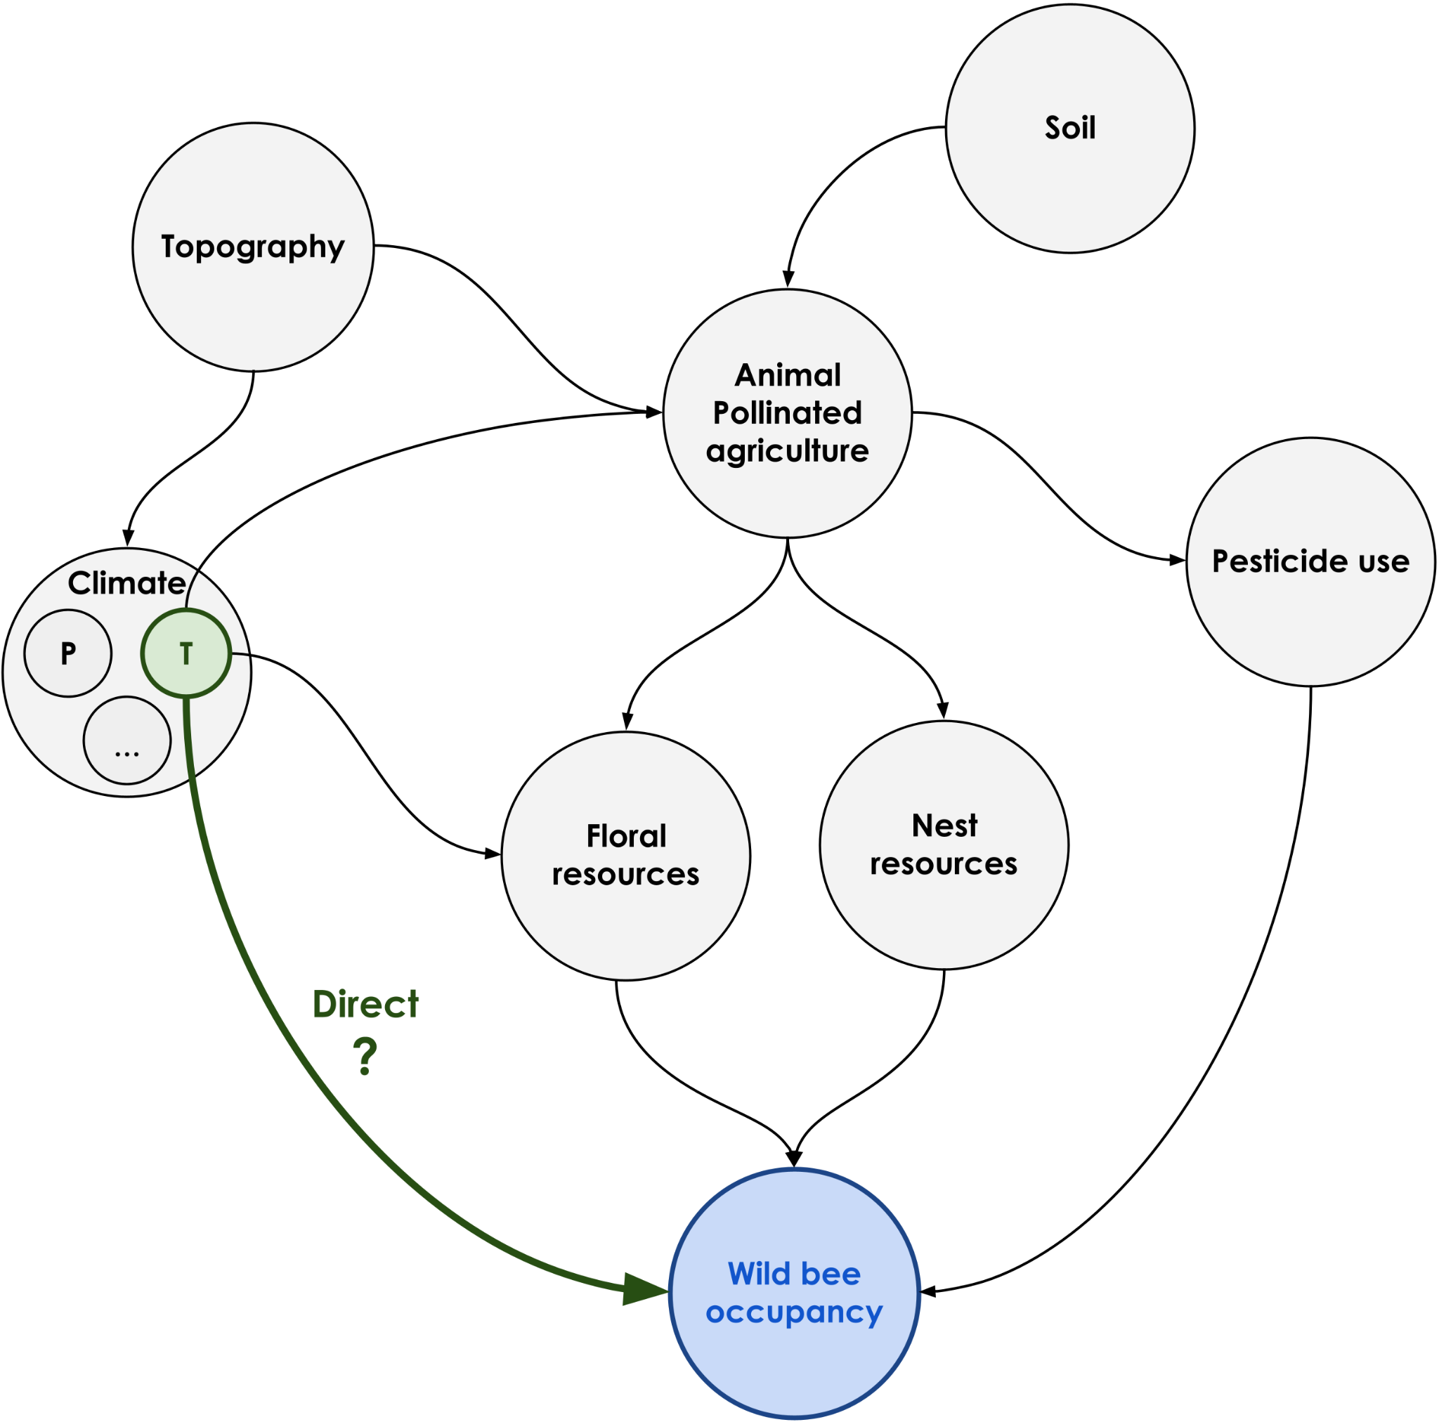

Biodiversity loss…
Monitored from increasing observational data sources
Resulting from blurry & entangled anthropogenic processes
How can observed and large-scale biodiversity changes be properly attributed to processes using the ever-increasing sources of data?
Correlation is not causation ⚠
Turner, Woody. "Sensing biodiversity." (2014)
Guzman, Laura Melissa et al. "Impact of pesticide use on wild bee distributions across the United States." (2024)

Slide 5
Some definitions
Detection | The process of demonstrating that a measure of biodiversity has changed relative to a baseline or reference distribution characterizing undisturbed variation (counterfactual state), or an appropriate model-derived null expectation of biodiversity change in the absence of a human driver(s) (from Gonzalez et al., 2023)
Attribution | The process of evaluating the relative contributions of multiple potential causal factors (drivers) to a detected biodiversity change, with an assignment of statistical confidence to the causal models used to estimate these effects (from Gonzalez et al., 2023)
Causal relationship | X → Y can be considered a causal relationship if variations in X propagate to subsequent variations in Y
Causal effect | For a given causal relationship, a magnitude measure quantifying how variation in the treatment impacts change in the outcome. Causal effects can be quantified with different metrics, depending on the study scale, objective and method applied. The most common metric is the average treatment effect (ATE)
Schrodt et al. "Advancing causal inference in ecology: Pathways for biodiversity change detection and attribution." (2025)
Gonzalez et al. “A framework for the detection and attribution of biodiversity change.” (2023)

Slide 6
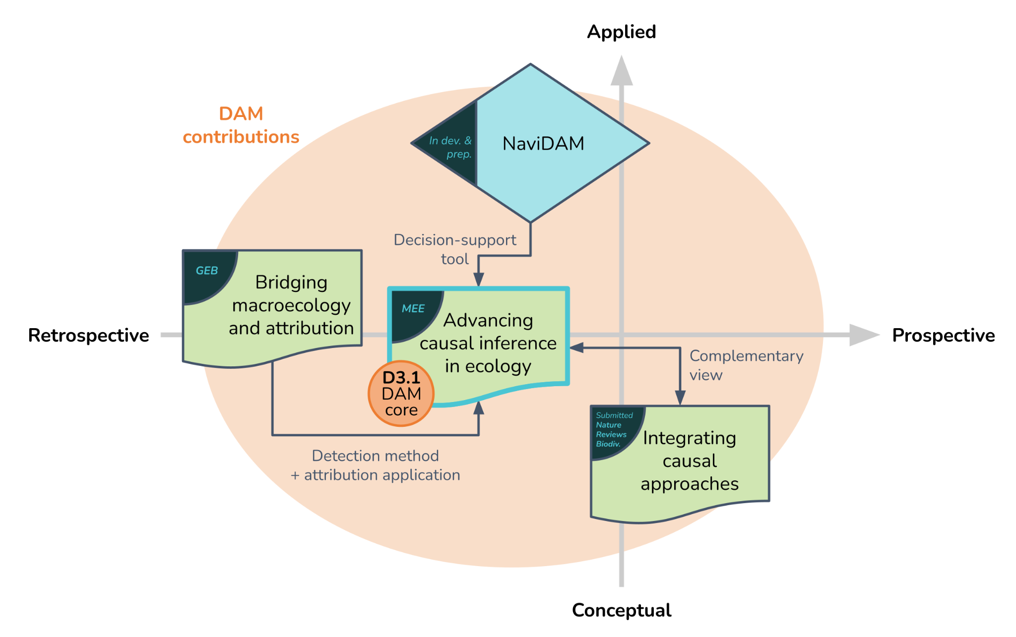
Contribution map

Slide 7
Complementary causal approaches to support biodiversity change attribution
Thomas A., Thuiller W., Gonzalez A., in revision with Nature Reviews - Biodiversity

Slide 8
Motivations
Place (detection and) attribution in a larger causal methodological context
Provide conceptual framework combining retrospective and prospective attribution
Compare strengths and weaknesses of attribution approaches
Promote complementary causal approaches and lines of evidence to increase confidence/robustness of attribution

Slide 9
Goals of attribution
Bridge a core scientific aim, understanding the causes of observed patterns, and the conservation mandate of actionable, quantitative information for decision-makers.
Overarching goals of attribution:
  (1) elucidate human impacts on biodiversity, disentangling them from natural driver variability,
  (2) quantify and assess the relative causal importance of different drivers,
  (3) communicate actionable attribution statements to inform biodiversity policy and interventions.

Slide 10
Challenges
Inherent complexity of causal networks in ecological systems
Data limitations and measurement/methodological challenges
Need for long-term commitment, collaboration, resources, and leadership

Slide 11
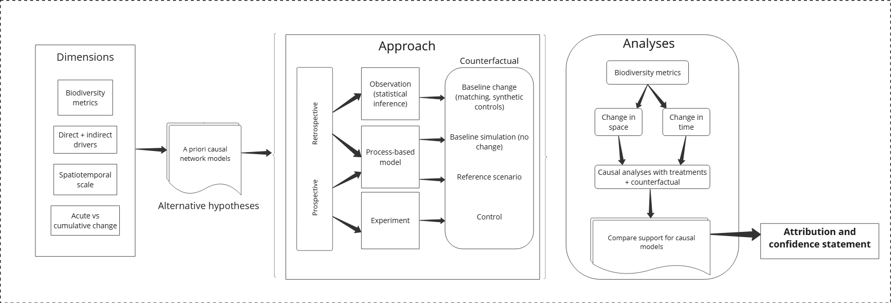
An Attribution Framework

Slide 12
Framework: Dimensions
Objectives and Dimensions
  Biodiversity metrics: e.g., species richness, population abundance, functional diversity
  Direct + indirect drivers: e.g. land-use change, climate change, pollution, invasive species
  Spatiotemporal scales
  Acute vs. cumulative change: abrupt changes (droughts, disease outbreaks, regional conflicts) or chronic, long-term trends?

Slide 13
Framework: Causal models
Hypotheses and causal models
  Causal model: Graphical, mathematical, or verbal representation of hypothesized causal network
  Alternative hypotheses = multiple models
  An investigation in itself: domain knowledge, experiments, etc.
  * Foundational to any causal analysis *

Slide 14
Framework: Approaches
Causal approaches: Intervention- and counterfactual-based methods for attributing causes and quantifying their effects
Counterfactual: what would have happened without the driver(s) in question

Slide 15
Framework: Retrospective vs. prospective attribution
Retrospective
  Reconstruct causal relationships after outcomes have occurred, using naturally observed variations.
  Statistical inference and quasi-experimental approaches (or process-based modeling)
  Common in conservation and biodiversity monitoring
Prospective
  Test or validate hypothesized causal mechanisms before/as outcomes occur, through designed interventions or controlled manipulations.
  Experimental and process-based modeling approaches
  More common in academic settings, but see adaptive management

Slide 16
Framework: Retrospective vs. prospective attribution
Retrospective
  Reconstruct causal relationships after outcomes have occurred, using naturally observed variations.
  Statistical inference and quasi-experimental approaches (or process-based modeling)
  Common in conservation and biodiversity monitoring
Prospective
  Test or validate hypothesized causal mechanisms before/as outcomes occur, through designed interventions or controlled manipulations.
  Experimental and process-based modeling approaches
  More common in academic settings, but see adaptive management

Slide 17
Framework: analysis and attribution statement
Analyses: includes standard methods like regression, occupancy modeling, etc.
Compare change in space or time between treatment and counterfactual
Compare statistical support for different casual models
    Attribution and confidence statement: Communicate clearly the contributions of drivers to biodiversity change and associated confidence

Slide 18
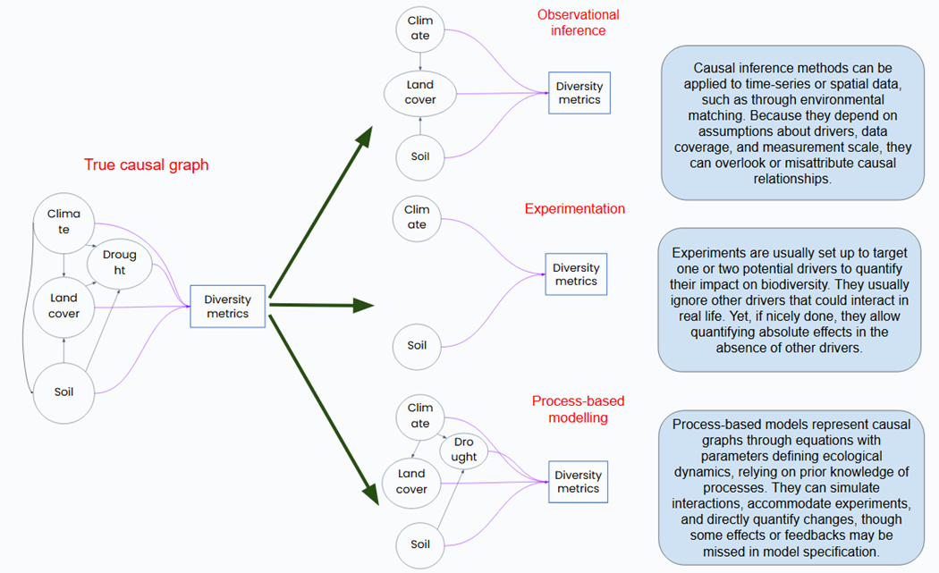
Causal approaches: Strengths and weaknesses

Slide 19
Retrospective: Observational inference
Method examples
  Structural causal modeling: use DAGs and a set of logical rules to select variables and reduce bias -> run standard statistical analyses
    DAG = directed acyclic graph
  Quasi-experimental design: approximate control and treatment groups and derive a counterfactual from natural settings
    Matching
    Regression discontinuity design
    Synthetic control with time series
  Instrumental variables, two-way fixed effects, etc: control for unknown confounding relationships through model structure

Slide 20
Retrospective: Observational inference
Strengths
  Enables inference from real-world systems where experiments are infeasible or unethical
  Captures long-term, emergent, or large-scale dynamics
Limitations
  Susceptible to confounding and other sources of bias
  Strong assumptions and high-quality data required
  Causality is inferred, not demonstrated

Slide 21
Prospective: Experiments
Features
  Controlled environments (grassland plots, lake mesocosms, warming chambers)
  Manipulate drivers like nutrients, pollutants, warming, fire, etc (typically only one or few)
  Identify direction and strength of drivers for further study
Example
  Long-term grassland nitrogen addition at Cedar Creek, Minnesota
  Increased nutrients = ↓ plant niche diversity = ↑ productivity, ↑ light competition, ↓ plant diversity

Slide 22
Prospective: Experiments
Strengths
  Provides direct evidence for causal mechanisms through controlled perturbation
  Aids prediction of system response to hypothetical interventions
Limitations
  Limited scalability and external validity
  Often expensive or impossible for large or slow systems (e.g. entire ecosystems)
  Also involves assumptions that can be overlooked

Slide 23
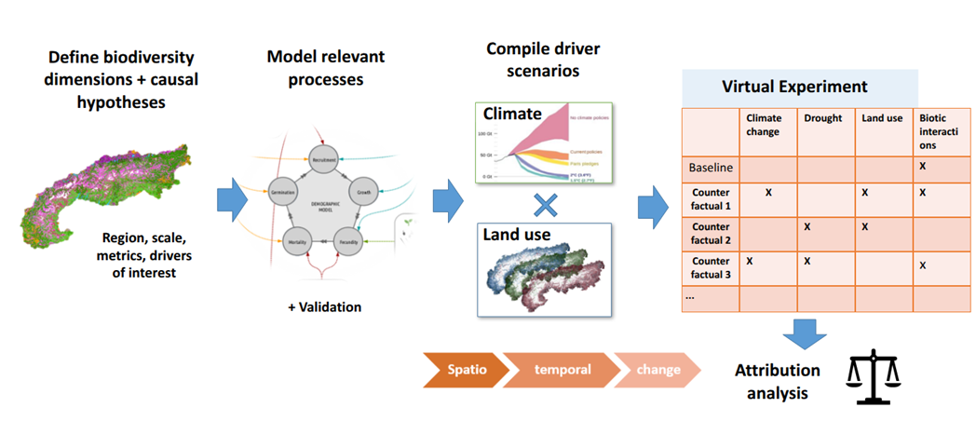
Prospective: Process-based modeling
Features: Dynamic equations and simulation models represent causal networks directly
Example: Future driver scenarios with dynamic vegetation model (FATE-HD)

Slide 24
Prospective: Process-based modeling
Strengths
  Easily manipulated and flexible spatiotemporal scale
  Simulations can directly model counterfactual conditions
  Allows future projections under different driver scenarios
Limitations
  Requires knowledge of system and coding expertise
  Data for parameterization can be scarce
  Computational barriers for finer scale and complexity

Slide 25
Conclusion: A need for complementarity
Existing tools in ecology are already useful for attribution, given causal framing
Key elements:
  Conceptual causal models
  Explicit causal assumptions
  Counterfactuals
  Communicate confidence
Combine and iterate between multiple approaches and lines of evidence

Slide 26
Q&A session
I. Introduction
Context, motivations & definitions
Contribution map
Plan
Anne’s article
Q?
A

Slide 27
DAM conceptual basis &
macroecological approach
Miriam Beck & Pierre Gaüzère

Slide 28
Advancing causal inference in ecology: Pathways for biodiversity change detection and attribution
Schrodt F., Beck M., Estopinan J., Bowler D. E., Fontaine C., Gaüzère P., ... & Thuiller W. (2025)

Slide 29
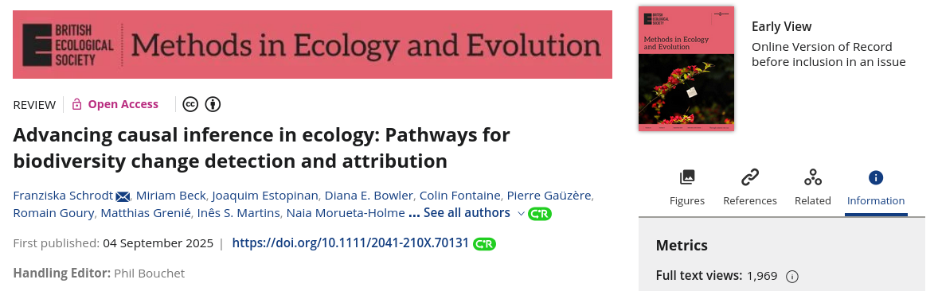
D3.1 | Detection & Attribution Modelling Framework

Slide 30
D3.1 | Detection & Attribution Modelling Framework
-> Challenges for D&A
correlation vs. prediction/association vs. causation
Detecting directional change (from observational data)
- data scarcity and non-random sampling, scale dependency, data mismatch
Complexity of mechanistic understanding
- lack of direct measurement, non-linearity/lags, feedback loops and context-dependent effects
Methodological and computational barriers
- (presumable) lack of expertise, data failing strict statistical requirements
Defining baselines in a changing world

Slide 31
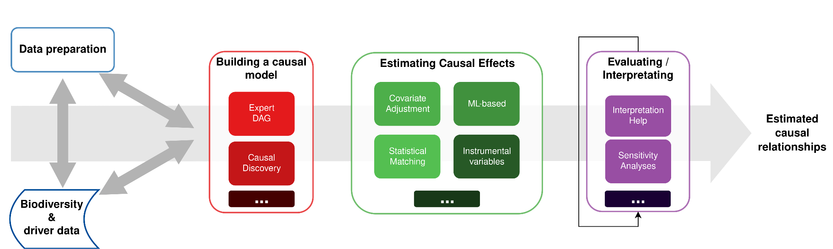
D3.1 | Detection & Attribution Modelling Framework
Workflow from data to estimated causal relationships
NaviDAM
suggests suited
methods
causal inference = multi-step process!

Slide 32
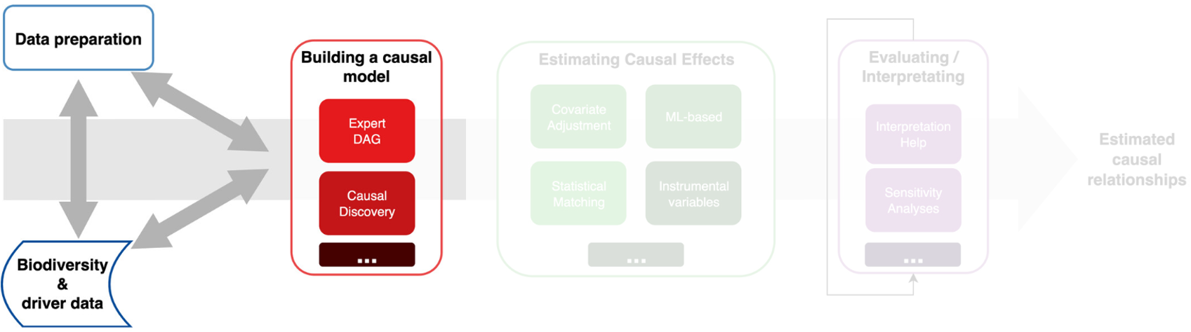
D3.1 | Detection & Attribution Modelling Framework
Workflow from data to estimated causal relationships

Slide 33
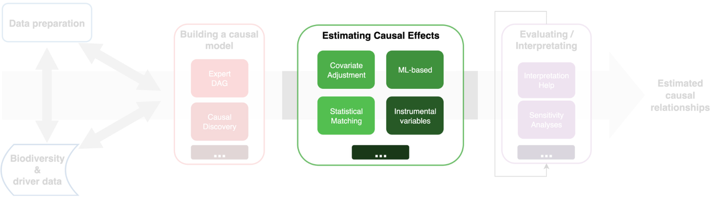
D3.1 | Detection & Attribution Modelling Framework
Workflow from data to estimated causal relationships

Slide 34
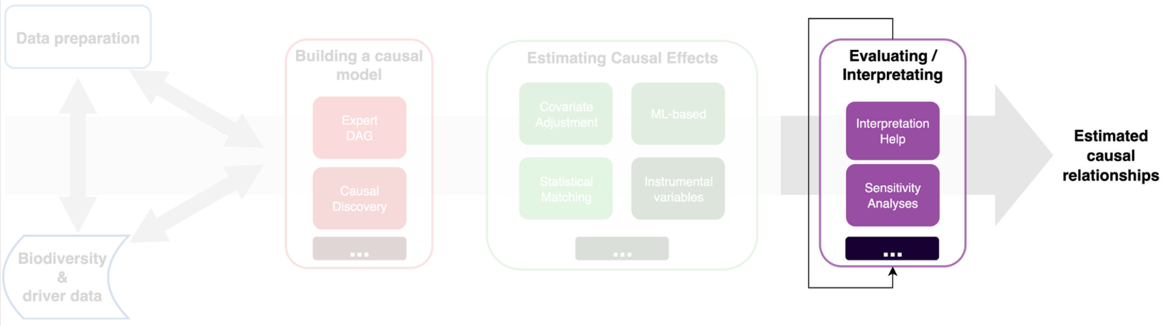
D3.1 | Detection & Attribution Modelling Framework
Workflow from data to estimated causal relationships

Slide 35
D3.1 | Detection & Attribution Modelling Framework
Workflow from data to estimated causal relationships
NaviDAM
suggests suited
methods
causal inference = multi-step process!

Slide 36
Q&A session
II. DAM conceptual basis & macroecological approach
MEE article
  DAM workflow
Q?
A

Slide 37
Bridging Macroecology and Temporal Dynamics to Better Attribute Global Change Impacts on Biodiversity
Gaüzère P., Violle C., Schrodt F., ... & Thuiller, W. (2025)

Slide 38
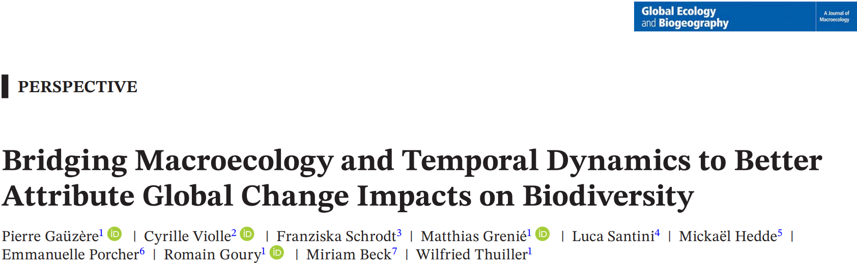
https://doi.org/10.1111/geb.70086

Slide 39
<bridging macroecology and time to attribute diversity changes>
the problem
  diversity trends differ across scales → lack of consensus
  alpha, beta, gamma are often compared at loosely defined “local” vs “regional” scales.
idea
  track temporal change in diversity-scaling relationships (integrate trends from local to regional continuously).
  leverage development in macroecology to attribute diversity changes via three components
  add traits and a causal lens to move from description to attribution.

Slide 40
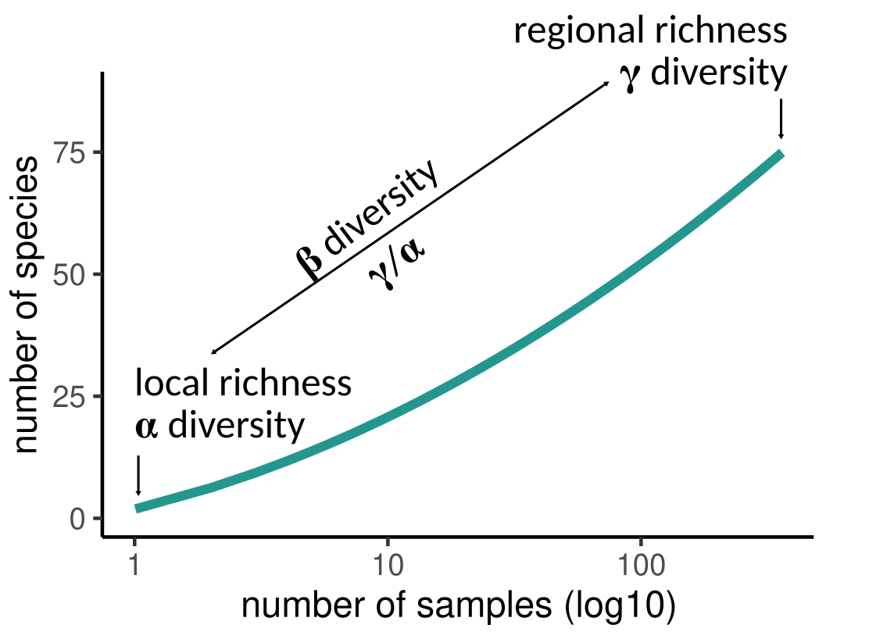
<why dynamic diversity-scaling>
species accumulation curves (SACs) summarize richness from one to many sites
different α/γ combinations map to predictable SAC shifts
  clarify when “no net local change” coexists with regional loss or homogenization

Slide 41
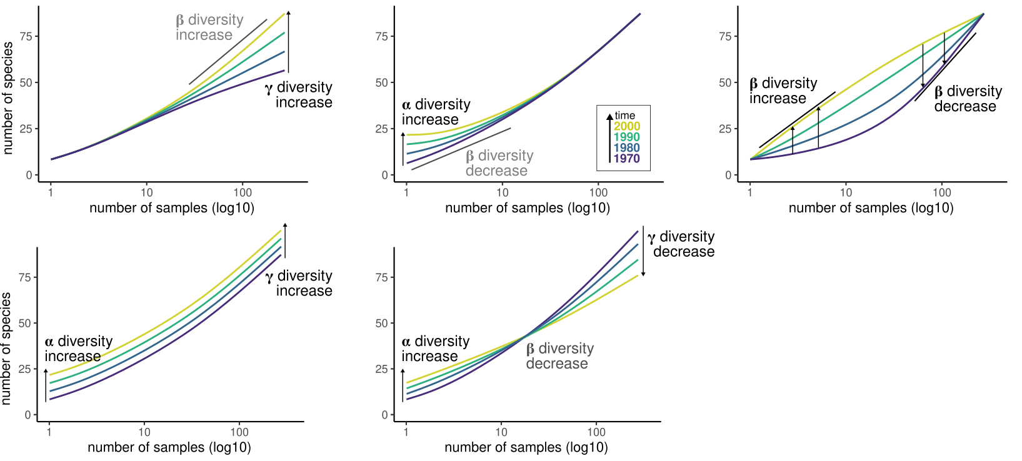
<why dynamic diversity-scaling>

Slide 42
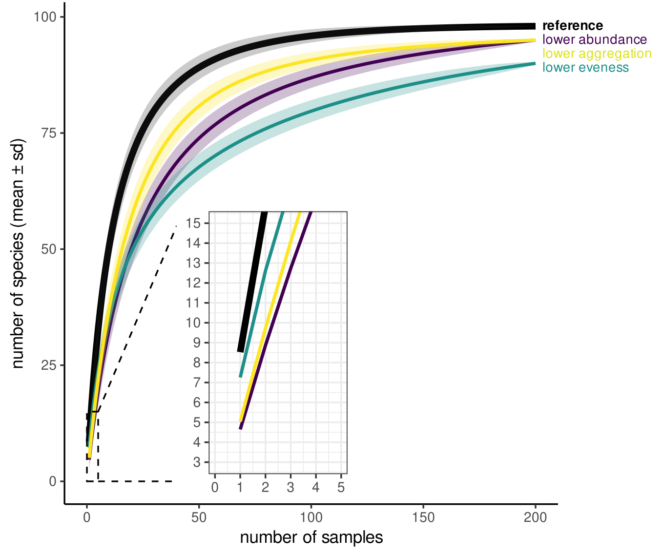
<three proximate components underpins SAC>
SAC changes stem from three “proximate” components
  total abundance (density N)
  evenness (SAD),
  spatial aggregation
MOB approach can distinguish each component effect
Can be applied to understand what underlies temporal changes of diversity across scales !

Slide 43
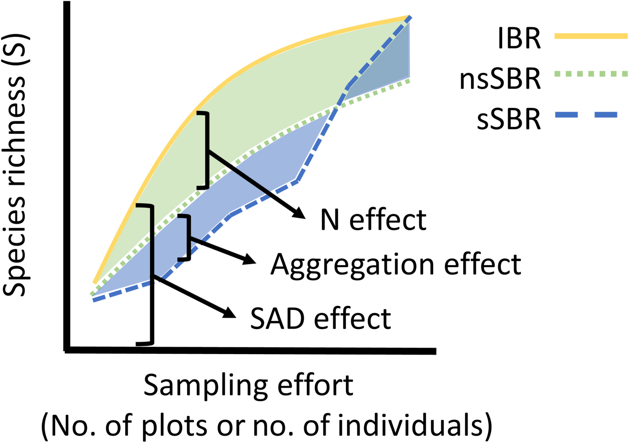
<three proximate components underpins SAC>
SAC changes stem from three “proximate” components
  total abundance (density N)
  evenness (SAD),
  spatial aggregation
MOB approach can distinguish each component effect
Can be applied to understand what underlies temporal changes of diversity across scales !

Slide 44
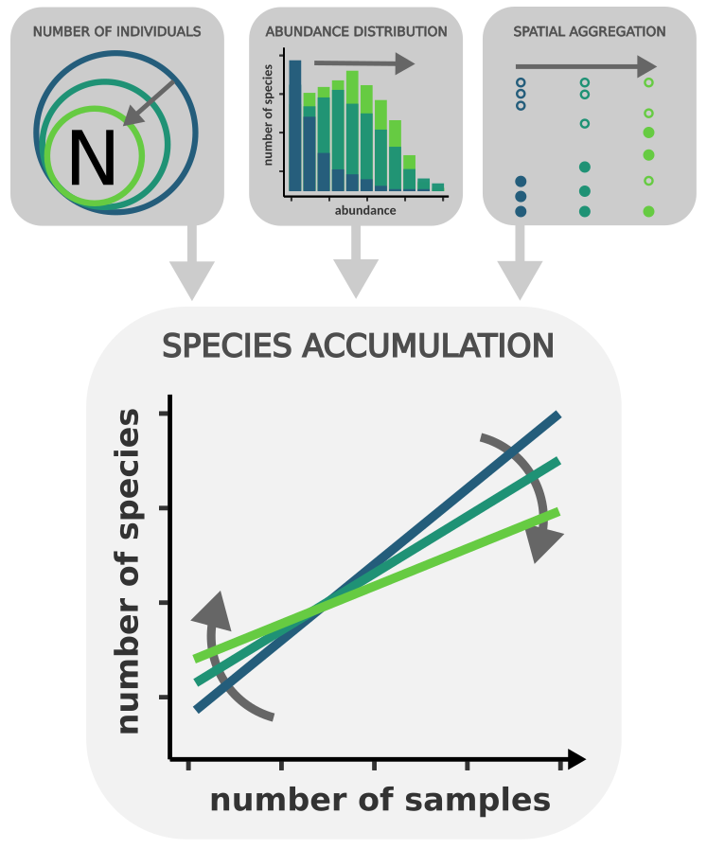
<three proximate components underpins SAC >
SAC changes stem from three “proximate” components
  total abundance (density N)
  evenness (SAD),
  spatial aggregation
MOB approach can distinguish each component effect
Can be applied to understand what underlies temporal changes of diversity across scales !
>time>

Slide 45
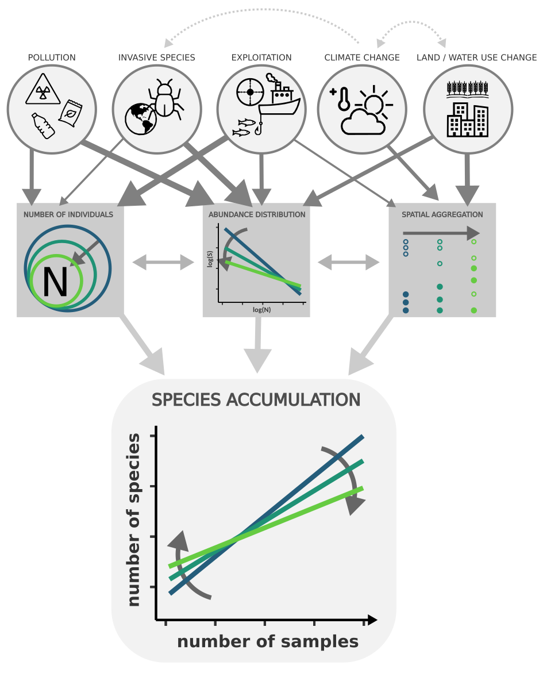
<adding causality and traits>
human
drivers
proximate
components
integrated
diversity
changes

Slide 46
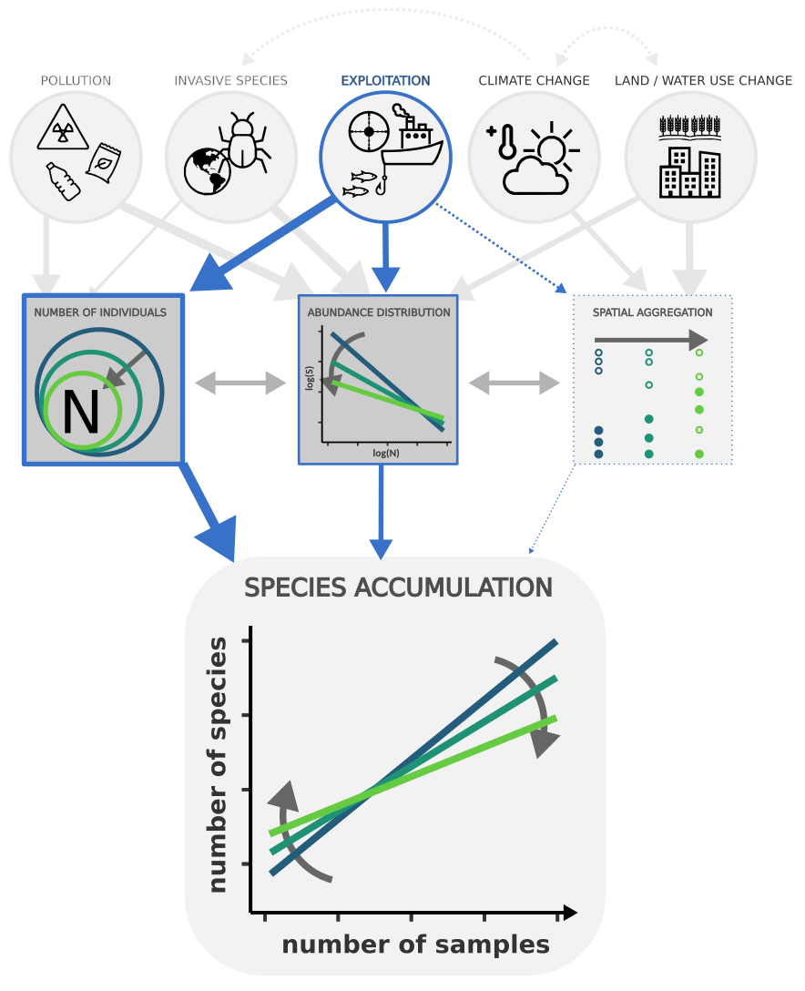
<adding causality and traits>
human
drivers
pathway for diversity change attribution to human exploitation
proximate
components
integrated
diversity
changes

Slide 47
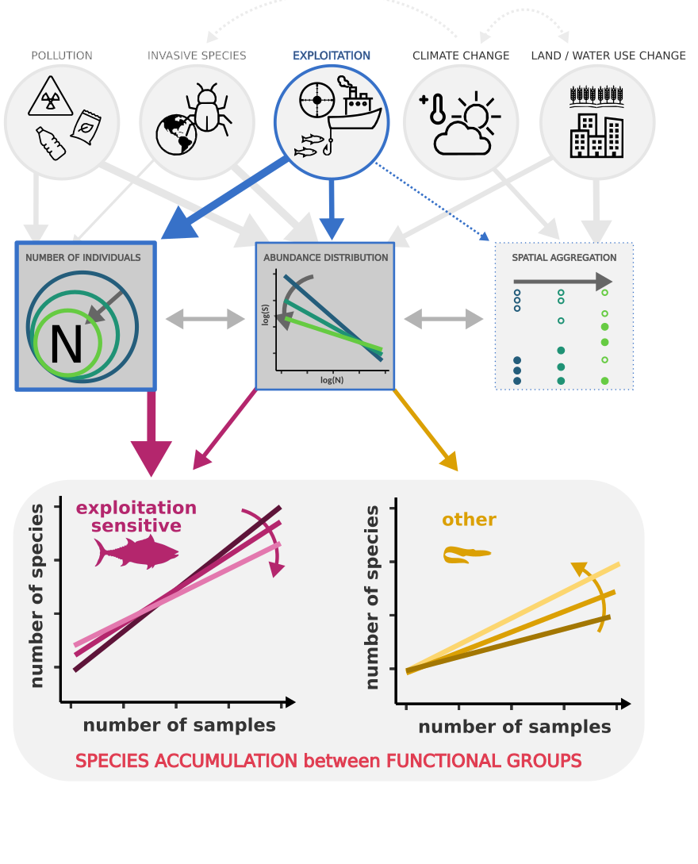
<adding causality and traits>
human
drivers
pathway for diversity change attribution to human exploitation
including trait-based comparison of
dynamic Species Accumulation !
proximate
components
integrated
diversity
changes

Slide 48
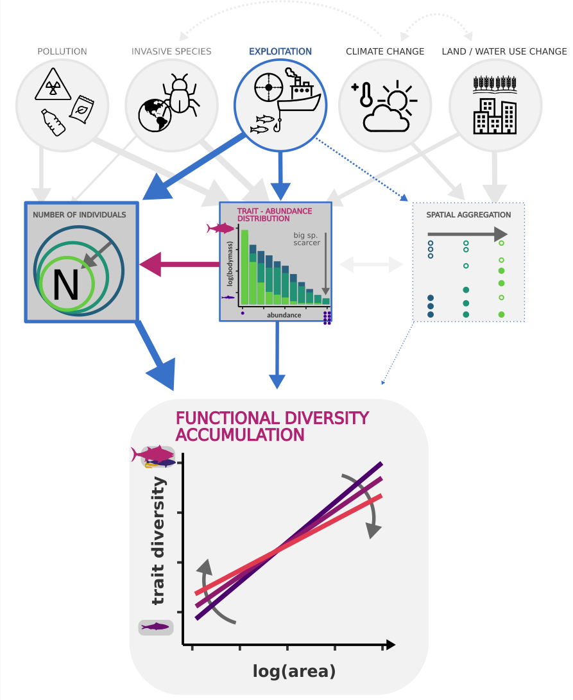
<adding causality and traits>
human
drivers
pathway for diversity change attribution to human exploitation
Including dynamic
Trait diversity
Accumulation !
proximate
components
integrated
diversity
changes

Slide 49
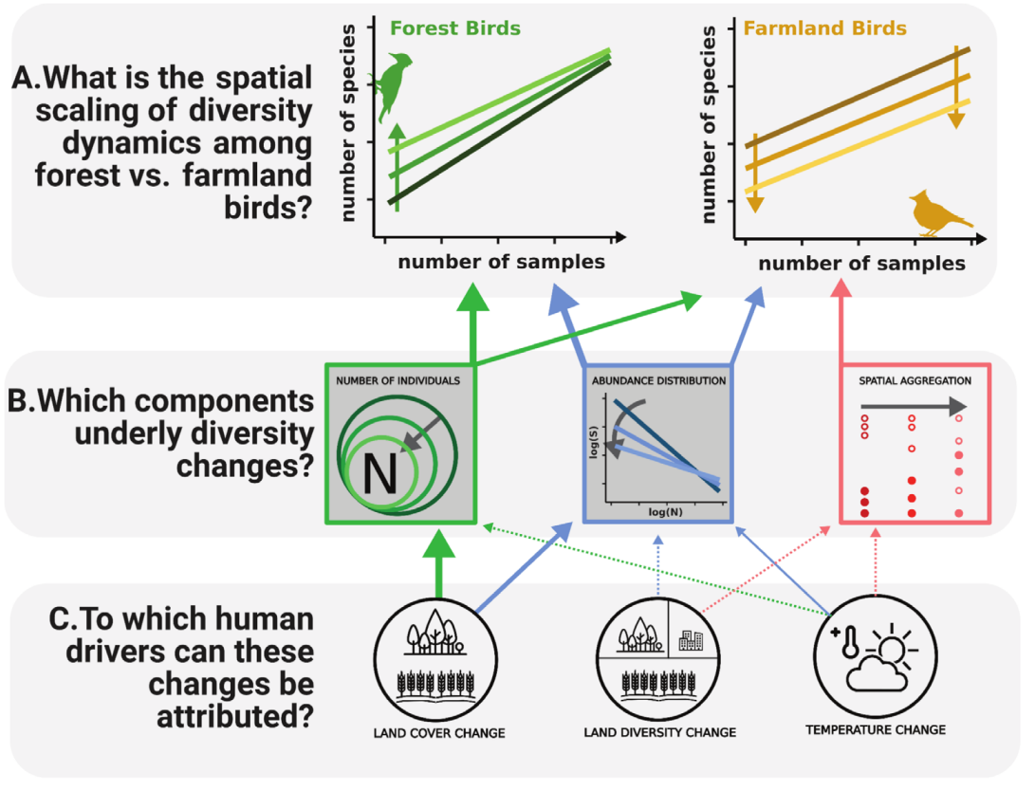
<case study: diversity change of birds>

Slide 50
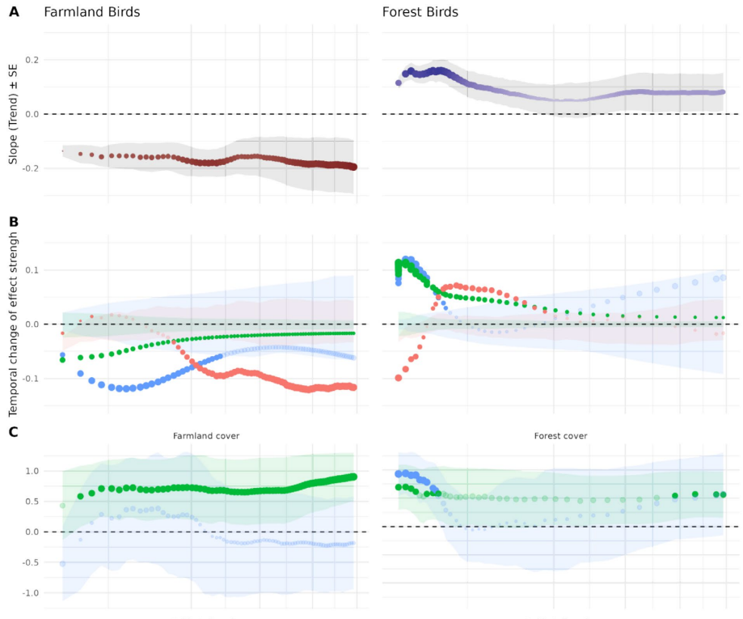
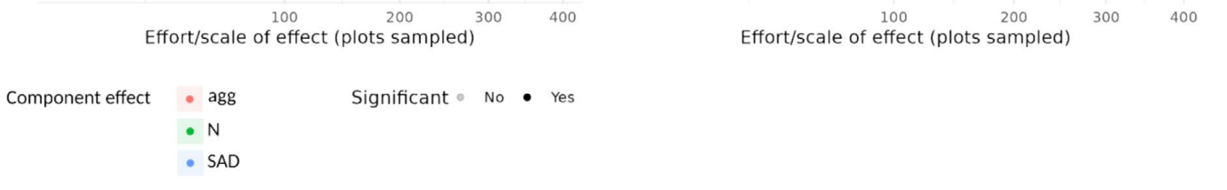
<case study: diversity change of birds>

Slide 51
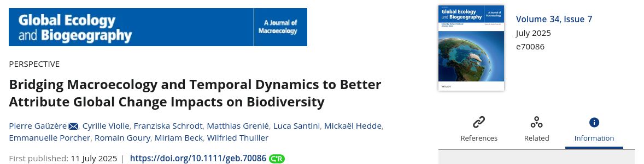
A perspective paper on Macroecology & attribution

Slide 52
Q&A session
II. DAM conceptual basis & macroecological approach
Pierre’s GEB article
Q?
A

Slide 53
~~ 10-min Coffee break ~~

Slide 54
NaviDAM decision tool
Joaquim Estopinan

Slide 55
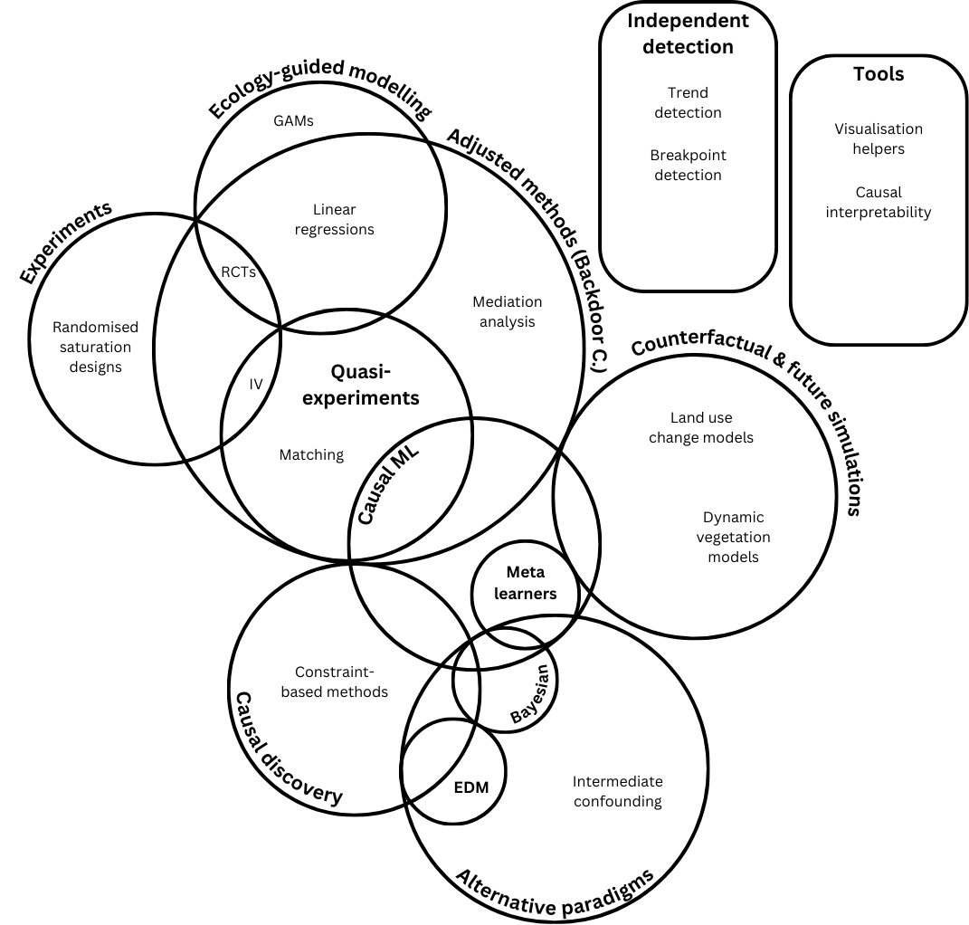
NaviDAM | Overview
Collaborative + updates
A website organised around a
dynamical method filtering tool
Users describe their study by assessing criteria with dropdown lists on:
  Objective
  Available data properties
  Affordable assumptions
  Desired model properties
  Programming language, etc.
↳ The selection gets refined to identify the set of suited methods

Slide 56
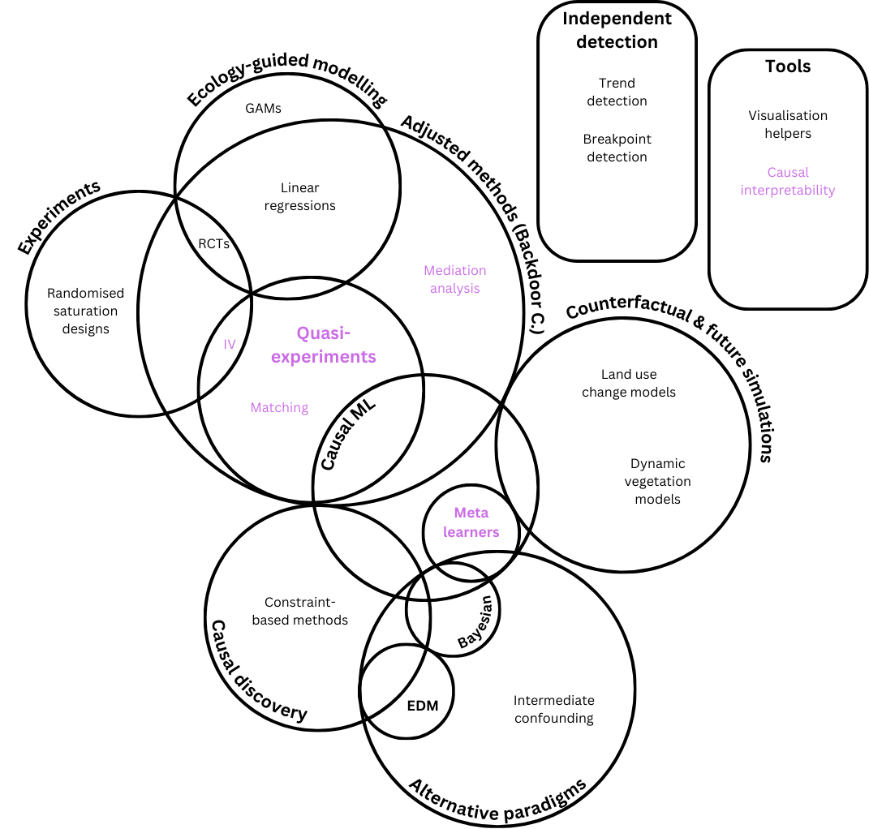
NaviDAM | Overview
Collaborative + updates
A blog-like website organised around a
dynamical method filtering tool
Users describe their study by assessing criteria with dropdown lists on:
  Objective
  Available data properties
  Affordable assumptions
  Desired model properties
  Programming language, etc.
↳ The selection gets refined to identify the set of suited methods

Slide 57
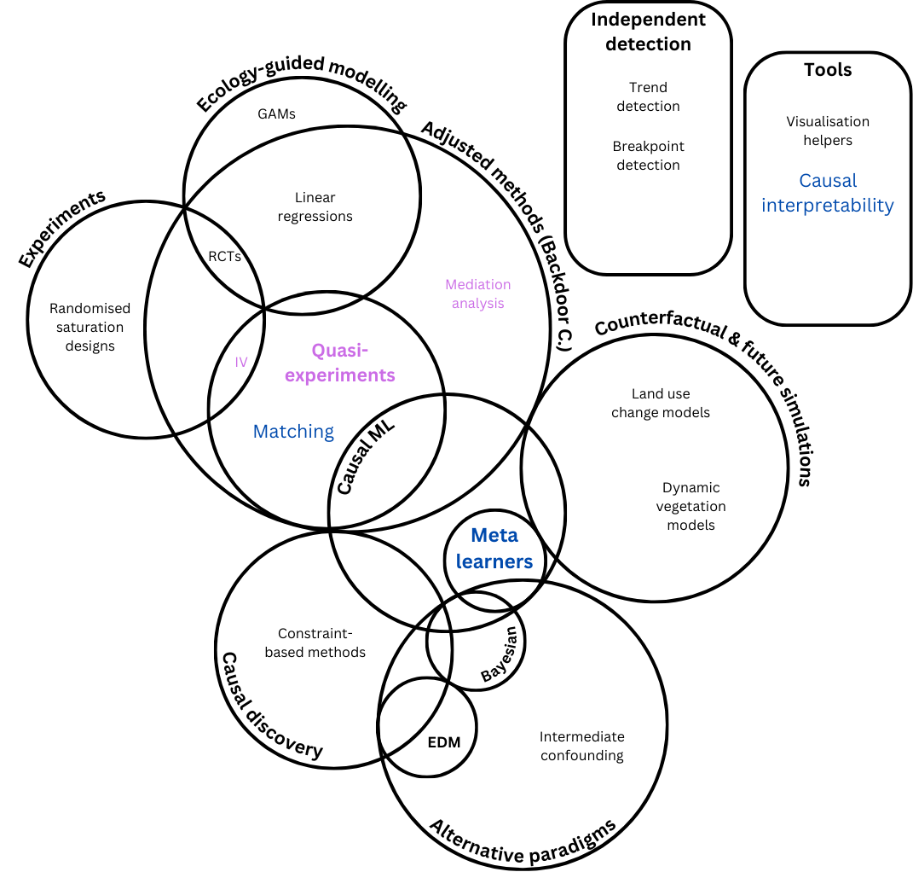
NaviDAM | Overview
Collaborative + updates
A blog-like website organised around a
dynamical method filtering tool
Users describe their study by assessing criteria with dropdown lists on:
  Objective
  Available data properties
  Affordable assumptions
  Desired model properties
  Programming language, etc.
↳ The selection gets refined to identify the set of suited methods

Slide 58
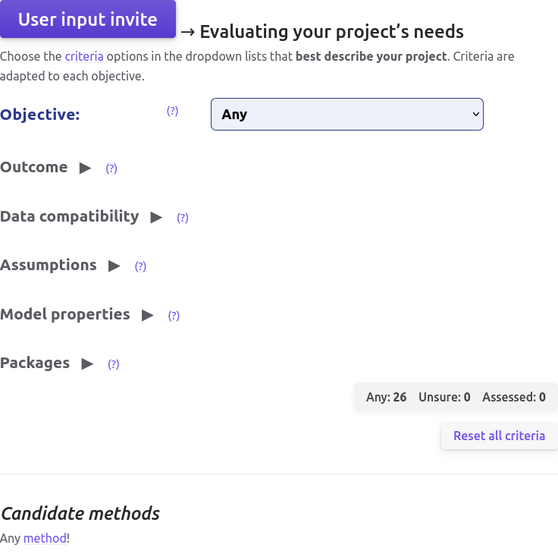
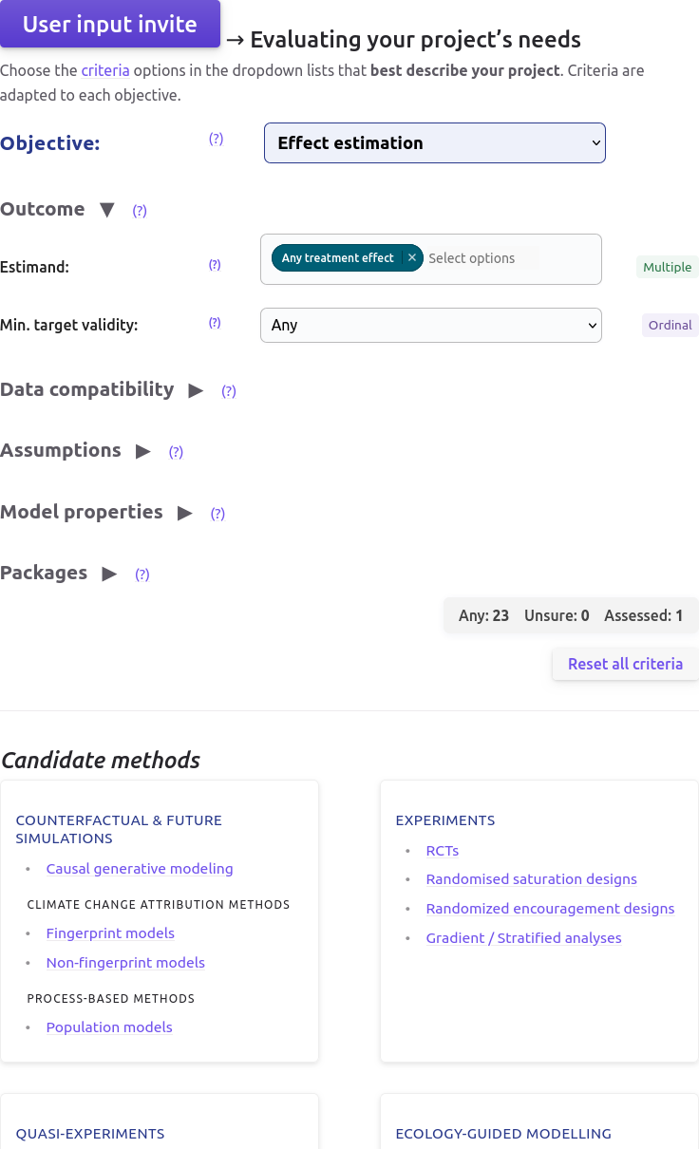
NaviDAM | Evaluating your project’s needs
Helper link redirecting to criteria description page
https://estopinj.github.io/dam/
→ Will be transfer on university servers later
→ Application example later in IV. Applying the DAM framework
Link to method documentation page

Slide 59
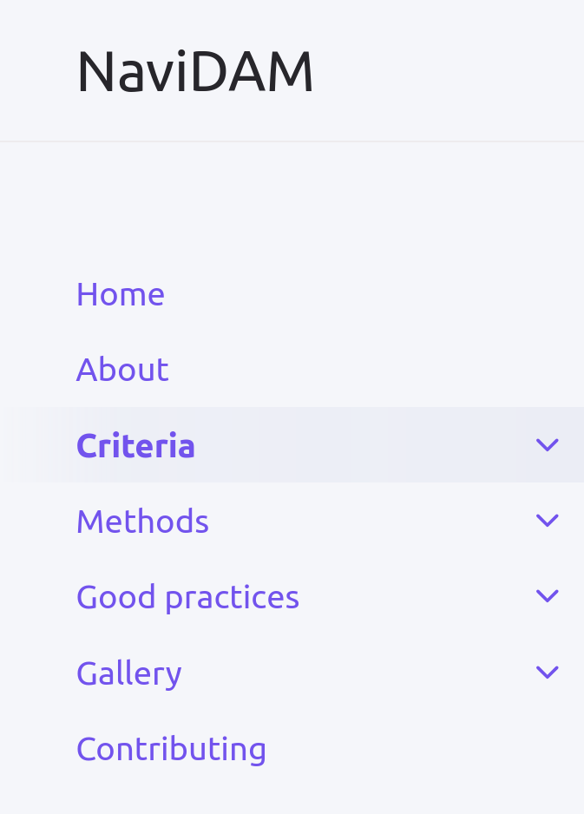
NaviDAM | Panels
https://estopinj.github.io/dam/
Criteria panel [1 page /criterion]
  Definition & explanation
  Tools/Rationale for helping assessment
  Assessment example
Good practices panel
  Adjustment & causal graphs
  Causal paradigms, cross methods, etc.
  Review articles
Method panel [1 page /method]
  Description, principle, variants
  Reference method article(s)
  Ref. research articles applying method
    w/o RS data for Ecology
  R/Python packages, usage
[+ code cells]
Gallery
  STOC & synthetic controls
  Other studies welcomed
→ Needs method selection tool ✔
& more method assessments ongoing

Slide 60
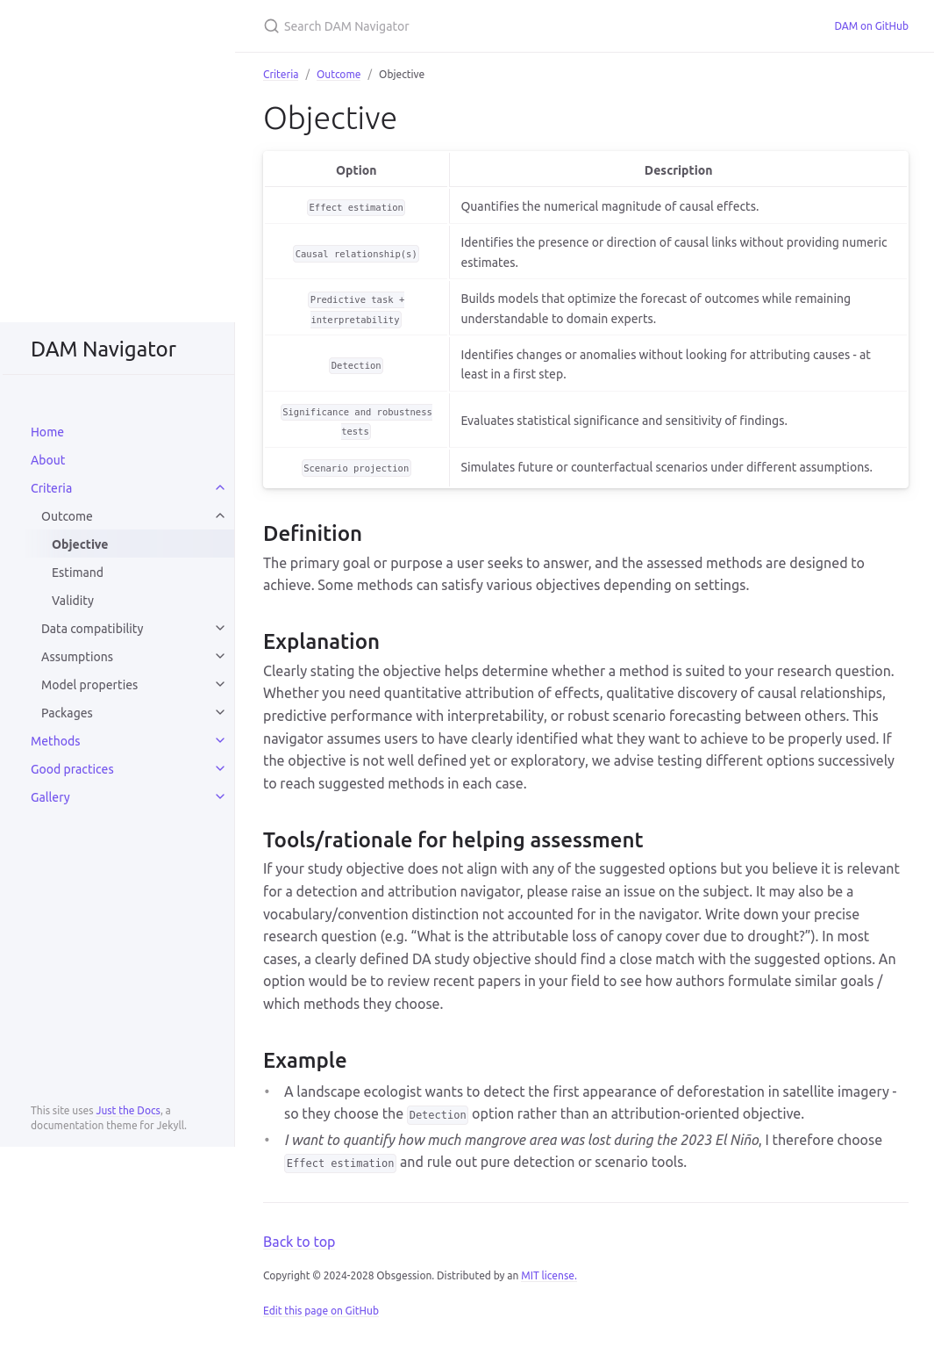
NaviDAM | Criteria Panel
Criteria page example: https://estopinj.github.io/dam/objective
→ Criteria are online and also described in NaviDAM_Criteria_Description_v1.docx
→ These criteria allows assessing methods in the
Excel| Method Assessment sheet [detailed after]
https://estopinj.github.io/dam/

Slide 61
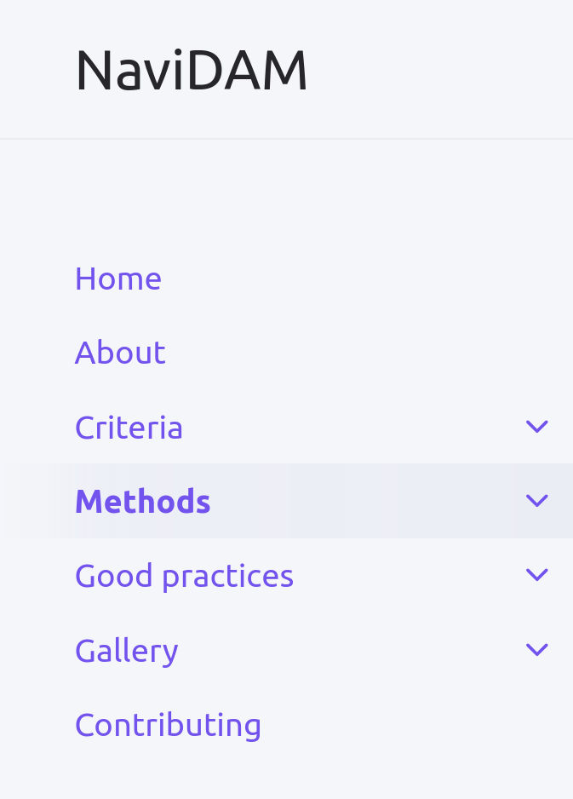
NaviDAM | Panels
https://estopinj.github.io/dam/
Criteria panel [1 page /criterion]
  Definition & explanation
  Tools/Rationale for helping assessment
  Assessment example
Good practices panel
  Adjustment & causal graphs
  Causal paradigms, cross methods, etc.
  Review articles
Method panel [1 page /method]
  Description, principle, variants
  Reference method article(s)
  Ref. research articles applying method
    w/o RS data for Ecology
  R/Python packages, usage
[+ code cells]
Gallery
  STOC & synthetic controls
  Other studies welcomed
→ Needs method selection tool ✔
& more method assessments ongoing

Slide 62
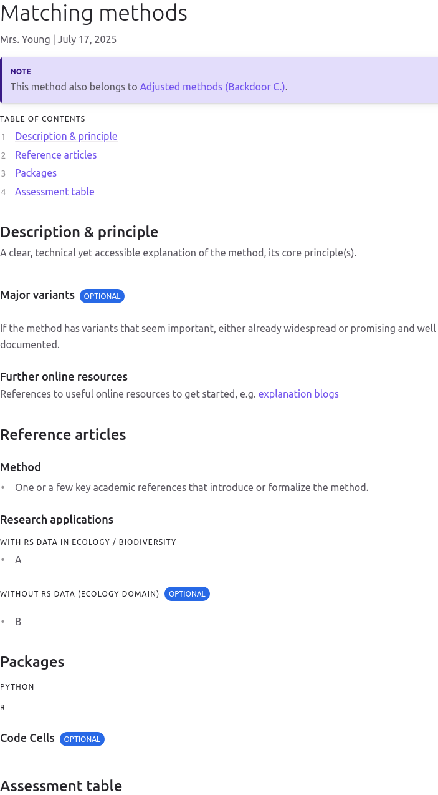
NaviDAM | Method Panel
Method page example: https://estopinj.github.io/dam/contents/methods/quasi-exps/synthetic_controls/
→ Need help with assessment, documentation & review of methods
Folder and template in SYKE sharepoint
Volunteers can still sign up for method assessment, documentation & review in Excel
To be completed in ~1 month when signed up
→ NaviDAM Contribution guide
https://estopinj.github.io/dam/

Slide 63
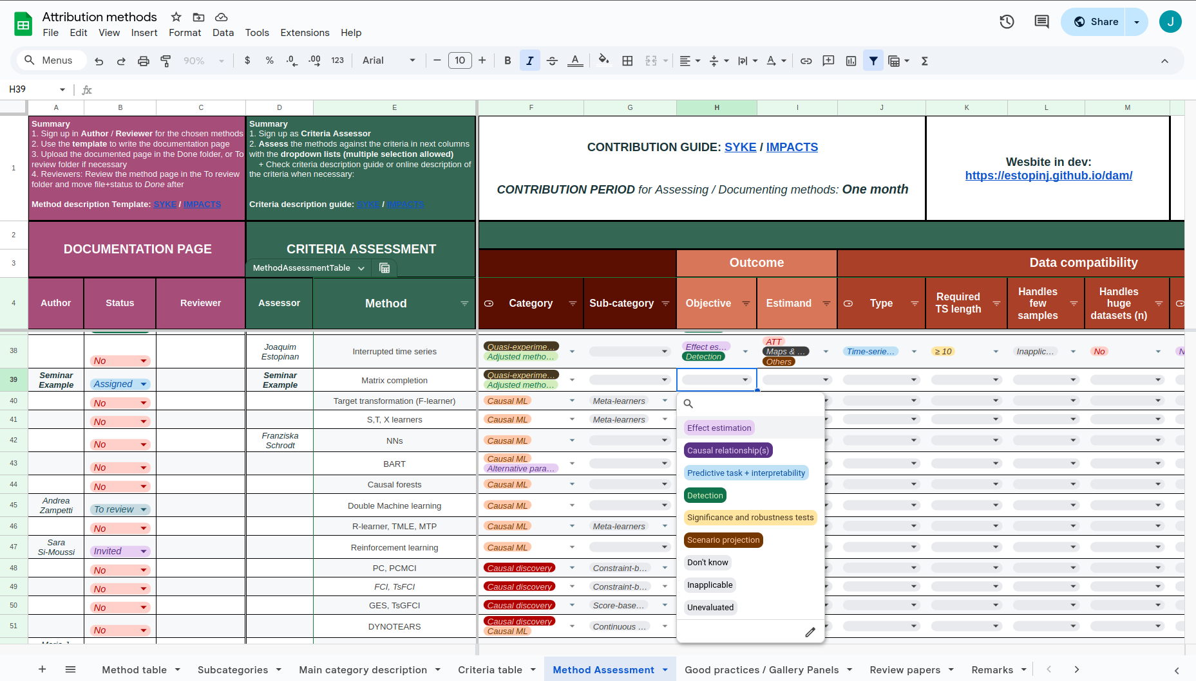
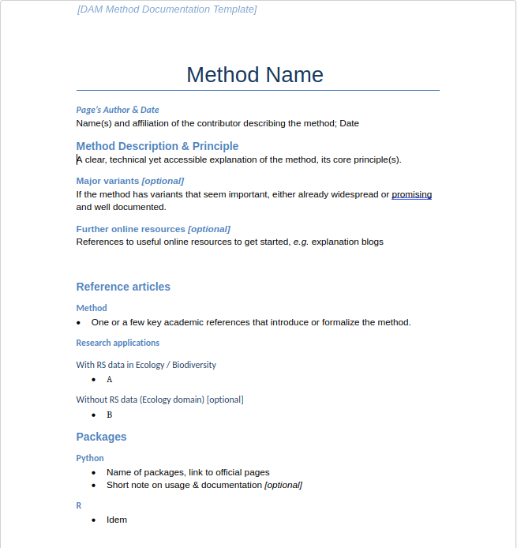
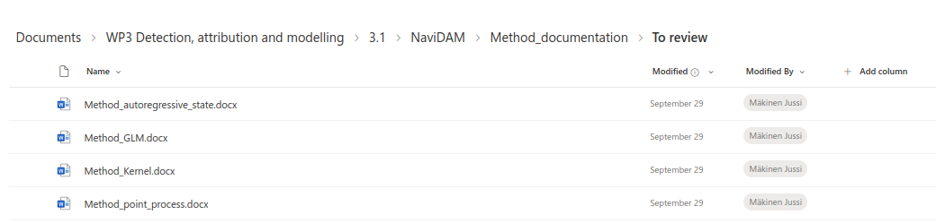
NaviDAM | Method assessment, description & review
1. Assessment
2. Documentation
3. Review
Excel| Method Assessment sheet
2.
3.
1.

Slide 64
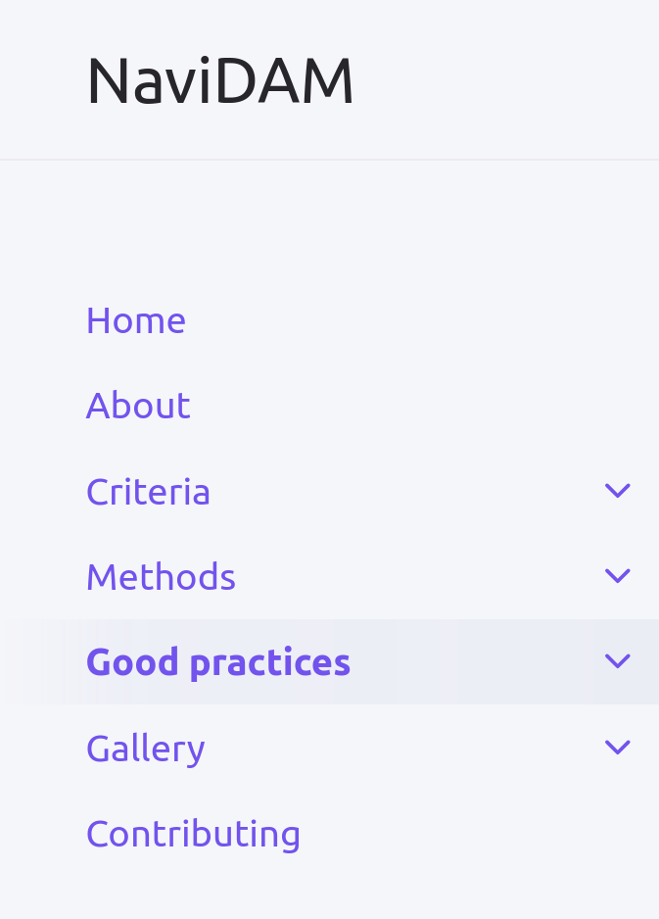
NaviDAM | Panels
https://estopinj.github.io/dam/
Criteria panel [1 page /criterion]
  Definition & explanation
  Tools/Rationale for helping assessment
  Assessment example
Good practices panel
  Adjustment & causal graphs
  Causal paradigms, cross methods, etc.
  Review articles
Method panel [1 page /method]
  Description, principle, variants
  Reference method article(s)
  Ref. research articles applying method
    w/o RS data for Ecology
  R/Python packages, usage
[+ code cells]
Gallery
  STOC & synthetic controls
  Other studies welcomed
→ Needs more method assessments [ongoing]

Slide 65
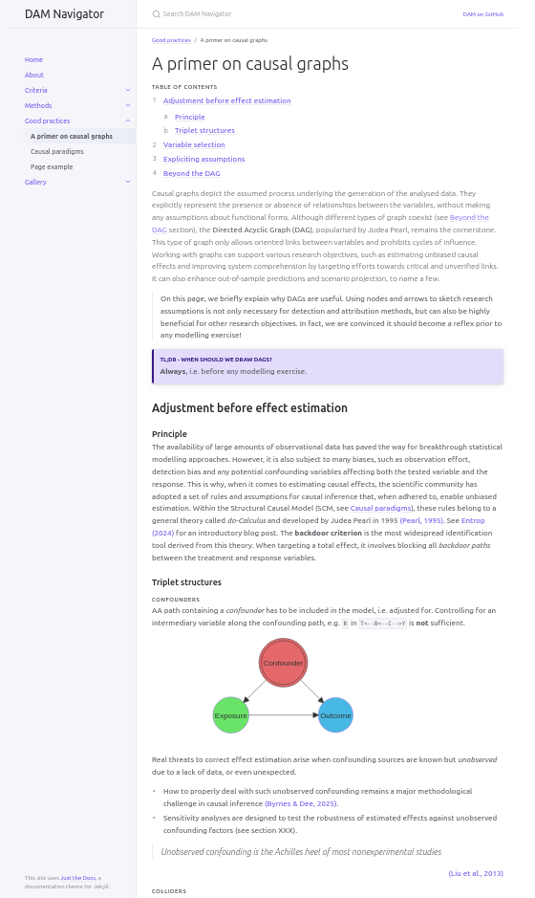
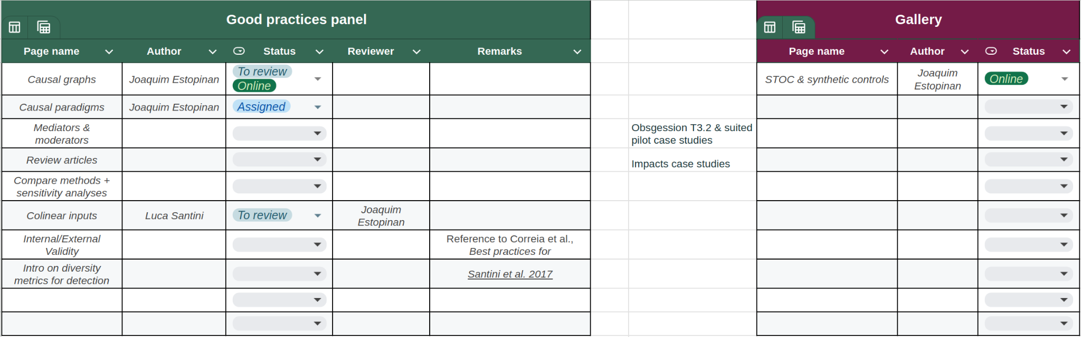
NaviDAM | Good practices / Gallery
Good practice page example: https://estopinj.github.io/dam/contents/practices/graphs/
→ Any volunteer for writing or reviewing such a page can sign up in the Excel | Good practices / Gallery Panels
https://estopinj.github.io/dam/

Slide 66
Companion article | Status
→ Working document: [draft] NaviDAM Companion article
Following ODMAP companion paper structure: Zurell et al. (2020)
Plan
Intro to motivate / position the decision-tool compared to existing resources [V1]
Filtering tool overview description
Section descriptions + usage examples
Discussion
https://estopinj.github.io/dam/

Slide 67
How to contribute | Summary
Syke sharepoint: NaviDAM
→ NaviDAM Contribution guide
By assessing, documenting & reviewing methods
  Volunteers can sign up for methods in the Excel| Method Assessment sheet
By writing good practice & gallery pages
  Idem Excel| Good practices / gallery sheet
With remarks & improvement suggestions on project / website [Excel’s remarks sheet /email]
Comments on companion article being written
https://estopinj.github.io/dam/

Slide 68
Next steps
Graph visualization of methods & criteria network in development by Julien Renaud [neo4j]
Set option to contribute via GitHub & pull requests
  More robust & to make it truly open
  Share to Causal Ecology slack (join link)
Continue with companion article writing
Continue methods integration + adding features to the website
Support to partners interested in applying NaviDAM to their projects
https://estopinj.github.io/dam/

Slide 69
Q&A session
III. NaviDAM decision tool
Objective, structure
How to contribute?
Q?
A

Slide 70
Applying the DAM framework
Jussi A. Mäkinen, Lori Giagnacovo, Joaquim Estopinan

Slide 71
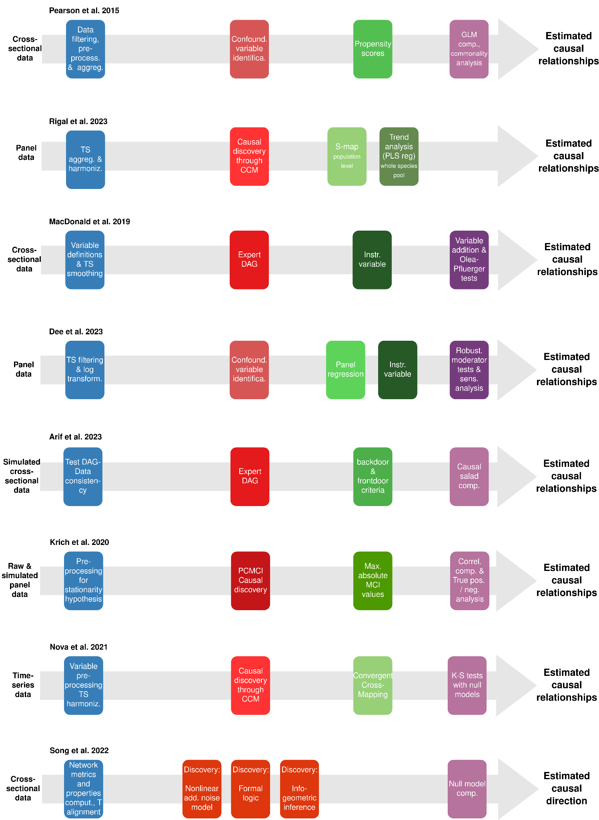
DAM workflow | Two application examples
NaviDAM
suggests suited
methods

Slide 72
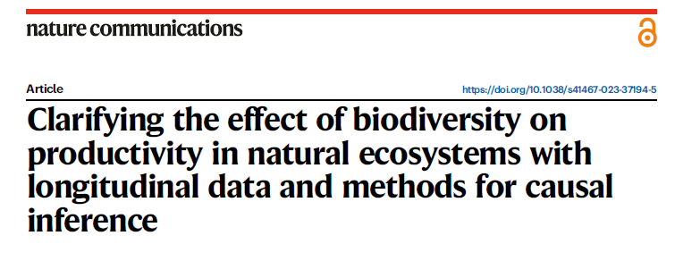
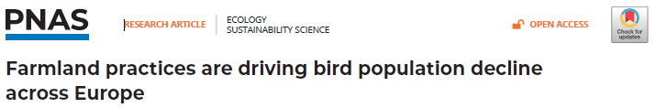
Examples of causal inference for effect estimation
Dee et al. 2023
Rigal et al. 2023
Diversity -> productivity
Panel (=spatiotemporal) data
Applies linear regression
  Accounts for confounding variables
Climate / anthropogenic factors -> bird populations
Panel data
Applies causally motivated algorithms:
  Convergent cross mapping
  S-map

Slide 73
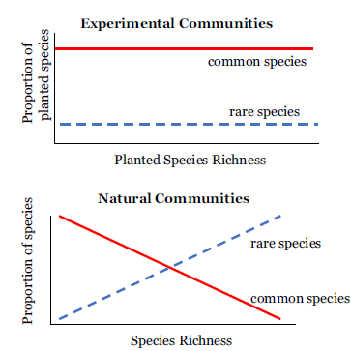
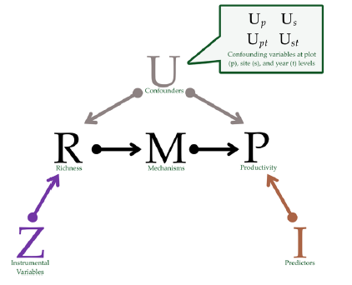
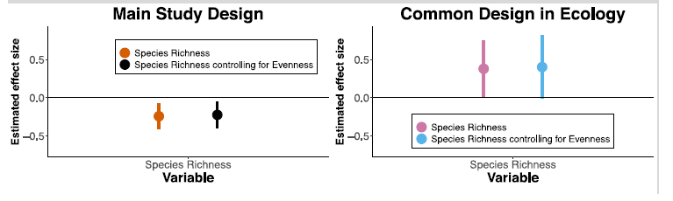
Dee et al. 2023
S₁
S₂
p₁
p₁
p₃
p₃
p₂
p₂
Account for confounders:
Measured confounders (conventional approach)
  Time varying plot- and site-level
    Linear regression
Unmeasured confounders (proposed approach)
  Time varying site-level
    Interaction between year and site
  Time-invariant plot- and site-level
    Subtract mean from the values
Robustness to alternative assumptions
Notes:
Check out the alternative assumptions
Linear regressions
Driver of the negative relationship

Slide 74
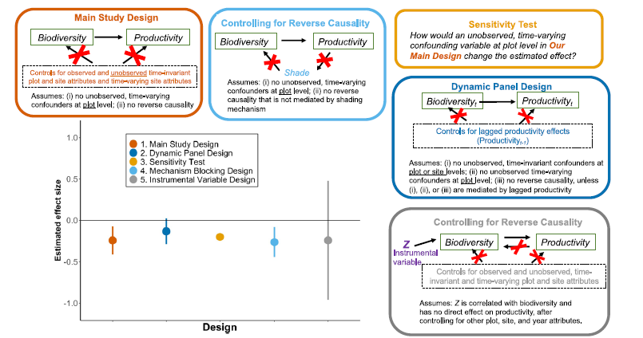
Dee et al. 2023 | Alternative formulations
Notes:
Check out the alternative assumptions
Linear regressions
Driver of the negative relationship

Slide 75
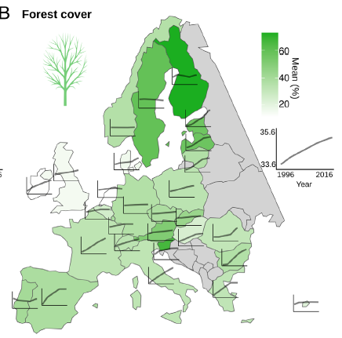
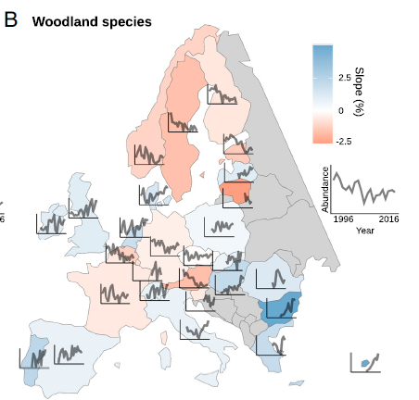
Rigal et al. 2023
Quasicausal inference:
Estimate the association between anthropogenic stressors and species pool
  Partial least squares regression (latent regression between two multivariate variables)
  Not very causal
Estimate the association between anthropogenic stressors and each species temporal trend
  Convergent cross mapping (CCM)
    An algorithm for detecting association with a stochastic process (non-linear and lagging effects)
  S-Map
    A locally weighted regression with a parameter to govern the ’localiness’
    Estimates the strength of an association
    Analytically linked to CCM

Slide 76





Box 1 | Key considerations & steps for causal attribution in ecology
→ Input to NaviDAM’s Objective field
→ Based on system knowledge and the literature review:
Describe expected results with assumptions to feed future interpretations and analyses
→ in NaviDAM
Figure: Diverging assumptions explaining biodiversity - productivity contrasts in experimental & natural conditions (Dee et al. 2023)
Figure: Expert DAG representing the causal structure between a marine protected area (MPA) and reef fish biomass (Arif & MacNeil, 2022)
…
…

Slide 77



Box 1 | Key considerations & steps for causal attribution in ecology
…
…
→ Main purpose of NaviDAM
→ In NaviDAM

Slide 78

NaviDAM example
STOC case study revisited
https://estopinj.github.io/dam/contents/gallery/STOC_synthetic-controls/
Gallery page

Slide 79


STOC | Temporal Monitoring of Common Birds
Standardized count protocol of common birds in France
  Study period = 2001 - 2019
4 km² square plots are monitored according to an annual random draw
391
Observed species since 2001
242
Observed species in 2019
Evolution of specialization group indicators
Relative Abundance
Monitored since 2001
2 893
Squares tracked
since 2001
Monitored in 2019
2 km
Agricultural areas
Built-up areas
Forest env.
Generalists
2 km
Count point
Fontaine, Benoît, et al. "Suivi des oiseaux communs en France 1989-2019: 30 ans de suivis participatifs." (2021)
Notes:
Description intéressant de la fig des indicateurs par groupe de spécialisation page 20 de la synthèse
https://www.vigienature.fr/sites/vigienature/files/atoms/files/syntheseoiseauxcommuns2020_final.pdf

Slide 80


STOC | Temporal Monitoring of Common Birds
Standardized count protocol of common birds in France
  Study period = 2001 - 2019
4 km² square plots are monitored according to an annual random draw
Abundance curve by: observation square & specialization group species: European green woodpecker
Abundance curve by: observation square & specialization group
Notes:
Description intéressant de la fig des indicateurs par groupe de spécialisation page 20 de la synthèse
https://www.vigienature.fr/sites/vigienature/files/atoms/files/syntheseoiseauxcommuns2020_final.pdf

Slide 81



Land cover | GLC_FCS30D (Zhang et al. 2024)
STOC plots [2001- 2019]
Spatial intersection with STOC square plots
1985, 1990, 1995, 2000 - 2022
→ Covers the study period
Notes:
Description intéressant de la fig des indicateurs par groupe de spécialisation page 20 de la synthèse
https://www.vigienature.fr/sites/vigienature/files/atoms/files/syntheseoiseauxcommuns2020_final.pdf

Slide 82


Land cover | GLC_FCS30D ∩ STOC squares
→ Suspected: Deforestation for agriculture
→ Suspected: Quarry excavation
Notes:
Description intéressant de la fig des indicateurs par groupe de spécialisation page 20 de la synthèse
https://www.vigienature.fr/sites/vigienature/files/atoms/files/syntheseoiseauxcommuns2020_final.pdf

Slide 83
NaviDAM example | Objectives
https://estopinj.github.io/dam/contents/gallery/STOC_synthetic-controls/
Detection
To identify STOC monitoring squares that have been affected by abrupt landscape changes.
    We compute landscape metrics on the annual land cover squares
    We look for a suited detection method with NaviDAM
Effect estimation
To test if the detected landscape changes result in bird diversity metric shifts
    We look for a suited detection method with NaviDAM

Slide 84






NaviDAM example | Detection
https://estopinj.github.io/dam/contents/gallery/STOC_synthetic-controls/

Slide 85



https://estopinj.github.io/dam/contents/gallery/STOC_synthetic-controls/
NaviDAM example | Applied detection
From the annual class metric differences computed with PyLandStats (Bosch, 2019)
Assumption:
Urbanization will disturb bird resources and habitats
Bosch, Martí. "PyLandStats: An open-source Pythonic library to compute landscape metrics." (2019)
Notes:
Description intéressant de la fig des indicateurs par groupe de spécialisation page 20 de la synthèse
https://www.vigienature.fr/sites/vigienature/files/atoms/files/syntheseoiseauxcommuns2020_final.pdf

Slide 86




NaviDAM example | Attribution
https://estopinj.github.io/dam/contents/gallery/STOC_synthetic-controls/

Slide 87


NaviDAM example | Attribution
https://estopinj.github.io/dam/contents/gallery/STOC_synthetic-controls/

Slide 88


NaviDAM example | Applied attribution
Ongoing work
https://estopinj.github.io/dam/contents/gallery/STOC_synthetic-controls/
Case study
Railroad plot
Sudden urbanization → Cropland bird A.
Detected on RS products STOC squares
?
Reconstructs what would have happened if a treatment had not occurred - the counterfactual - based on the pre-intervention relationship between the impacted unit and a group of unaffected units
Cropland species Abundance
ATT
Treated
Fick et al. “Evaluating natural experiments in ecology: using synthetic controls in assessments of remotely sensed land treatments” (2021)
Abadie, Alberto. "Using synthetic controls: Feasibility, data requirements, and methodological aspects." (2021)
Ben-Michael et al. “The Augmented Synthetic Control Method.” (2020)

Slide 89
Q&A session
IV. Applying the DAM framework
MEE article
  Workflow application examples
  Box 1 key steps
STOC revisited with NaviDAM
Your application ?
Q?
A

Slide 90
Conclusion
Joaquim Estopinan & Wilfried Thuiller

Slide 91
Take home-messages
The DAM framework is composed of four complementary contributions spread on two gradients:
  Conceptual - Applied
  Prospective - Retrospective
Three articles provide:
  Conceptual guidance
  Practical resources
  Applied method examples
NaviDAM is a collaborative method decision-support tool to identify detection and attribution methods suited to your projects
  Open to contributions

Slide 92
Q&A session
V. Conclusion
Summary
Outstanding questions
Q?
A

Slide 93



Thank you
joaquim.estopinan@grenoble-univ-alpes.fr
anne.thomas@grenoble-univ-alpes.fr
pierre.gauzere@grenoble-univ-alpes.fr
wilfried.thuiller@grenoble-univ-alpes.fr
miriam.beck@fondationbiodiversite.fr
lori.giagnacovo@vito.be
jussi.a.makinen@syke.fi
obsgession.eu
@obsgession.eu
OBSGESSION_HorizonEurope
OBSGESSION receives funding from the European Union's Horizon Europe research and innovation programme under grant agreement No. 101134954. Views and opinions expressed are those of the author(s) only and do not necessarily reflect those of the European Union or the European Research Executive Agency (REA). Neither the EU nor the European Research Executive Agency (REA) can be held responsible for them.

