Slide 1

Seminar 1, pt. 2 : EBV & RS based biodiversity products overview
Dr. Marcel Buchhorn
Lori Giagnacovo
Bruno Smets
April 29th 2024/OBSGESSION internal seminar
obsgession.eu

Slide 2
T2.3: Develop EBV algorithms
(VITO, BG, CNRS, ITC, UZH, SYKE, WR)
M1-48
Realm | EBV class | Initial EBV candidates
Freshwater | Community composition | EQR of phytoplankton and macrophytes
 | Ecosystem structure | Ecosystem distribution of EUNIS habitats
 |  | Structural complexity of riparian habitats
 |  | River connectivity / free river flows
 | Ecosystem function | Primary productivity
 |  | Harmful freshwater algal blooms
 |  | Freshwater phenology
Terrestrial | Community composition | Species diversity, Invasive species, Functional diversity, Trophic diversity
 | Ecosystem structure | Vertical structure (vegetation height)
 |  | Ecosystem distribution of EUNIS habitats
 |  | Ecosystem fragmentation and heterogeneity (variance)
 | Ecosystem function | Ecosystem phenology (minimum, peak, green-up, senescence)
 |  | Primary productivity
 |  | Fire disturbance (biological effects as direction, duration, abruptness, magnitude, frequency)
 |  | Irregular inundation
EBV selection driven by WP1, WP3, WP4 & WP5
Finalize initial list (of proposal), see on the right
Per EBV: review, develop and benchmark methods
Notes:
Just to refer back to the draft list of EBV’s in the proposal, and indicating already in the beginning that it is mostly WP1, 3, 4 and 5 that have to give the input!

Slide 3
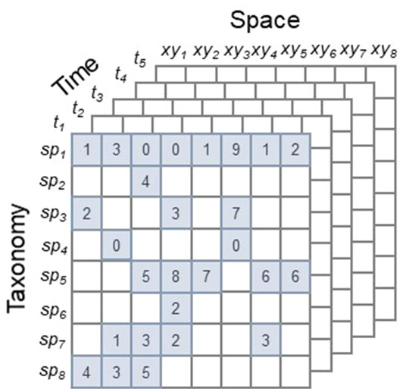
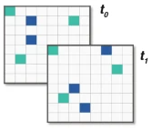
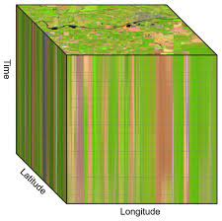
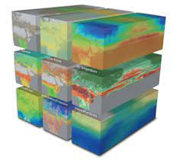

WP2: visual overview
In-situ observations
T2.2
datacube
Calibrate
&
validate
EBV datacube
Models
Remote sensing observations
(space, airborne, experimental)
T2.1
T2.3
Pre-processing
Model benchmarking
Remote sensing products
Re-formatting
T2.4
EBV data
distribution
&
visualization
Remote sensing biodiversity products
Re-formatting
Notes:
Added this slide: give very quickly overview what task of WP2 is (basically saying okay we have to create the EBV, therefore we need to know which variable you want to evaluate and which data layers you need to generate that EBV so we can fill up the cube)

Slide 4
Outline of this seminar
Importance of RS (Remote Sensing) in EBV (Essential Biodiversity Variable) generation
Where to find existing EBV datasets (most important portals)
RS based biodiversity product catalogs
EO (Earth Observation) overview & what to expect from this data source
Upcoming EO sensors and products
Call for action

Slide 5
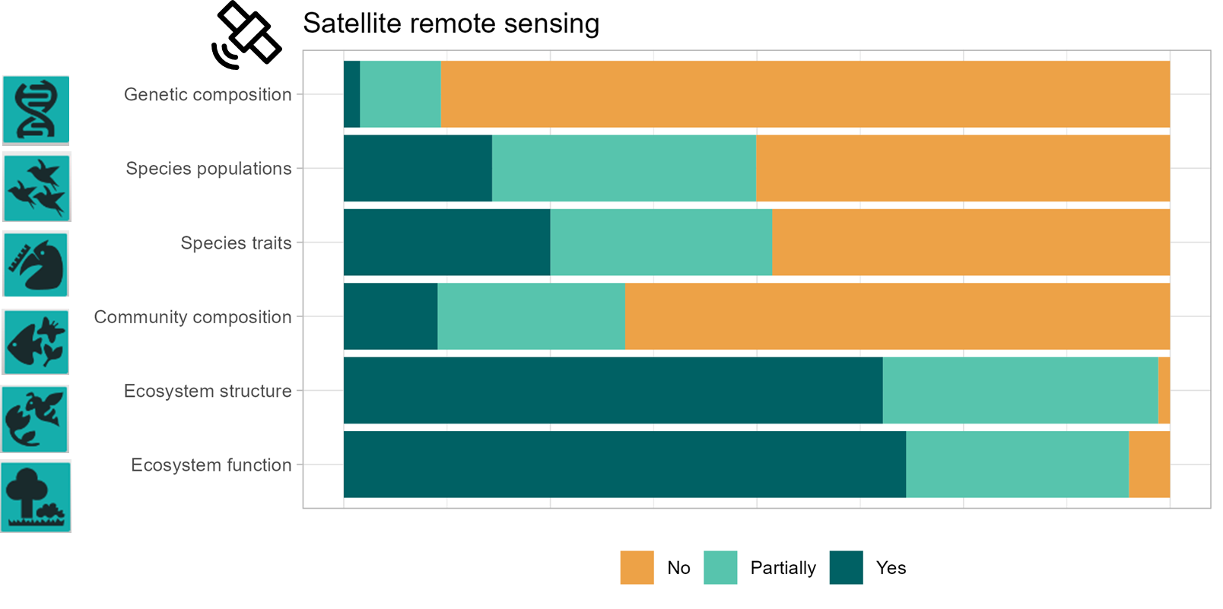


Importance of RS data per EBV category
Source: Lumbierres et al., 2023

Slide 6
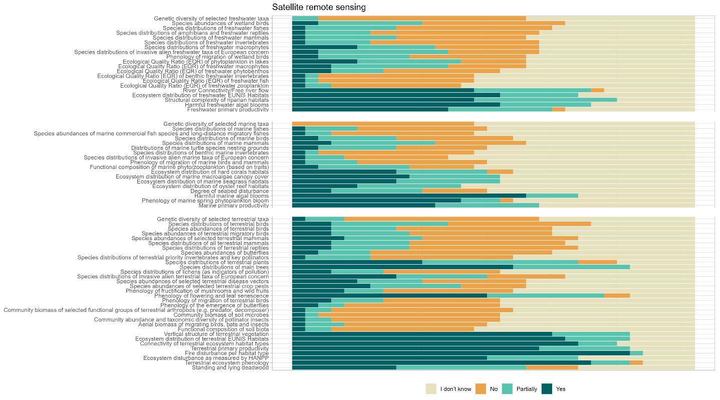
Importance of RS data for specific EBV’s
terrestrial
Fresh water
Marine
Source: Lumbierres et al., 2023

Slide 7
Where to find existing EBV datasets: overview of most important portals
Bon in a box: https://boninabox.geobon.org/index
EBV data portal (GEO BON): https://portal.geobon.org/home
EuropaBON portal: https://monitoring.europabon.org/monitoring/data_stream/list/all/
GlobDiversity portal: https://www.globdiversity.net/ (only 3 project EBV products: Canopy Chlorophyll Content, Ecosystem Fragmentation & Land Surface Phenology)
GOOS BioEco portal: https://bioeco.goosocean.org/
NEXTGEOSS data hub: https://catalogue.nextgeoss.eu/

Slide 8
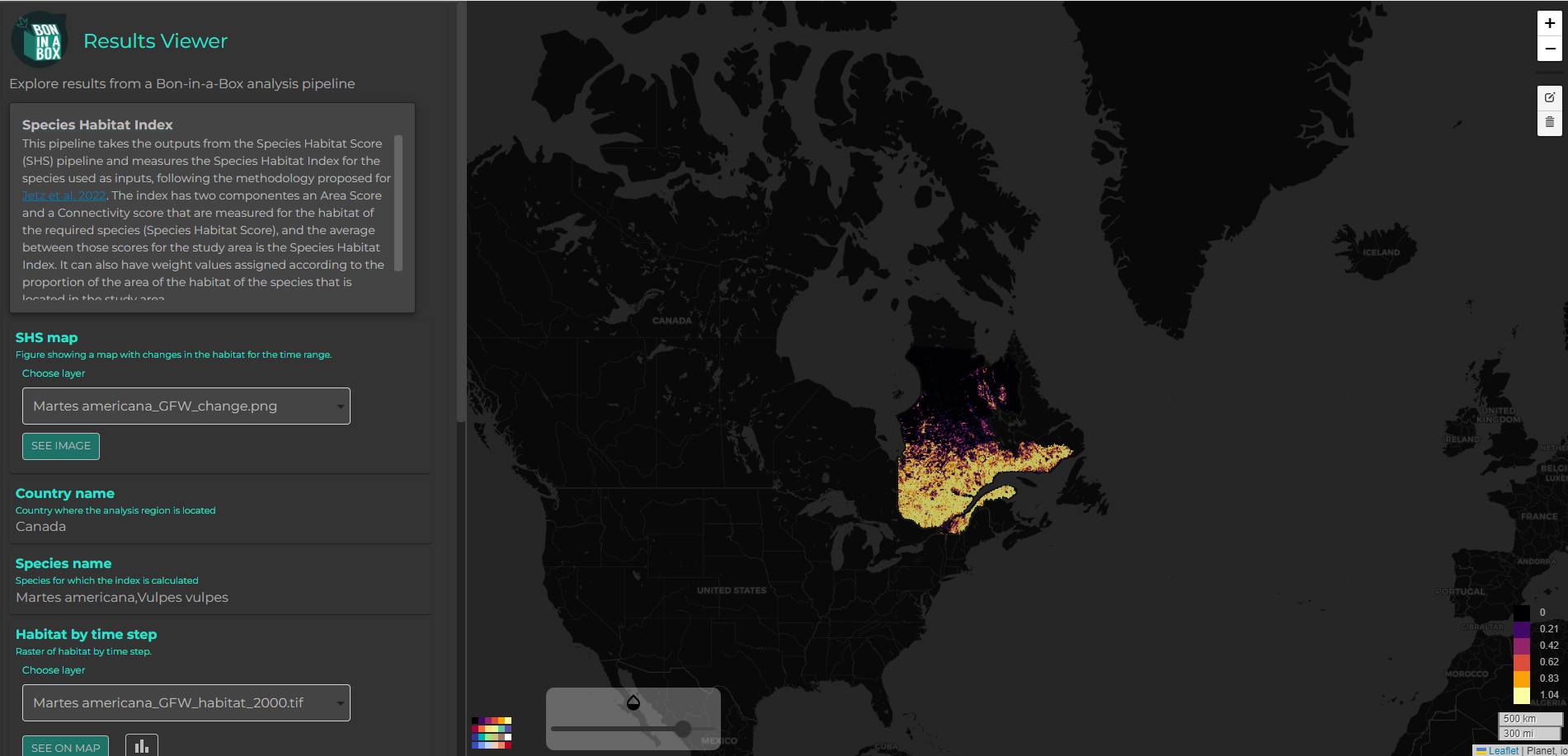
EBV portals: Bon in a box
Provides tools/code for biodiversity monitoring
Some EBV example datasets (e.g. species habitat index, species distribution)
Good overview of biodiversity projects
https://boninabox.geobon.org/index

Slide 9
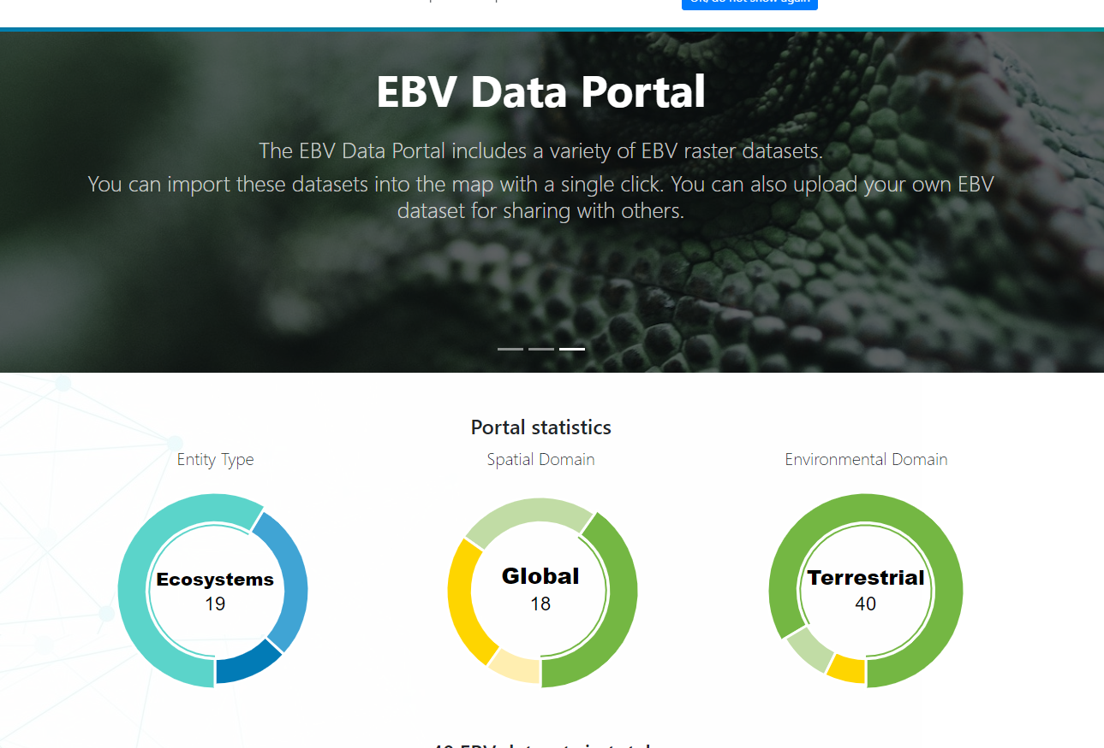
EBV portals: GEO BON, EBV data portal
Distribution and visualization of EBV datasets
Results of “BON in a box” pipelines should result in here
https://portal.geobon.org/home

Slide 10
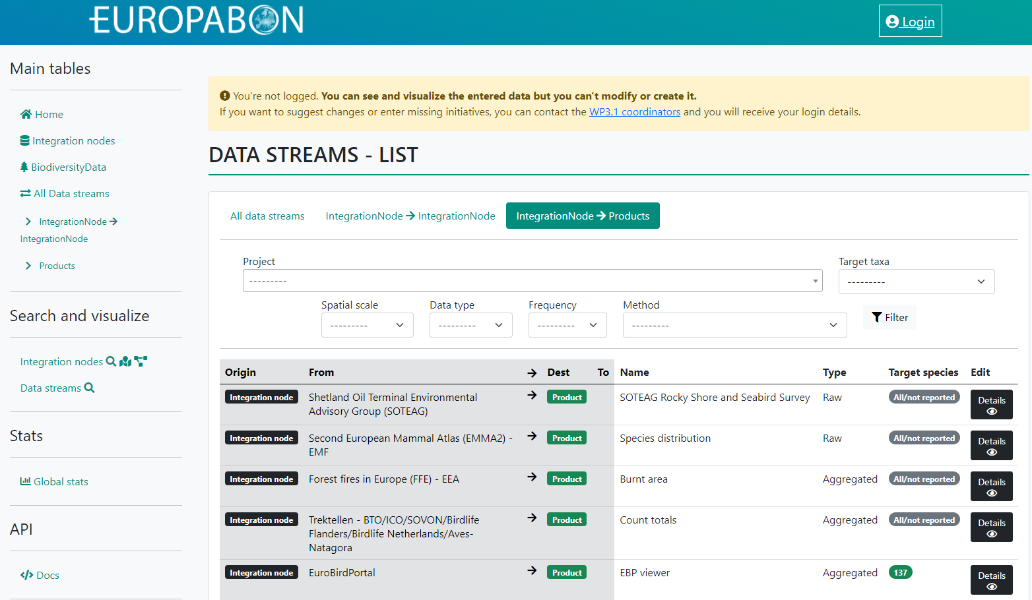
EBV portals: EuropaBON portal
EBV integration and monitoring concepts
Biodiversity datasets
Shows combination of data streams to generate products
NOTE: for European EBV definition see: https://github.com/EuropaBON/EBV-Descriptions
https://monitoring.europabon.org/monitoring/data_stream/list/all/

Slide 11
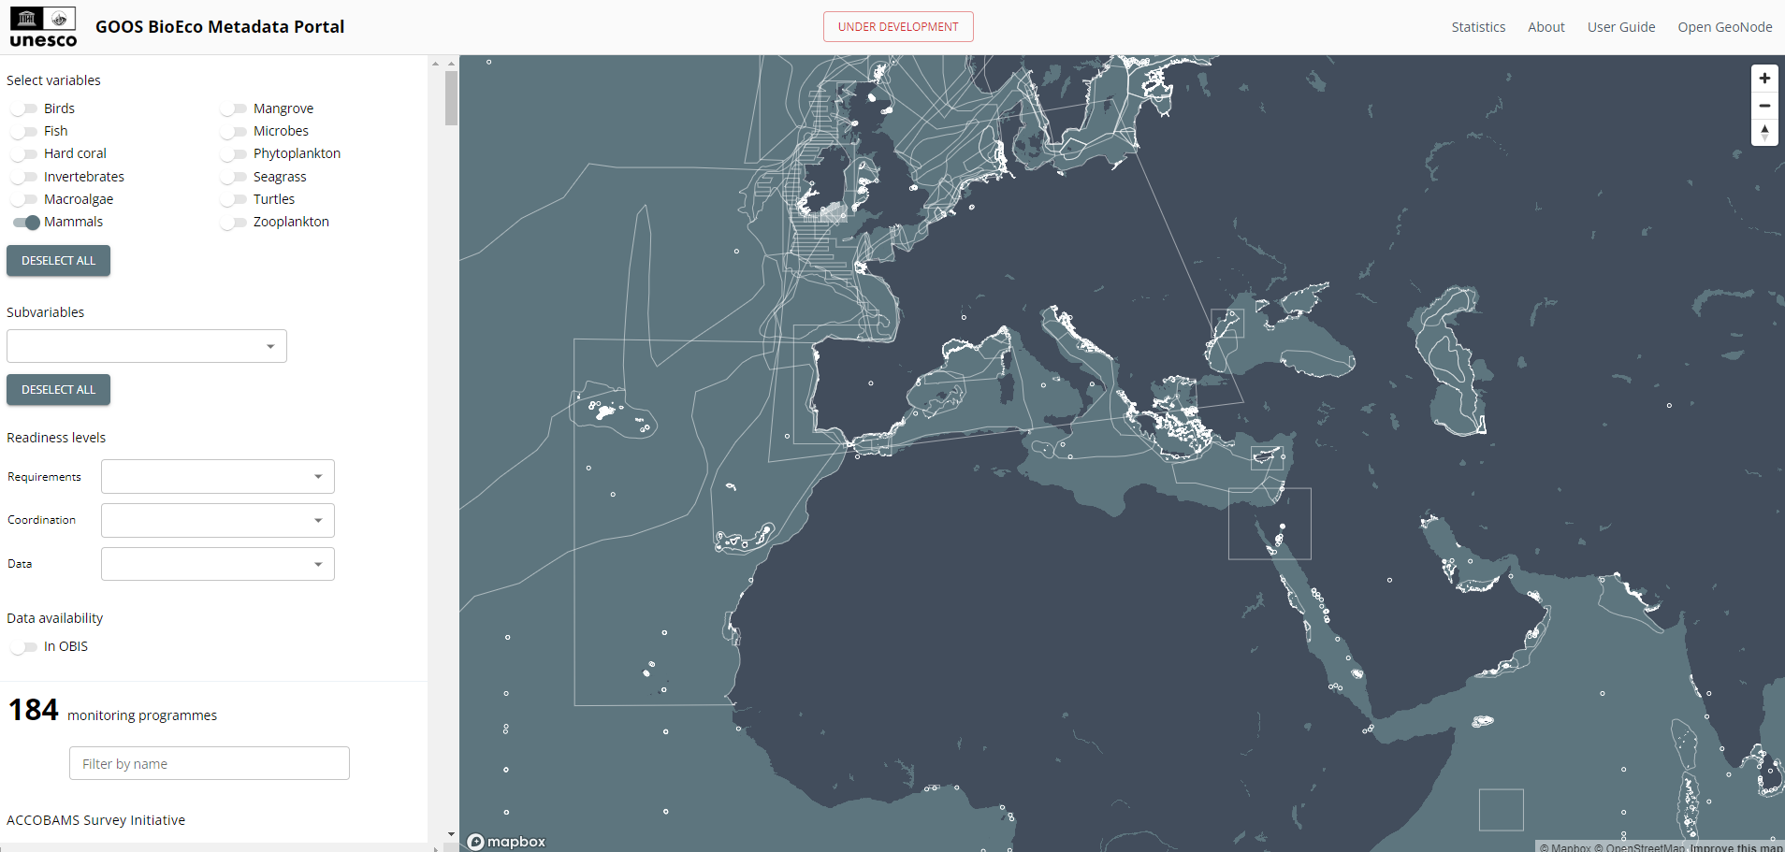
EBV portals: GOOS BioEco portal
NOTE: more an EOV (Essential Ocean Variables) portal but could be useful for EBV development
https://bioeco.goosocean.org/

Slide 12
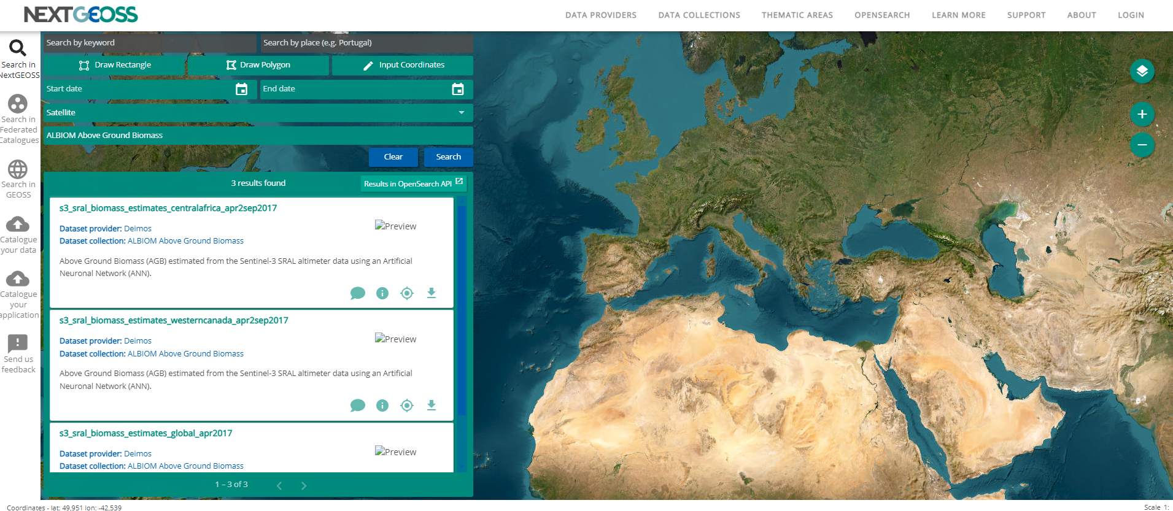
EBV portal: NEXTGEOSS data hub
Data collections span satellite data, in situ data, models & statistics
6 EBV datasets (mostly water related)
https://catalogue.nextgeoss.eu/

Slide 13
RS based biodiversity product catalogs (part 1)
Copernicus portals
  Copernicus land monitoring service: https://land.copernicus.eu/en/dataset-catalog https://land.copernicus.eu/en/map-viewer
  Copernicus Climate Change service: https://cds.climate.copernicus.eu/#!/home
  Copernicus Marine service: https://marine.copernicus.eu/access-data
Google Earth Engine: https://developers.google.com/earth-engine/datasets
Planetary computers: https://planetarycomputer.microsoft.com/catalog
STAC index: https://stacindex.org/
  STAC: SpatioTemporal Asset Catalogs (the STAC specification is a common language to describe geospatial information so easier to work with, index or discover)
  This STAC catalog index lists nearly all existing datasets

Slide 14
RS based biodiversity product catalogs (part 2)
Terrascope portal / openEO: https://viewer.terrascope.be/
Copernicus Data Space Ecosystem (CDSE) / openEO: https://dataspace.copernicus.eu/explore-data/data-collections
  https://openeo.dataspace.copernicus.eu/
Planet
  Core data like Planetary Variables in high resolution - https://www.planet.com/products/planetary-variables/
  Not free
Zenodo platform (mostly datasets from published articles or projects) - https://zenodo.org/
A good overview of additional portals: https://spatialagent.org/Biodiversity/

Slide 15
EO overview
Currently: over 300 satellites in space operational and for research purposes
Per satellite mission: one or many instruments on board
A good overview of past, current and future missions: https://www.eoportal.org/satellite-missions
A good overview of satellites and sensors (incl. specifications): https://www.itc.nl/facilities/satellite-sensor-database/
Most important satellite missions: (see next slides)

Slide 16
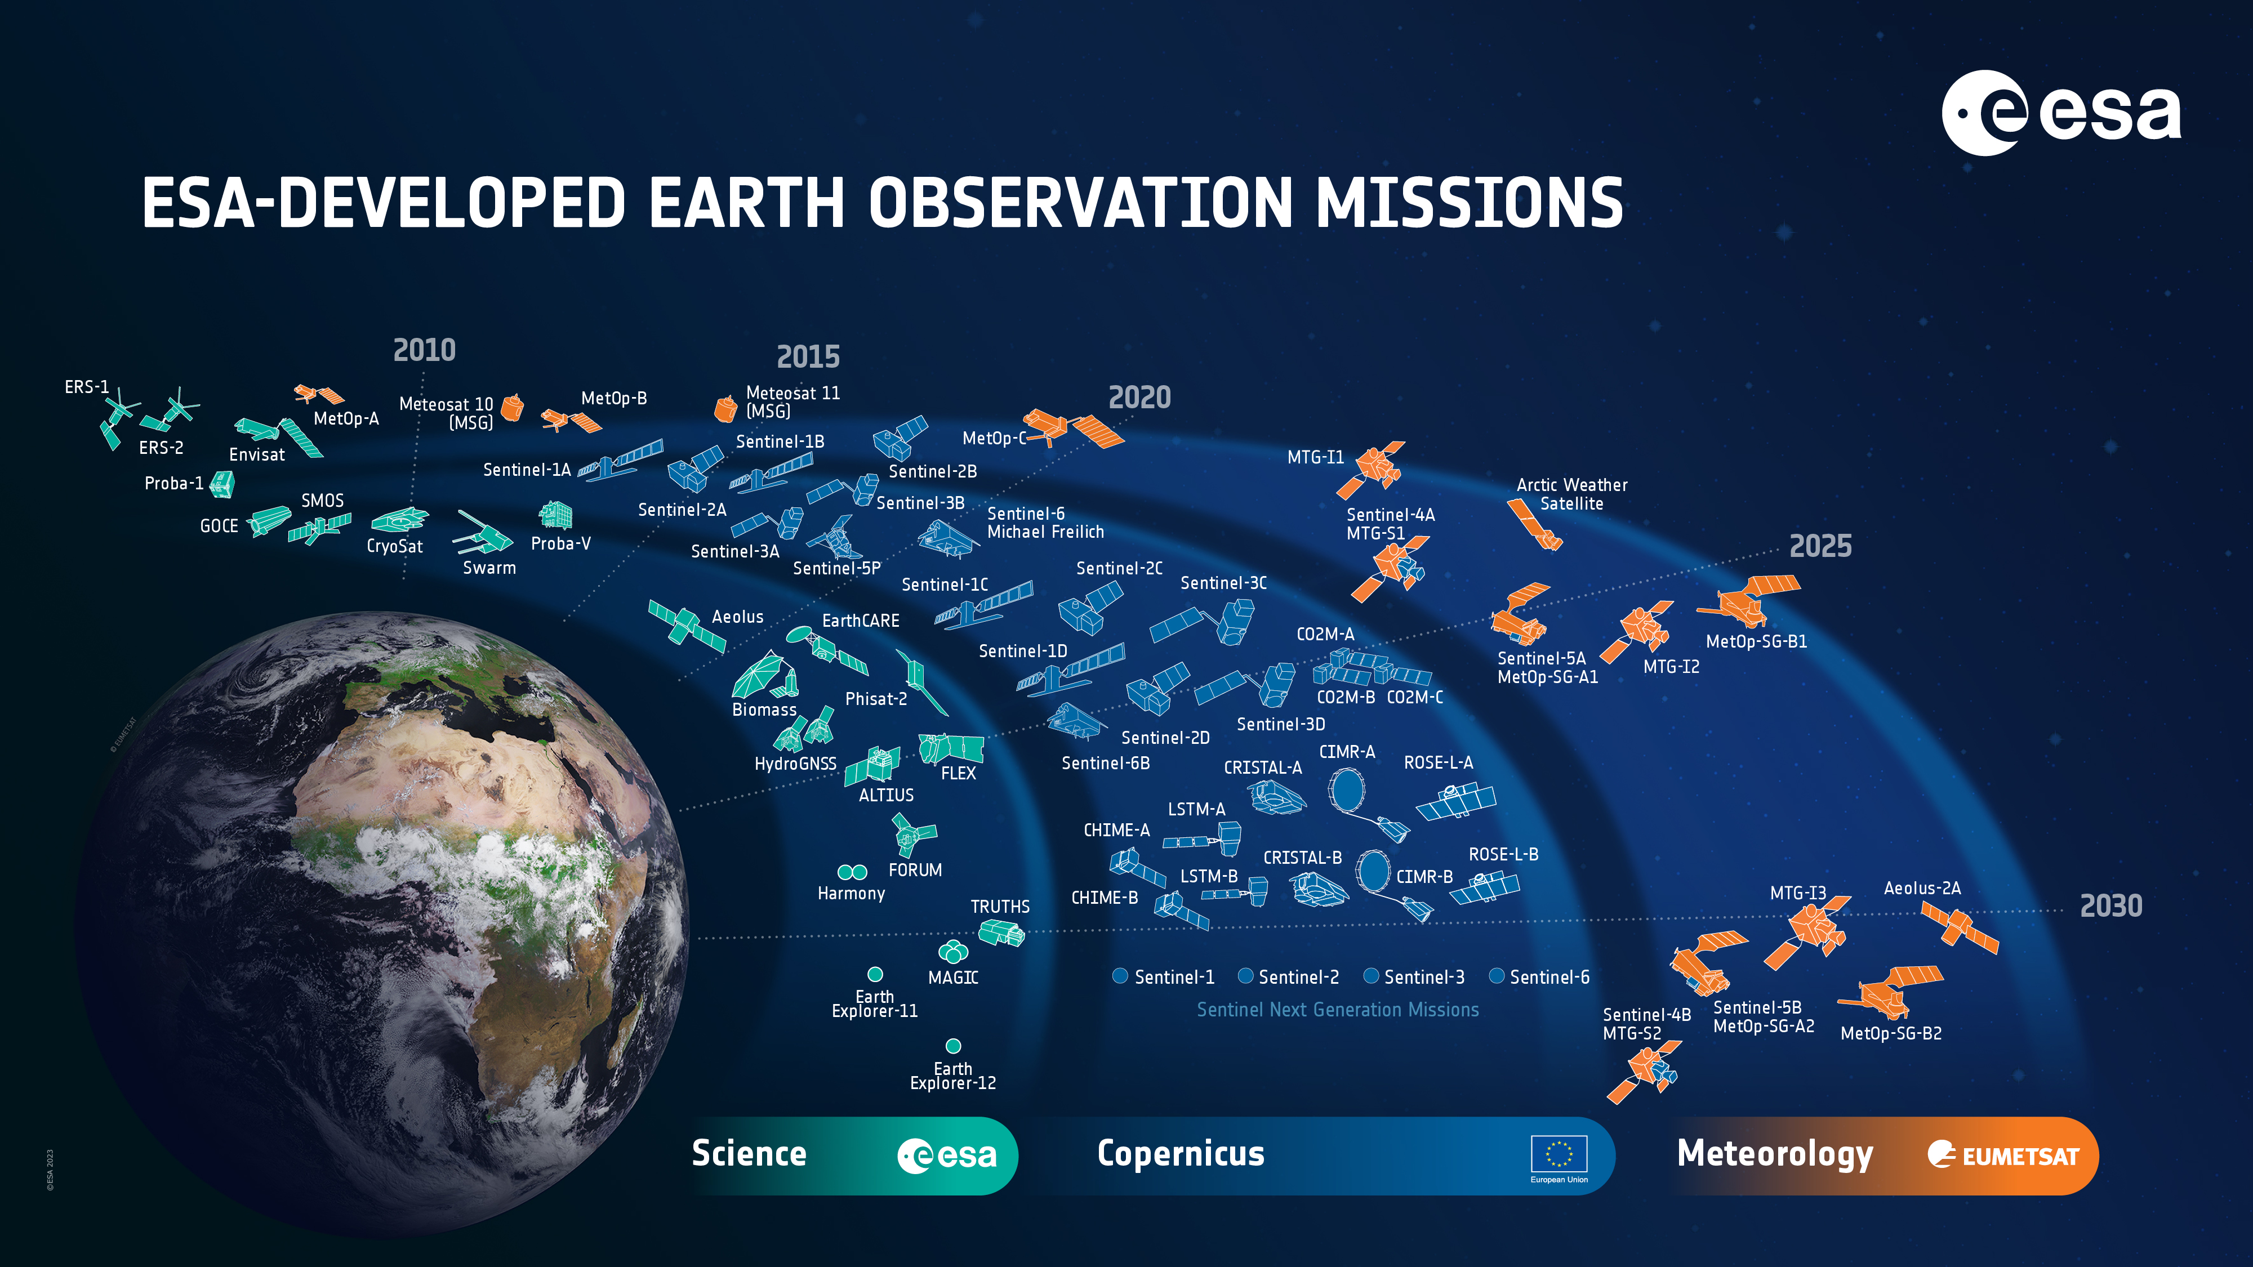
Source: ESA, 2023
Notes:
I already circled some important missions, can you edit or add?

Slide 17
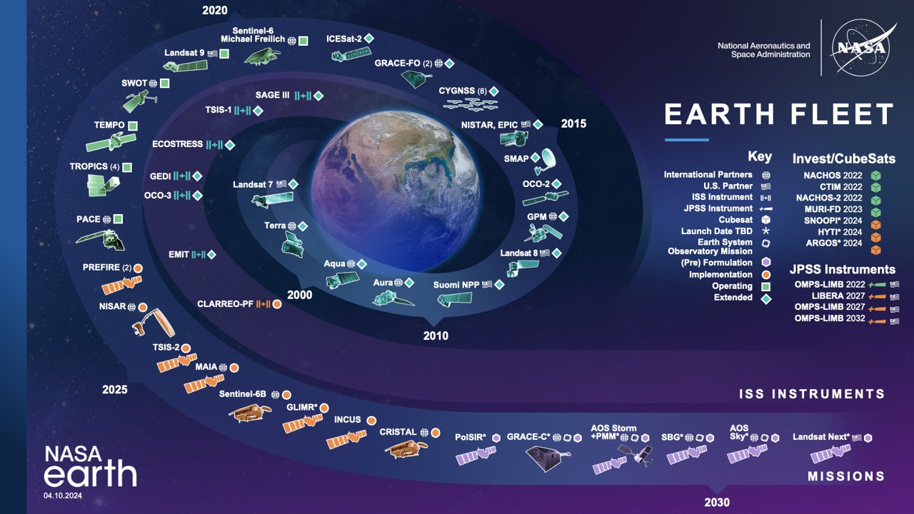
Source: NASA, 2024

Slide 18
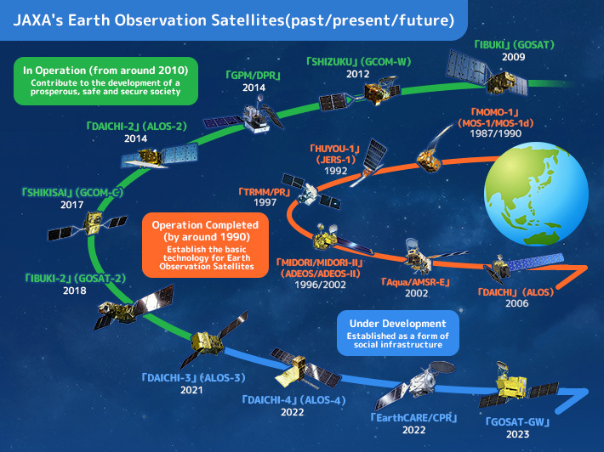
Credit: Japan Aerospace Exploration Agency
Source: JAXA, 2024

Slide 19
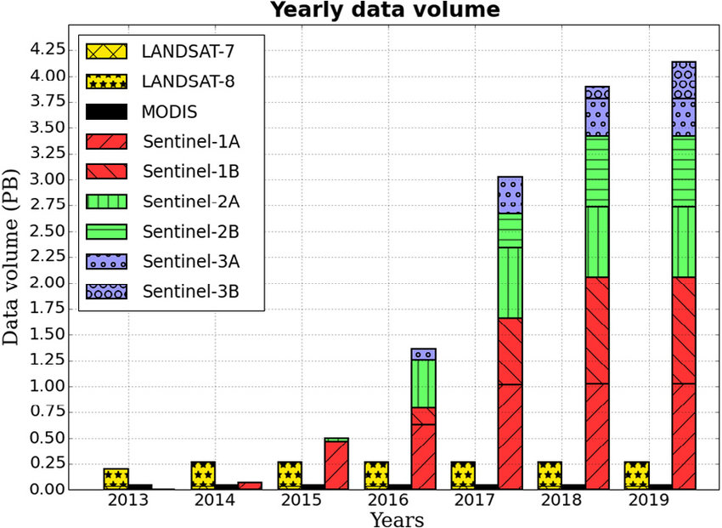
Take-home messages (from EO overview)
Huge amount of EO data available BUT time series density with same specifications is limited to only some sensors
Interoperability issues → always look to the data of one sensor stand-alone!
A lot of missions are only for research, not all (rather a few) for monitoring purposes
High resolution long-term datasets are available since 1983, dense temporal resolution only since 2016
Source: Soille et al., 2017

Slide 20
Most important missions with long-term datasets
Mission |  | Year | Band number | Spatial resolution (m) | Temporal resolution (days) | Notes
Landsat | Landsat-1 | 1972 - 1978 | 4 | 60 | 18
 | Landsat-2 | 1975 - 1982 | 4 | 60 | 18
 | Landsat-3 | 1978 - 1983 | 4 | 60 | 18
 | Landsat-4 | 1982 - 1993 | 7 | 30 | 16
 | Landsat-5 | 1984 - 2013 | 7 | 30 | 16
 | Landsat-7 | 1999 - present | 8 | 30 | 16
 | Landsat-8 | 2013 - present | 9 | 30 | 16
MODIS |  | 1999/2002 | 36 | 250/500/1000 | 16 | Aqua & Terra satellites
AVHRR |  | 1978 - present | 6 | 1100 | 1 | over 19 satellites over time
Spot - ProbaV-Sentinel-3 | Sport VGT | 1998 - 2014 | 4 | 1150 | 2
 | Proba-V | 2013 - 2021 | 4 | 1000/300/100 | 1/1/5
 | Sentinel-3
Sentinel-1 |  | 2014 - present | 2 | 5 - 40 | 12/6 | 6days with 2 satellites
Sentinel-2 |  | 2015 - present | 13 | 10-20 | 5
Landsat
MODIS
AVHRR
Spot-VGT/Proba V/Sentinel-3
Sentinel-1
Sentinel-2

Slide 21
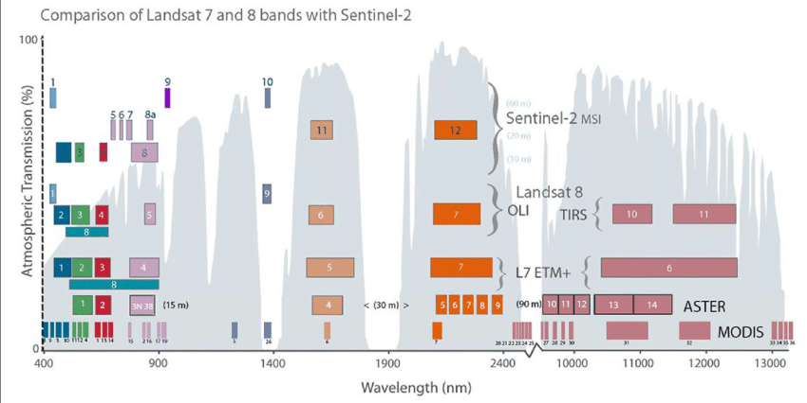
Beware of operability of missions within different atmospheric windows
Comparison of Landsat-7, Landsat-8, and Landsat-9 bands with Sentinel-2, ASTER, and MODIS bands. Band widths, wavelength locations, and spectral region: VIS-blue, green, and red, NIR-lavender; SWIR 1-earth orange and SWIR-2 brick red; rose-colored bands are TIR. The band numbers for MODIS bands (Bottom Row 1) are shown in order of wavelength, in colors matching the bands: 8, 9, 3, 10-blue; 11, 12, 4-green; 1, 13, 14-red; 15, 2, 16, 17, 19-lavender; 5, 26-light blue; 6-earth orange; 7-brick red; 20, 21, 22, 23, 24, 25, 27, 28, 29, 30, 31, 32, 33, 34, 35, 36-rose. The narrow band 18 (931-941 nm) is not represented in this figure because it is within the wavelength range of band 19 (915-965 nm). Band 18 is located in the atmospheric water vapor absorption feature and contributes to the MODIS Precipitable Water Product. ASTER's 14 bands (Row 2) range in size from 15 to 90 m, as shown. Landsat-7 and Landsat-8 (Rows 3 and 4) optical bands have 30 m pixels and thermal bands with 120 m (L-7) or 100 m (L-8). Sentinel-2 (Top Row 5) has 13 optical bands at either 10 m, 20 m, or 60 m spatial resolution and no TIR bands.
Source: Ustin et al., 2021
Source: NASA, 2024

Slide 22
EO harmonized datasets / Analysis ready data
Not many harmonized EO time series available
  Currently best option: Landsat HLS2 (Landsat-8 & Sentinel-2 harmonized data) → 30m, starting from 2013 onwards
  ESA plans a Sentinel/Landsat product at 10m resolution
But ARD (analysis ready data) proves to be user friendly
  All new archives/platforms provide ARD to ease the EO data usage
  ARD data is directly accessible in GEE and CDSE
  It will save you up to 80% time in pre-processing of the data BUT the last 20% are on you!

Slide 23
Upcoming EO sensors & products
Sensor Type | Platform/sensor | Data characteristics
Optical - Multispectral | Landsat-Next (NASA) | From 2030 Spatial resolution: 10-60m, global Temporal resolution: 6-daily global Spectral resolution: 23 spectral bands
Optical – Hyperspectral | CHIME (ESA, expand Sentinel missions) | From 2028 Spatial resolution: 30m Temporal resolution: 25-day Spectral resolution: >200 bands (bandwidth < 10nm)
 | SBG (NASA) | From 2027
 | Planetlabs | From 2023 Small narrow bands (5nm)
Optical - Thermal | Landsat-Next (NASA) | From 2030 Spatial resolution: 10-60m global Temporal resolution: 6-daily global Spectral resolution: 5 thermal channels
 | Trishna (CNES) | From 2024
 | LSTM (ESA) | From 2028
Synthetic Aperture Radar – L-band | ALOS-4 Palsar-3 (JAXA) | From 2024
 | NISAR (NASA/ISRO) | From 2024 Temporal resolution: 12-daily global
 | ROSE-L (ESA) | From 2028 Spatial resolution: 25-50m
Notes:
Not many in OBSGESSION life-span, so I just added all I could find, might be just interesting to show and see what is coming up, prospections for future studies

Slide 24
Call for action
Which biodiversity variable (EBV) do you want to evaluate in your use case?
Is this EBV algorithm already existing or defined? → check EBV portals (slides 7-12)
If yes: evaluate EBV product in your use case to be sufficient
If no: check for existing RS biodiversity products (slides 13-14) and/or existing methodologies to calculate EBV (T2.3 supports in benchmarking)
Kind but urgent request to follow these steps

Slide 25
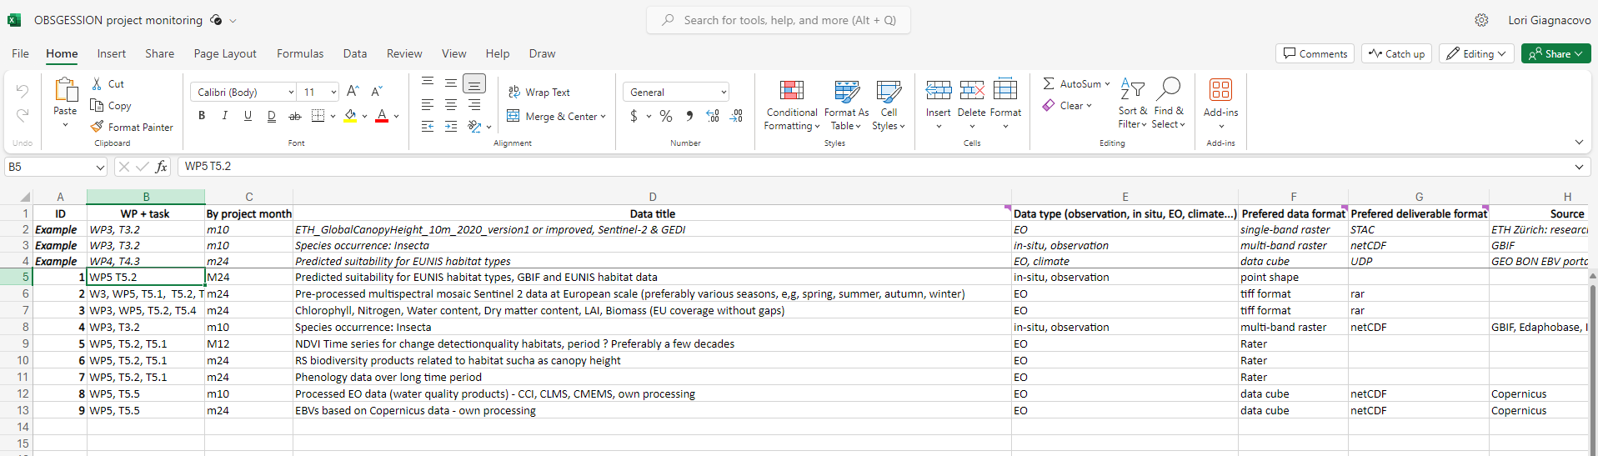
Call for action
D
D
D
D
If RS biodiversity products are non existing --> check for RS time series data to generate products (slides 15-20)
!! Fill needed data list !!
Kind but urgent request to follow these steps

Slide 26

Thank you
marcel.buchhorn@vito.be
obsgession.eu
obsgession_
OBSGESSION_HorizonEurope
OBSGESSION receives funding from the European Union's Horizon Europe research and innovation programme under grant agreement No. 101134954. Views and opinions expressed are those of the author(s) only and do not necessarily reflect those of the European Union or the European Research Executive Agency (REA). Neither the EU nor the European Research Executive Agency (REA) can be held responsible for them.

Slide 27
References
Lumbierres M, Kissling WD (2023) Important first steps towards designing the freshwater, marine and terrestrial Essential Biodiversity Variable (EBV) workflows for the European Biodiversity Observation Network. Research Ideas and Outcomes 9: e109120. https://doi.org/10.3897/rio.9.e109120
ESA (2023) ESA-developed Earth observation mission. The European Space Agency. Observing the Earth. https://www.esa.int/ESA_Multimedia/Images/2019/05/ESA-developed_Earth_observation_missions
NASA (2024) NASA Earth Science Division Missions. NASA. Scientific Visualization Studio. https://svs.gsfc.nasa.gov/30065
JAXA (2024) History of JAXA’s Earth Observation Satellite. JAXA. Space Technology Directorate: Satellite Navigator. https://www.satnavi.jaxa.jp/en/satellite-knowledge/trivia/jaxa-eosatellite-history/index.html
Soille, P. & Burger, A. & Marchi, Davide & Kempeneers, P. & Rodriguez Aseretto, Dario & Syrris, Vasileios & Vasilev, V.. (2017). A versatile data-intensive computing platform for information retrieval from big geospatial data. Future Generation Computer Systems. 81. 10.1016/j.future.2017.11.007.
NASA (2024) Technical Details. NASA: Landsat Science. https://landsat.gsfc.nasa.gov/about/technical-details/
Ustin, Susan & Middleton, Elizabeth. (2021). Current and near-term advances in Earth observation for ecological applications. Ecological Processes. 10. 10.1186/s13717-020-00255-4.

