Slide 1

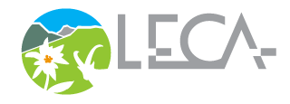

Detection & Attribution Modelling Framework
Joaquim Estopinan/ CNRS
June 5th 2024 / Grenoble, France / Obsgession Seminar 2
obsgession.eu

Slide 2
Introduction
Motivation & definitions

Slide 3
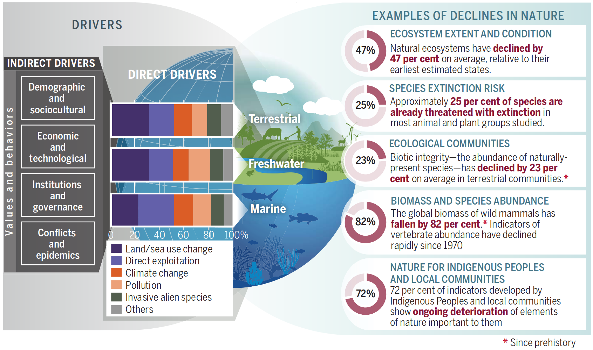
Biodiversity loss…
…from blurry & entangled anthropogenic processes
Diaz et al. 2019 https://doi.org/10.1126/science.aax3100

Slide 4
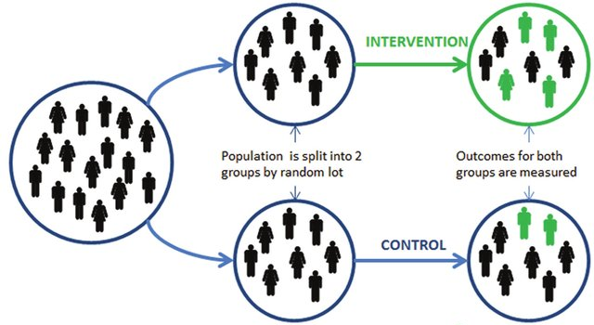

Motivation: What is the causal effect of a given action on a given outcome variable?
Gold standard: Randomised Control Trials
Balances out all confoundings effects
But: Impossible and/or unethical to run in many ecological applications
Climate
Habitat structure
Species richness
→ Causal inference to the rescue
Haynes et al. 2012 http://dx.doi.org/10.2139/ssrn.2131581

Slide 5
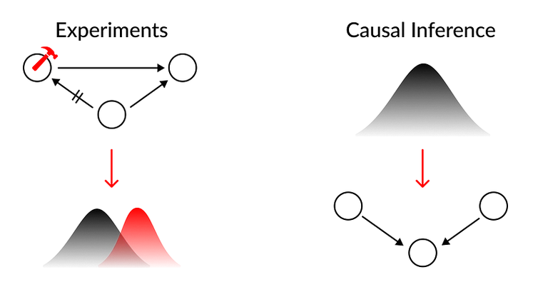
To answer causal questions
Conducting so-called interventions to assess causal relationships, e.g. RCTs
Using assumptions in a theoretical framework to derive causal statements from observational data only
→ Both allow to attribute the causes of (possibly) detected changes
Image source: https://medium.com/causality-in-data-science

Slide 6
To answer causal questions
Interventional Study
Observational Study
C
C
do(T=t)
Covariates
Covariates
X
T
Y
T
Y
Treatment
Outcome
Treatment
Outcome
ATE = 𝔼[Y|do(T=1)] - 𝔼[Y|do(T=0)]
The selection bias associated with the non‐random assignment of treatment precludes the direct identification of causal relationships.
Counterfactual: What would outcomes for the treated units be in the absence of the treatment?

Slide 7

Definitions
from Climate Science: Knutson et al. 2017 Climate Science Special Report: Fourth
National Climate Assessment, Volume I
https://science2017.globalchange.gov/chapter/appendix-c/
Detectable change: A change that is determined to be highly unlikely to occur (less
than about a 10% chance) due to internal variability alone
Attributable change: A change in which the relative contribution of causal factors
has been evaluated with an assignment of statistical confidence

Slide 8
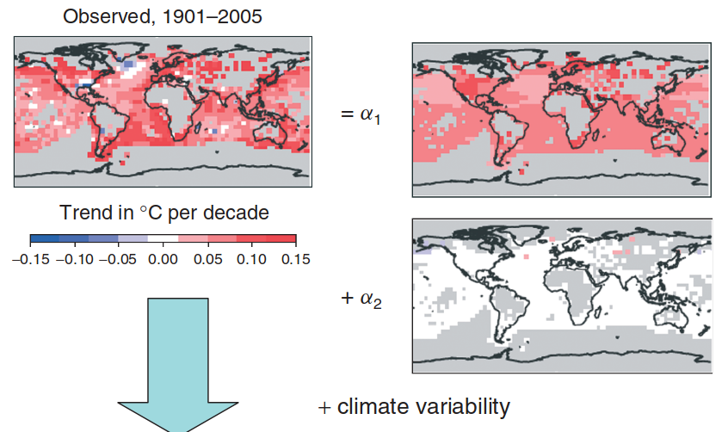
Detection and attribution in Climate Science
Fingerprint methods
Observed changes are regressed onto model-generated, anticipated response patterns to forcings
Based on the scaling factors, if a change is significant and cannot be explained by climate variability only: it is attributed to the corresponding forcing
Hegerl et al. 2011https://doi.org/10.1002/wcc.121

Slide 9
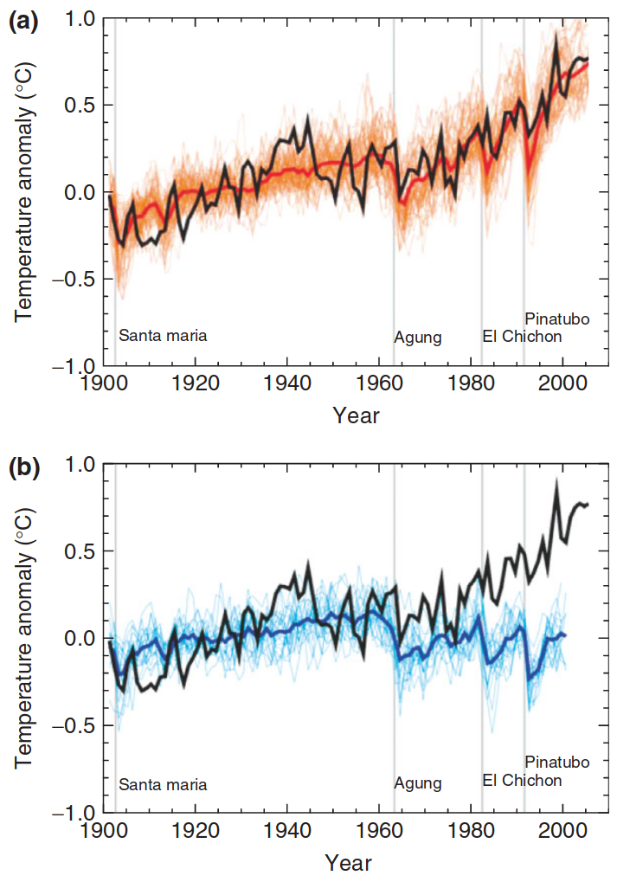
Detection and attribution in Climate Science
Non-Fingerprint methods
Observed temperatures (black) are directly compared to climate model simulations:
(a) both human and natural influences on climate
(b) natural influences only.
→ Natural variability fails to explains observations in contrast to both human and natural influences, so the deviation is attributed to the forcing.
Hegerl et al. 2011https://doi.org/10.1002/wcc.121

Slide 10
Detection and attribution in Climate Science
These method families rely on:
Physics-based climate models simulating the anticipated patterns of anthropogenic forcings
The usual assumption that radiative forcings are modeling as external to the climate system → no possible confounding biases → inference is significantly simplified
↪ Process-based dynamic vegetation models such as LPJ-GUESS and FATE-HD (WP 3.3) enable comparable analyses
However, process-based simulations are not always feasible to analyse biodiversity changes (lack of data/process knowledge)
→ Different tools are needed

Slide 11
Quasi-experimental methods
or impact evaluation methods
-
Potential outcome framework
Notes:
DAM-framework seminar
Program:
2 - 3PM CNRS
Motivation and definitions
Quasi-experimental methods in ecological studies
Causal discovery: Assumptions & methods
Quantifying causal effects & variants
Causal Machine Learning: Where does it fit?
Conclusion, questions

Slide 12


Two reviews
Five quasi-experimental statistical approaches:
Matching
Regression discontinuity design
Difference-in-difference models
Fixed effects panel regression
Instrumental variables
https://doi.org/10.1111/2041-210X.13190
https://doi.org/10.1016/j.baae.2017.01.005
Many ecological processes take place in settings with non-random treatments and unobservable variables.
The key to quasi-experimental methods is to i) identify valid control and treatment groups and ii) account for potentially unobserved correlation between treatment assignment and outcome.

Slide 13
Definition & a key assumption
→ Quasi-experimental methods in Ecology : borrowed from econometrics
Effect estimation methods seeking to overcome the non-random assignment of treatment, so we can isolate the target causal effect from observed outcome differences between treatment and control groups.
The stable unit treatment value assumption (SUTVA, Rubin 1980):
No treatment spillover or interference between sites & no different versions of the same treatment
→ Be careful of the spatial dependence between outcomes, e.g. aggregating to large independent research units with a spatial split helps

Slide 14
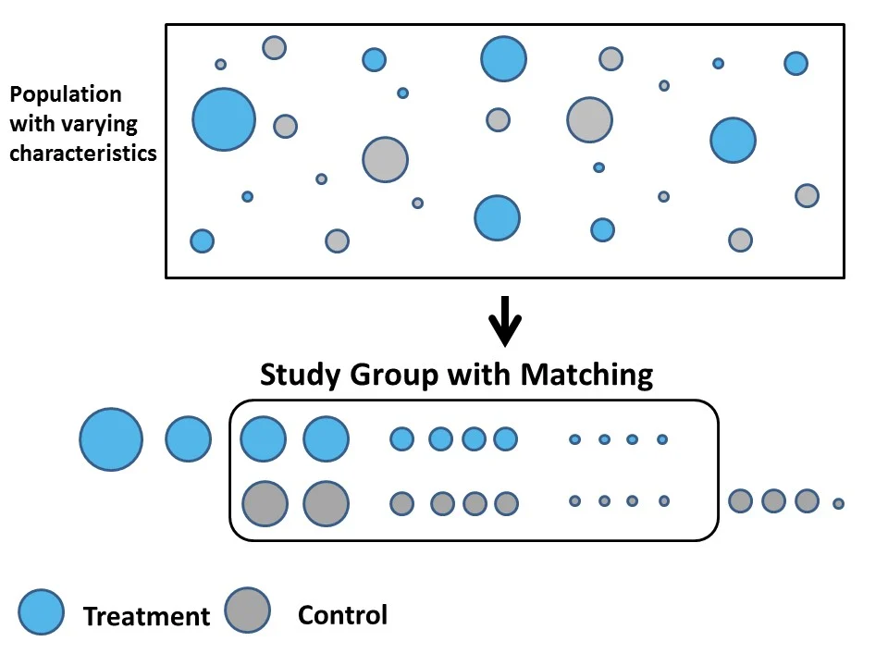
Matching methods
Binary treatment in its base version
Group control and treatment observations with similar covariates
→ Implies defining a distance measure
Create balanced groups
Clearer inference not confounded with the treatment assignation effect
Rely on the assumption that there is no unobserved confounder
(Treatment ignorability assumption = causal sufficiency)
Image source: https://www.summitllc.us/blog/what-is-a-quasi-experimental-design

Slide 15


Matching methods: Propensity scores
The propensity score for a sample i is defined as:
the probability of receiving the treatment given the observed covariates
→ Such probability can be used to group variables → Allows to reduce the possible high dimensionality problem with many covariates
Theory and method explanations
Ecological application example
https://doi.org/10.1111/2041-210X.13111
https://doi.org/10.1111/1365-2664.12586

Slide 16

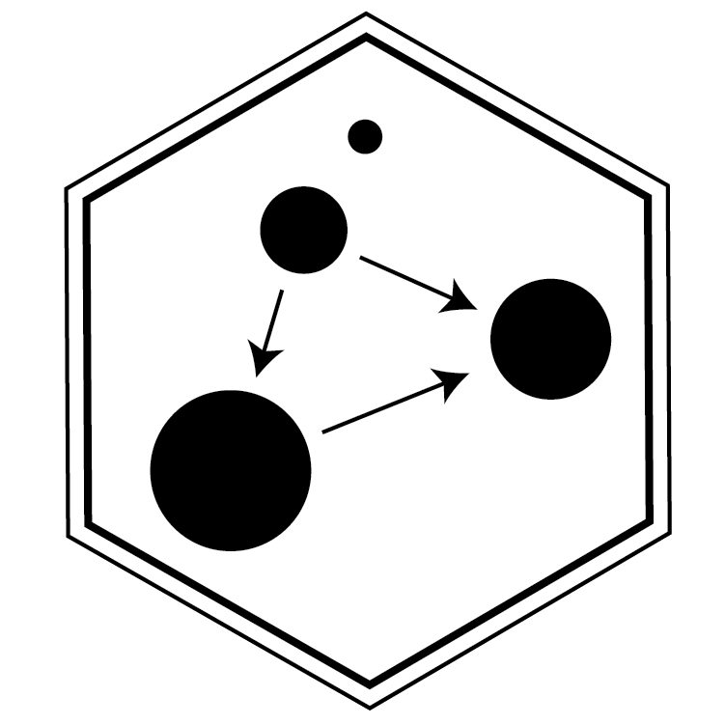
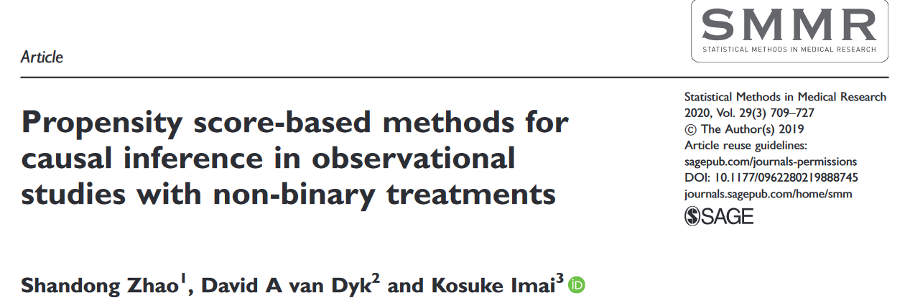
Matching methods: PS extensions
https://doi.org/10.1080/01621459.2022.2144737
CausalGPS
→ Matching methods allow space-for-time analyses
https://doi.org/10.1177/0962280219888745

Slide 17
Regression discontinuity design
Exploits the arbitrary nature of an intervention:
In the neighbourhood of an (arbitrary) intervention, unobserved variables are equals between treated and control observations
Example Thinning effect ?→ bird abundances
  Forest stands eligible for thinning if:
i) within 15 km of a developed area ii) Size >= 3 ha
→ Compare:
Stands above 3 ha in size that are:
  just <15 km from a developed area (treatment) with
  just more than 15 km from a developed area (control)
For all parcels that are <15 km from a developed area:
  stands that are just above 3 ha in size (treatment) with
  those that are just below 3 ha (control)
Notes:
→ Rely on the assumption that only the probability of receiving the treatment jumps discontinuously as the forcing variable crosses the threshold.
All other factors that determine the outcome must be continuous around the threshold.

Slide 18
Difference-in-differences (DiD) models
A before/after control intervention method (BACI) with time-series data in treatment and control groups
Parallel-trends assumption:
If not for the treatment, control and treatment groups would have parallel time trends
→ Controls for time invariant unobservables
Treatment effect: Difference between the before/after-treatment differences for the treated and non-treated observations
DiD can be extended to include covariates, different timing of treatment (staggered DiD) and an additional control group (triple difference)

Slide 19
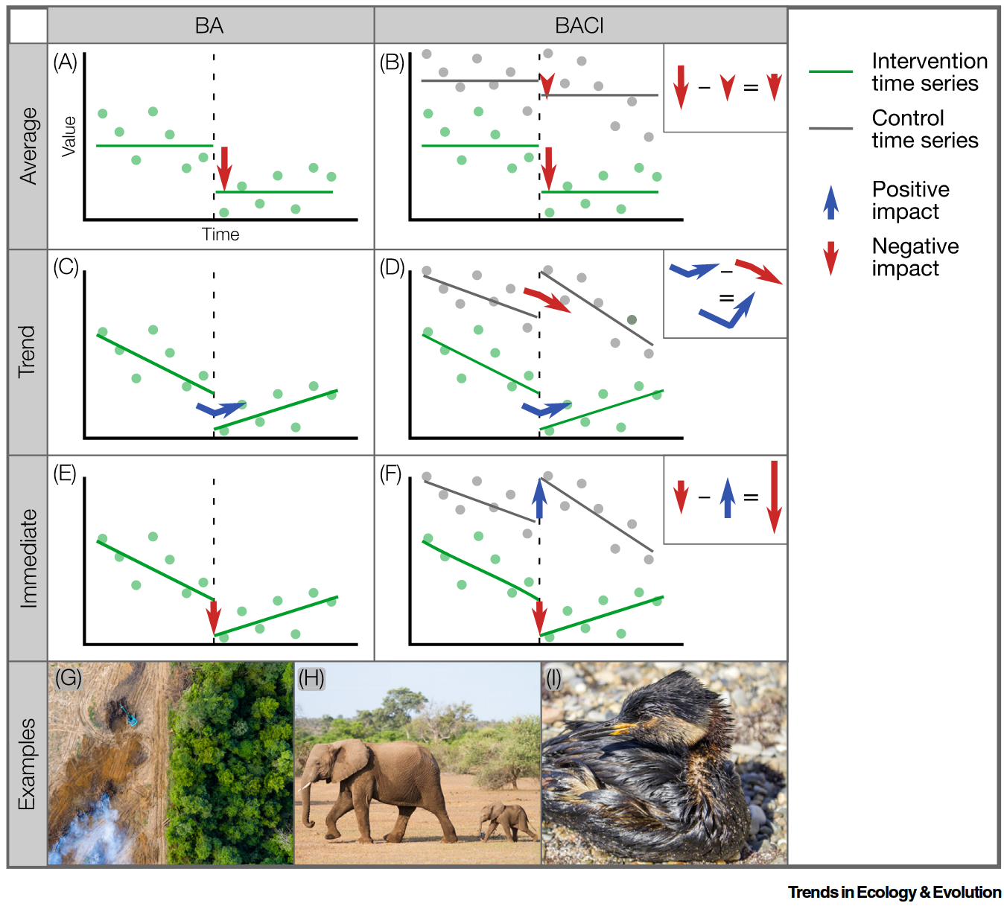
BACI illustration
with different detection methods
Figure 1. Average, Trend, and Immediate Change When Assessing the Impact of an Intervention (broken vertical line) Using BA (Before After) or BACI (Before After Control Intervention) data.
Wauchope et al. 2021
https://doi.org/10.1016/j.tree.2020.11.001
Suits quite abrupt changes with already well defined treatment / control groups
carbon payments on tropical deforestation
hunting ban
oil spills on waterbird populations

Slide 20
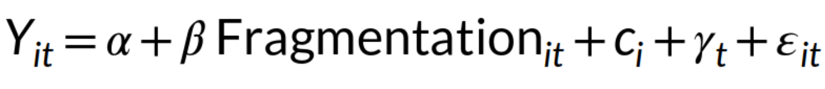
Fixed effects panel regression
Walkthrough example: Forest fragmentation → Songbird abundance (Y) with repeated observations of the same sites over years
Y_{it} bird abundance in site i and time t
𝜶 the intercept
β the causal coefficient of interest
ɛ_{it} the random error term
(Covariates are ignored for convenience)
c_{i} unobserved site-specific and time-invariant latent variable (e.g. soil)
𝞬_{t} unobserved site-invariant and year-specific latent variable (e.g. large climate trend, captor technology)
→ Connection with the JPCMCI+ method (see later)

Slide 21
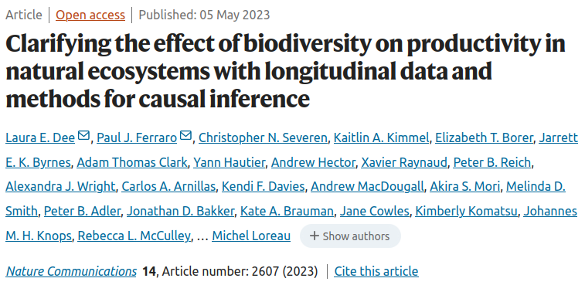
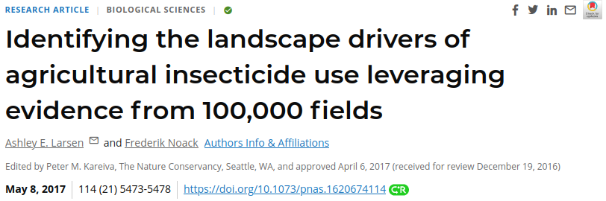
Fixed effects panel regression
https://doi.org/10.1073/pnas.1620674114
https://doi.org/10.1038/s41467-023-37194-5
Plant species diversity ?→ Productivity
Crop homogenisation ?→ Insecticide use

Slide 22
Instrumental variables (IV)
C
Z
unobserved
X
?
Y
Identify and measure a instrumental variable Z that:
a) accounts for some variation in the treatment X, but
b) does not affect Y or other Y determinants
→ The instrument can then be used to eliminate the correlation between the treatment and unobservables that are affecting the outcome, in a two-step process:
Predict the level of the treatment x̂, using the instrumental variable Z, and all other exogenous variables as predictors
The predicted treatment x̂, rather than the actual treatment, is then used to estimate the treatment effect.
Notes:
Identify a variable, Z accounting for some of the variation in X (treatment variable) that is uncorrelated with other variables.
In particular, the predicted value of X given Z, denoted as X^, is uncorrelated with ε
Thus, a consistent estimate of the effect of X on Y is obtained by regressing Y on ̂ X.

Slide 23
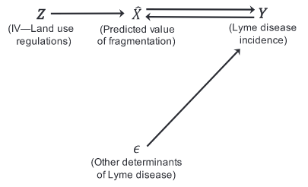


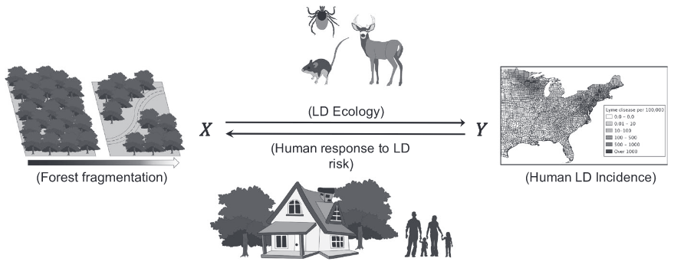
Instrumental variables (IV)
X
https://doi.org/10.1111/1365-2664.13289
min. lot size restrictions
IV: Land use regulations
Notes:
Land-use regulations, such as minimum lot size restrictions, affect residential development patterns and, thus, are correlated with forest fragmentation.
However, it is safe to assume these regulations are not adopted to address Lyme disease and, therefore, are unlikely to be correlated with the other determinants of LDI.

Slide 24
When to use which quasi-experimental method?
→ Heavily influenced by the data at hands
NO
Matching methods
https://doi.org/10.1016/j.baae.2017.01.005
Unobserved confounders?
YES
Regression discontinuity design
- Requires a high density of observations around the threshold
- Additional data needed
+ Suits situations when treatment ?= cause / consequence
Breakpoint in the data?
NO
Instrumental variable
YES
Temporal variation in treatment?
YES
Fixed effects panel regression
NO
Site- & year- specific confounders?
YES
Difference-in-differences methods
NO
Notes:
Land-use regulations, such as minimum lot size restrictions, affect residential development patterns and, thus, are correlated with forest fragmentation.
However, it is safe to assume these regulations are not adopted to address Lyme disease and, therefore, are unlikely to be correlated with the other determinants of LDI.

Slide 25
Causal discovery
Assumptions & methods

Slide 26
Causal inference
Causal discovery
Causal effect estimation
Learning qualitative causal relationships
Quantifying causal effects given causal relationships

Slide 27
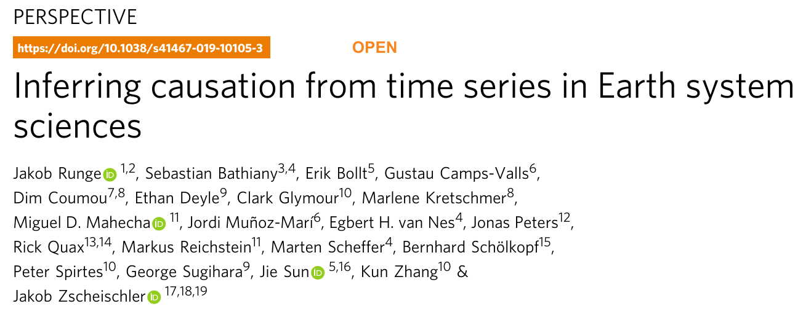
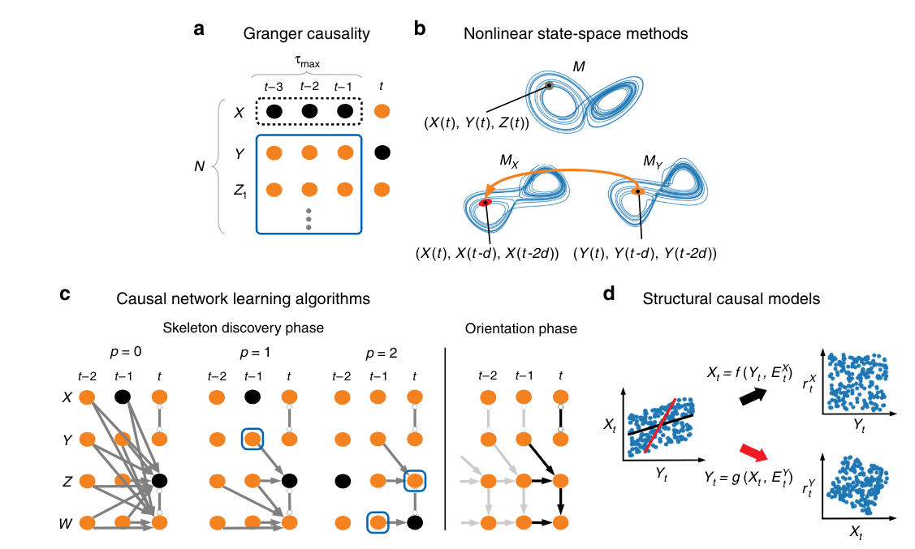
Runge et al. 2019 https://doi.org/10.1038/s41467-019-10105-3

Slide 28
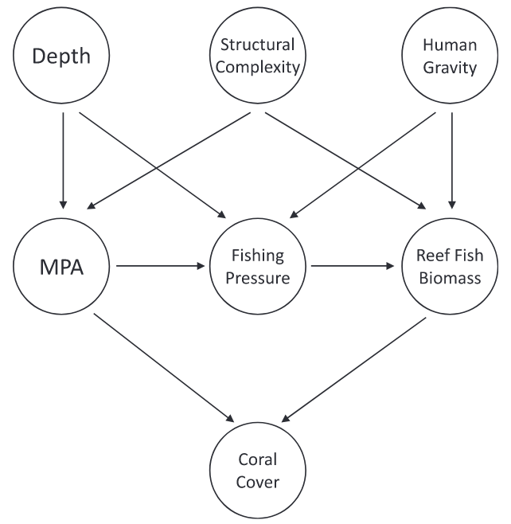
Directed Acyclic Graph (DAG)
Acyclic: No bidirectional relationship or feedback loop
Non parametric: No assumption about nature of variables, their observation, functional forms
→ Compatible with a wide range of ecological systems
Marine Protected Area
Arif et al. 2022 https://doi.org/10.1002/ecs2.4009
→ DAGs represent a researcher’s causal knowledge & assumptions about the data-generating process of the system
Includes all relevant measured & unmeasured variables
Based on domain knowledge, theory & research (past literature, experimental data etc)...
…. or causal discovery when relationships are (partially) unknown

Slide 29
Assumptions for causal discovery
All conclusions from causal discovery rest on key assumptions about the data and need to be critically assessed.
Some models introduce additional assumptions but the most important ones are:
Causal Markov assumption
Faithfulness
Causal sufficiency
These assumptions allow us to identify causal relationships and to turn theoretical causal quantities into statistical quantities.

Slide 30
Summary of assumptions
All conditional independencies in the DAG are reflected in the data
Causal graph
(1) Causal Markov Condition
Dataset
(Joint probability distribution)
(2)
Faithfulness
No additional conditional independencies in the data that are not encoded in the graph

Slide 31
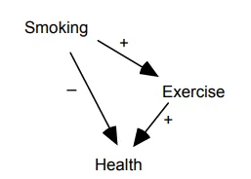
Faithfulness violation example
In the dataset,
the positive effect of exercise coincidentally cancels out the negative effect of smoking on health
DAG
Smoking is independent of Health in the data
The data distribution is unfaithful to the causal graph
Image source: https://medium.com/causality-in-data-science

Slide 32
Summary of assumptions
(3) Causal sufficiency
No unobserved confounders
All conditional independencies in the CG are reflected in the data
Causal graph
(1) Causal Markov Condition
Dataset
(Joint probability distribution)
These assumptions enable us to learn causal structures from data, e.g. using conditional independence tests for constraint-based methods
(2)
Faithfulness
No additional conditional independencies in the data that are not encoded in the graph

Slide 33
PCMCI algorithm
(Peter Clark Momentary Conditional Independence)
→Assumes causal sufficiency in its base version

Slide 34
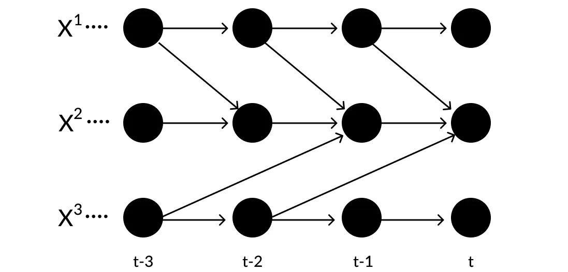

PCMCI algorithm
Assumed to be repetitive for all time points t
Additional assumption: Causal stationarity
f_{j} and the parents do not depend on t
→ The conditional independence tests can be repeated at every time step
→ Temporal precedence helps orienting relationships

Slide 35
PCMCI algorithm: 2 steps
Condition-selection (PC₁):
→ Learns a conditioning set containing the parents of each variable, considering points up to a max. time lag 𝜏_{max}.
Momentary Conditional Independence (MCI) tests
→ Removes links within the [t, t-𝜏_{max}] window based on conditional independence tests on the two nodes’ parents

Slide 36
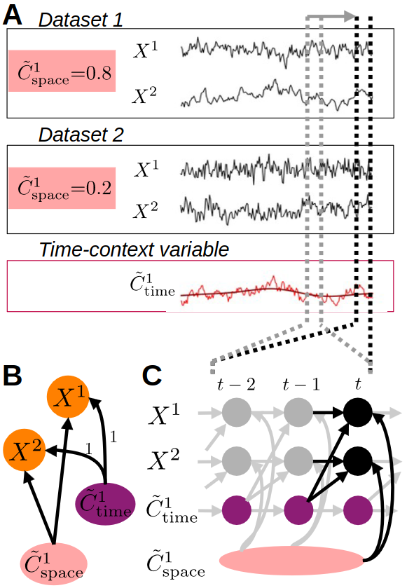
JPCMCI+: Causal discovery for time-series from multiple contexts
PCMCI has many variants relaxing assumptions, including JPCMCI+ to jointly learn causal graphs from different sites
→ Similar setting to fixed-effects panel regression settings with site-specific and year-specific unobserved latent variables, but for causal discovery
→ Examples & tutorials available on https://github.com/jakobrunge/tigramite

Slide 37
Include expert knowledge
Why ?
Significantly simplify the search problem (less conditional independence tests)
Benefit from common sense & expert knowledge
Types of expert knowledge
Independence
(absence of direct effect)
Force
orientation
(if dependent)
Force
orientation on known dependence
Force
dependence
but unknown orientation
A_{bear} x A_{camel}
P -?> A_{bird}
T° --> A_{bird}
A_{prey} o-o A_{pred}

Slide 38
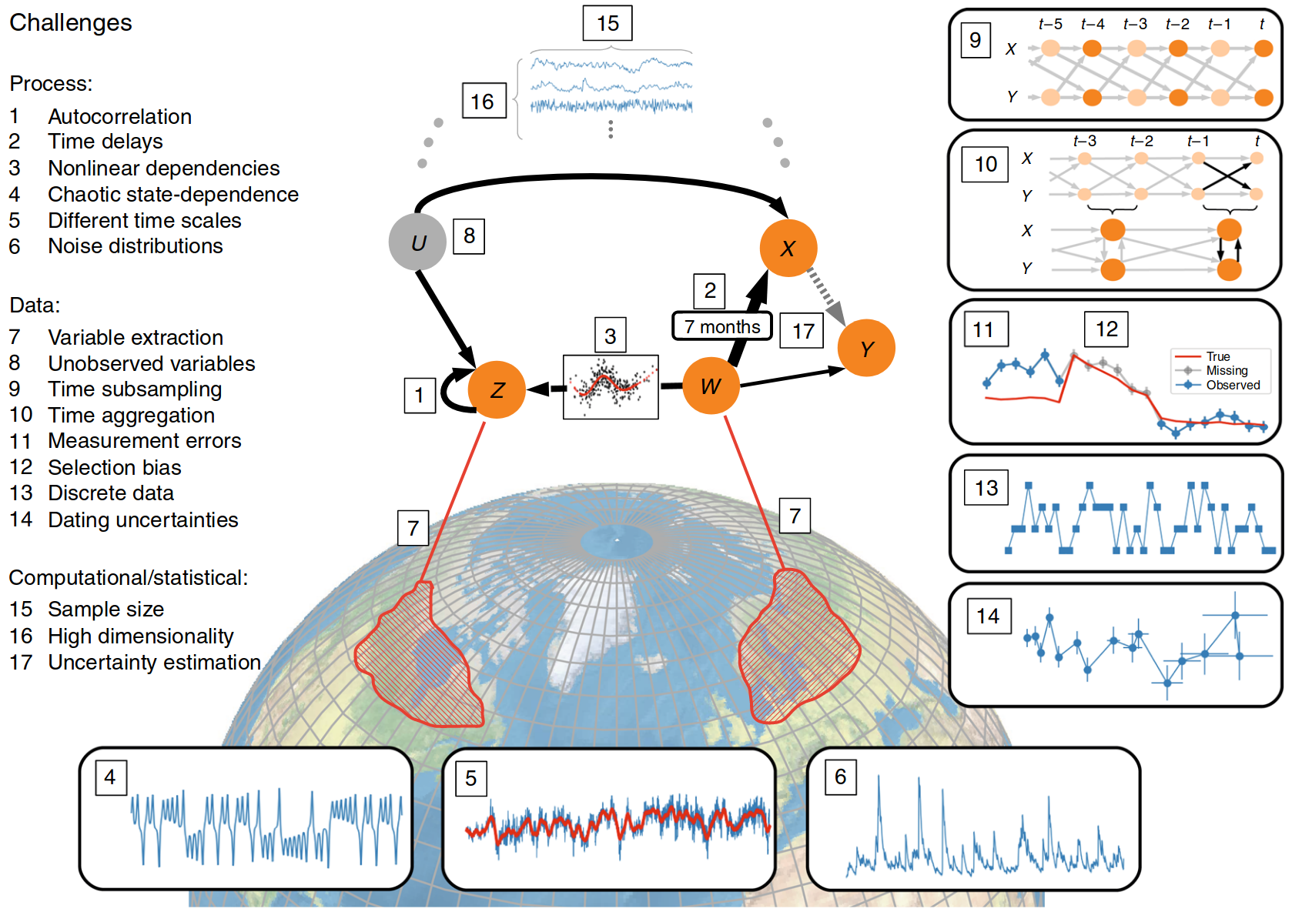
Causal discovery conclusion
Many different families of methods: constraint-based methods, score-based, continuous optimization-based (benefiting from ML), asymmetry-based.
Many challenges:
Methodological challenges for causal discovery in complex spatio-temporal systems such as the Earth system (Runge et al. 2019)

Slide 39
Covariate adjustment
Structural Causal Models

Slide 40
Effect estimation overview
Causal effects can be estimated:
  Quasi-experimental methods: Matching methods, Instrument variables, panel regression etc
  Covariate adjustment methods: backdoor & frontdoor criteria, mediation analysis, do-calculus
  ML: Meta-learners, e.g. Double Machine Learning

Slide 41
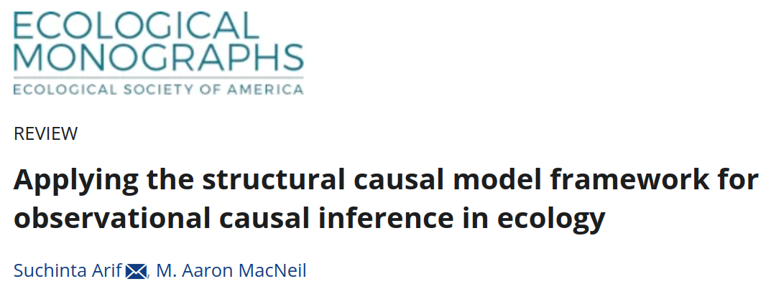
SCM & Covariate adjustment | A review
https://doi.org/10.1002/ecm.1554
→ Overview of the structural causal modeling (SCM) as a framework to detect cause-effect relationships in observational data.

Slide 42
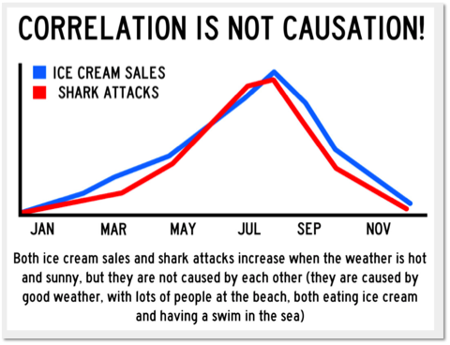
Biases to avoid
In a chain
In a fork
With a collider
T
Alarm
T
#P. sea
#
shark attack
Ice cream
sales
?
#
shark attack
earthquake
?
robbery
Overcontrol
→Do not condition on intermed. nodes
Confounder
→Condition on confounders
Selection
→Do not condition on a collider
→ Draw a Directed Acyclic Graph (DAG) & apply specific rules on information flow:
Backdoor or Frontdoor criterion

Slide 43
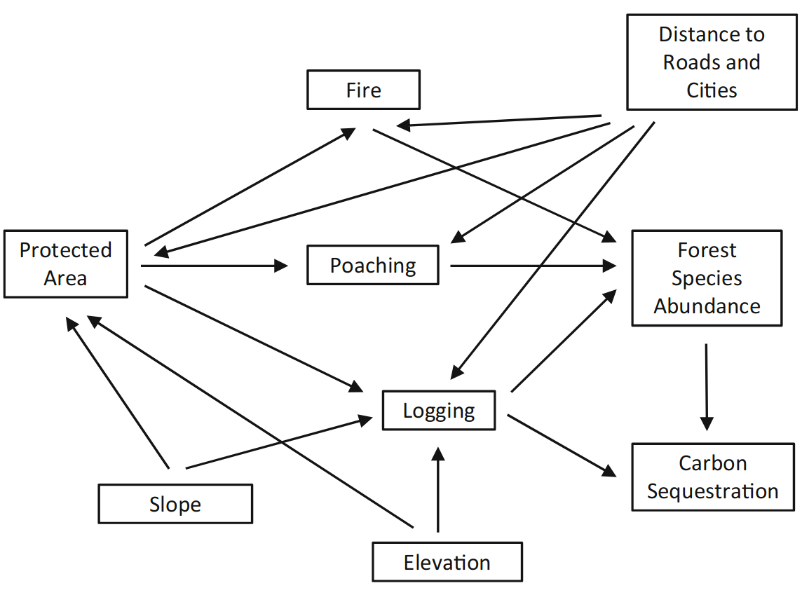
DAG example
Adams et al. 2015 https://doi.org/10.1098/rstb.2014.0274

Slide 44
Backdoor criterion
→ A backdoor path between X and Y is blocked by a conditioning set Z if either:
Along the path, there is a chain → W → or a fork ← W → where W is conditioned on (W ∈ Z)
There is a collider →W ← on the path that is not conditioned on
(W ∉ Z), and neither of its descendants are.
Observational Study
Backdoor path between X and Y: Path with an arrow pointing into X
Covariates
Backdoor criterion
→ Identify a set of variables Z, that, when adjusted for,
blocks all backdoor paths between X and Y.
It allows the interventional query
P(Y|do(X=x))
to be accurately estimated from observational data.
C
do(X=x) ✖
X
Y
Treatment
Outcome

Slide 45
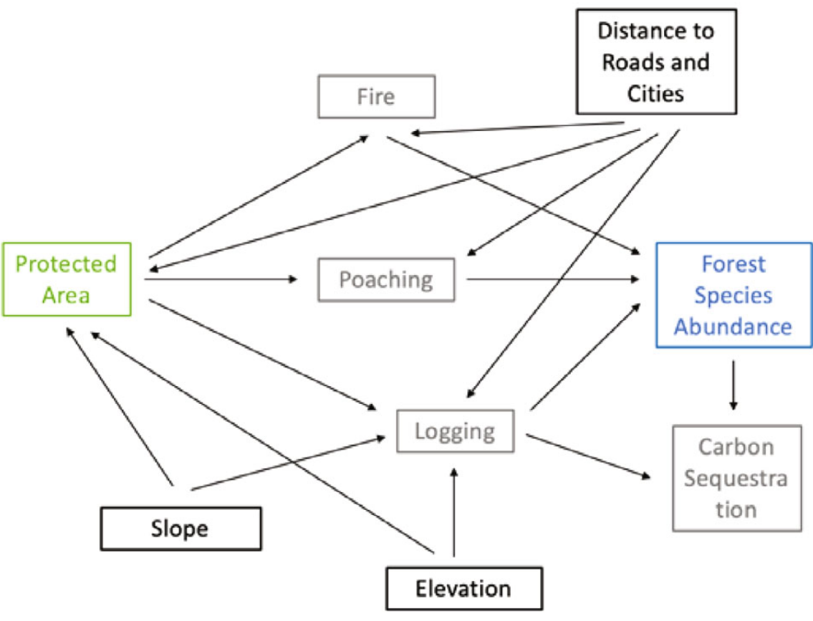
Example
9 backdoor paths need to be blocked, including:
Forest Species Abundance → Carbon Sequestration ← Logging ← Elevation → Protected Area
Forest Species Abundance ← Logging ← Elevation → Protected Area
http://dagitty.net/m18S_bV identifies variables to control for

Slide 46
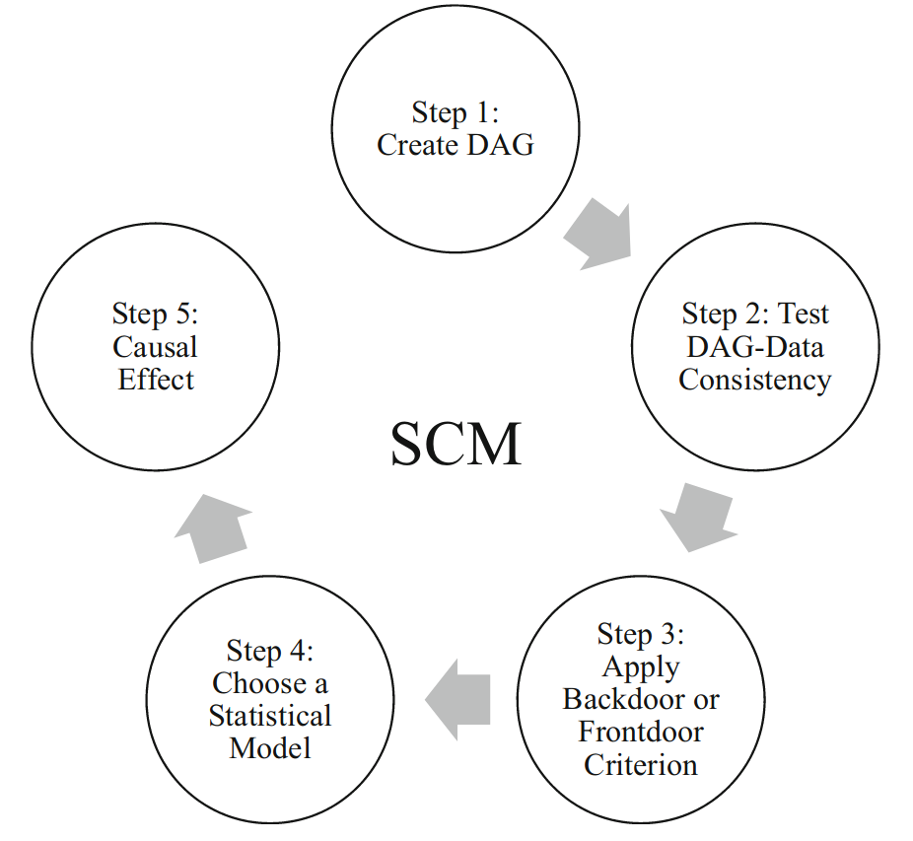
Example
The dataset was simulated with a linear structure
→ a linear regression model is chosen to estimate the effect (step 4)
Species Abundance_{i} = α + β₁Protected Area_{i} + β₂Slope_{i} + β₃Elevation_{i} + β₄Distance to Roads and Cities_{i} + ε_{i}

Slide 47
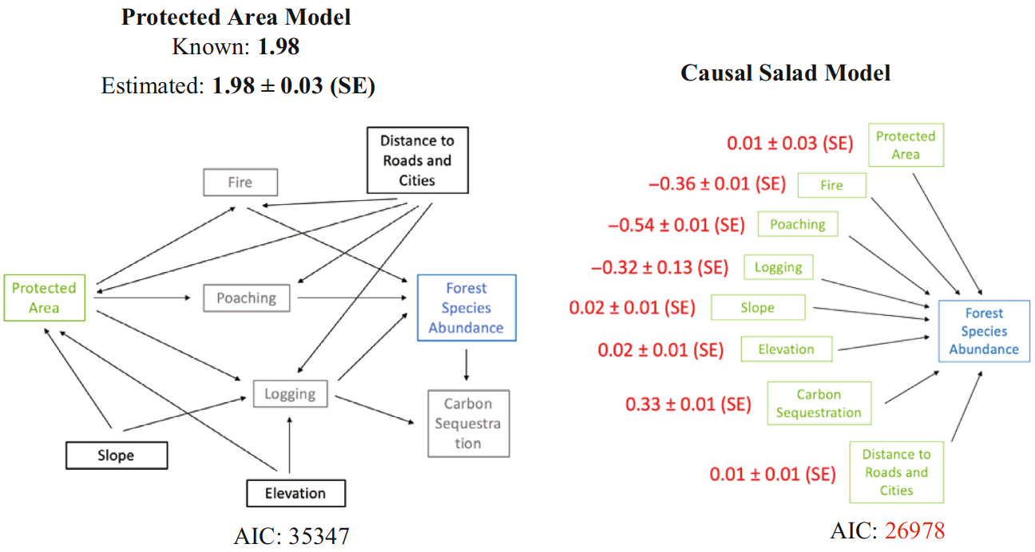
Example
Strengths
→Causal effect estimation is possible without requiring the availability of all variables in the DAG
→ Not computationally taxing, compatible across linear and nonparametric statistical approaches
→ A widely applicable method for covariate selection across observational studies

Slide 48
Causal Machine Learning

Slide 49
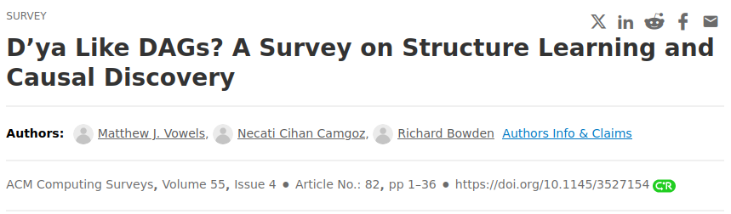
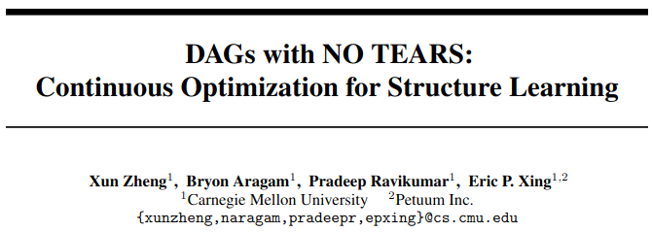
Causal discovery: Optimization-based methods
Causal discovery
Combinatoric graph-search problem recast into a continuous optimization problem
Combinatoric algorithms
Continuous optimization algorithms
NO TEARS, DAG-GNN, DYNOTEARS
Constraint
-based
Score
-based
Asymmetry-based
https://doi.org/10.1145/3527154
Motivation:
Do not impose restrictions on the functional forms a priori
Increased computational power (particularly with GPUs) makes the task of learning from large, high-dimensional datasets feasible.
↗↗ Number of recent methods, very active field
PC, PCMCI, FCI
GES
LiNGAM
Number of possible DAGs: ↗ super-expo. with the number of variables
Zheng et al. 2018

Slide 50

Double Machine Learning
Given causal sufficiency
(no unobserved confounders)
Frisch-Waugh-Lovell theorem
Given the linear model Y=β₀+β₁T+β₂X+U, the two following approaches for estimating β₁ yield the same result:
Linear regression of Y on T and X, using OLS
Three-step procedure:
    Regress T on X
    Regress Y on X
    Regress the X_{residuals} on the T_{residuals} getting β₁
https://doi.org/10.1111/ectj.12097
Motivation:
ML models can capture covariate interactions and non linearities when estimating the Y and T residuals while still maintaining a FWL style orthogonalisation
Compatible with both continuous and discrete treatments contrary to other meta-learners
    Regress T on X → Estimate T from X with a ML model
    Regress Y on X → Estimate Y from X with a ML model

Slide 51



Double ML | Resources & example
Excellent tutorial: https://matheusfacure.github.io/python-causality-handbook/22-Debiased-Orthogonal-Machine-Learning.html#
Implementations
https://doi.org/10.1111/2041-210X.14186

Slide 52

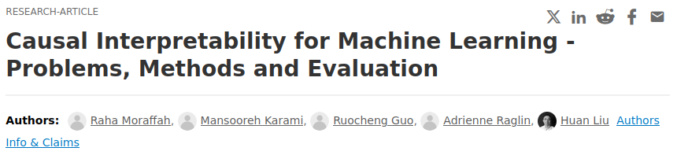


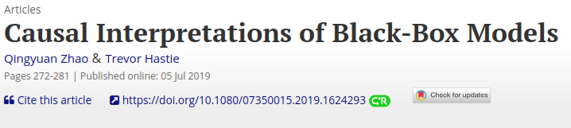
Causal Interpretability
https://doi.org/10.1145/3400051.3400058
Traditional interpretable model:
Can explain how and why a decision is made for a given instance
Causal interpretable model:
Can explain their decisions based on the outcomes of alternative scenarios:
“what would have happened with input X’ instead of X?”
= Counterfactual reasoning

Slide 53
Conclusion

Slide 54
Take-home messages
Causal inference allows to estimate correct causal effects from observational data when RCTs and model simulations are not feasible.
Quasi-experimental methods aim at overcoming the non-random treatment assignment bias when estimating causal effects.
Causal discovery helps to learn causal relationships from assumptions and data when expert knowledge is (partially) lacking.
Covariate adjustment is a simple but powerful tool to estimate causal effects from DAGs.
Machine learning is driving the field, especially with continuous optimization algorithms in causal discovery and meta-learners such as double machine learning.

Slide 55
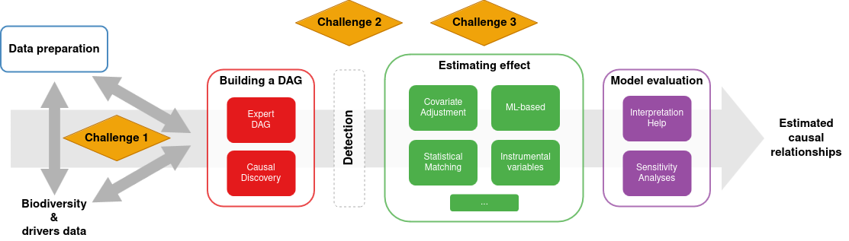
Looping with Obsgession’s Task 3.1
→ Ongoing perspective paper within the IMPACTS working group:
A practical guide for biodiversity change detection and attribution (Shrodt et al., in prep)
Flowchart situating the steps and challenges toward estimating causal effects
↪ Task 3.1 on building a detection-attribution-modelling framework

Slide 56
Looping with Obsgession’s Task 3.1
→ Ongoing research articles related to the DAM framework:
A paper focused on FRESCALO, a sampling bias correction method to enable valid detection: Winners and loser plant species in the French Alps (Goury et al., to be submitted)
A perspective article on how dynamic macroecological patterns can help explaining biodiversity changes: Dynamic macroecological patterns elucidate biodiversity changes (Gaüzère et al., in prep.)
Considering a comparative paper on the sensitivity of different causal attribution methods for ecology with Miriam Beck (IMPACTS postdoctoral researcher)

Slide 57



Thank you
joaquim.estopinan@grenoble-univ-alpes.fr
obsgession.eu
obsgession_
OBSGESSION_HorizonEurope
OBSGESSION receives funding from the European Union's Horizon Europe research and innovation programme under grant agreement No. 101134954. Views and opinions expressed are those of the author(s) only and do not necessarily reflect those of the European Union or the European Research Executive Agency (REA). Neither the EU nor the European Research Executive Agency (REA) can be held responsible for them.

Slide 58
How to test for conditional independence ?
→ Lots of test candidates depending on assumed forms of relationships…
Cond. I. test | Data type | Assumptions
ParCorr | continuous | linear dependencies and Gaussian noise
RobustParCorr | continuous | linear dependencies, robust for different marginal distributions
ParCorrWLS | continuous | linear dependencies, can account for heteroskedastic data
GPDC | continuous | with additive dependencies
CMIknn | continuous | with more general dependencies (permutation-based test)
Gsquared | discrete/cat.
CMIsymb | discrete/cat. | permutation-based test
RegressionCI | mixed datasets | discrete/categorical and (linear) continuous variables
Source: https://github.com/jakobrunge/tigramite/tree/master
… influencing causal discovery results

Slide 59
Literature review
Arif et al. 2022
Web of Science
“Ecology” & “Overcontrol”
=
∅
→ Present in the ecology literature
Example: (Guo et al. 2018)
But does not mean always well accounted for
Web of Science
“Ecology” & “Collider”
=
∅
Land use change
Climate
Elev. species redistribution
Overcontrol
Confounder
Collider

